Slide 1
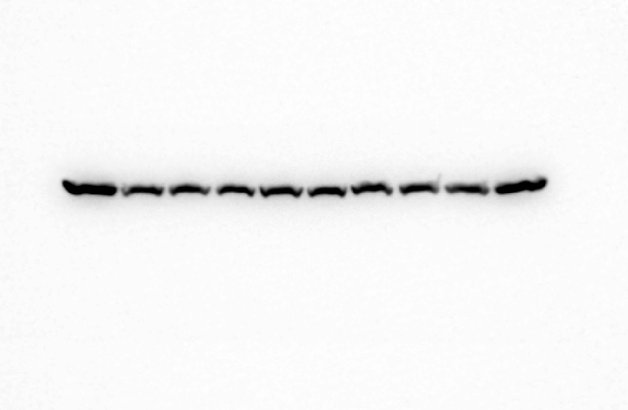
RAW264.7 cells - PR8-GFP
Scramble
sh-FAF1
0 2 4 8 16
0 2 4 8 16 (hr)
β-actin

