Slide 1
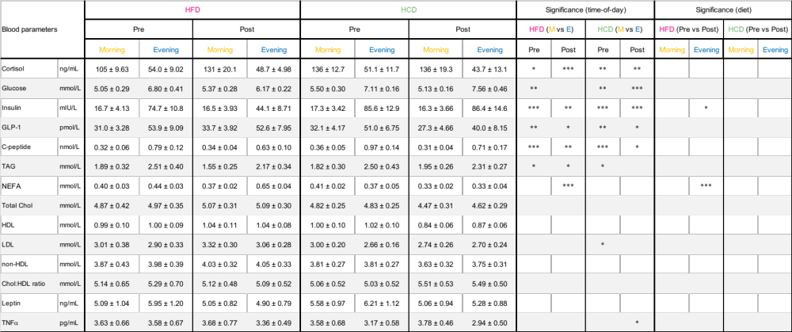
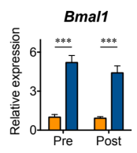
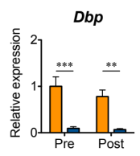
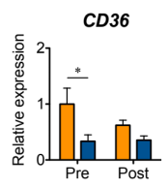
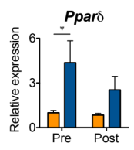
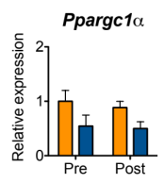
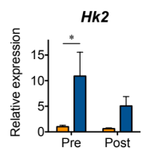
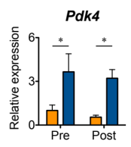
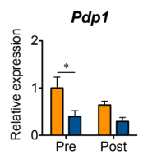

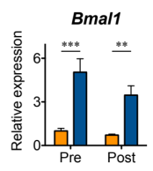
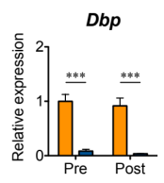
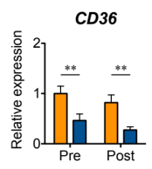
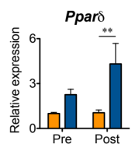
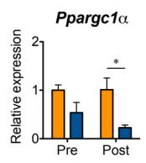
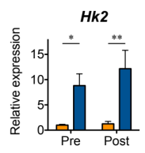
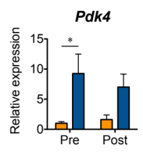
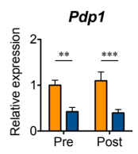
A
7 days
5 days
7 days
5 days
B
07:30
13:30
18:30
19:30
Habitual period
Day 0 (habitual)
HFD
or
HCD
Day 5 (HFD or HCD)
7 day
washout
Habitual period
Day 0 (habitual)
HFD
or
HCD
Day 5 (HFD or HCD)
Lab
free living
Lab
meal
meal
meal
C
D
E
Figure S1

Slide 2












A
Pre HFD
Post HFD
Both
Higher in the Morning
Higher in the Evening
Higher in the Morning
Higher in the Evening
Higher in the Morning
Higher in the Evening
Pregnenolone steroid (1/3)
Inositol (1/2)
Carnitine (2/2)
Ketone body (2/2)
CS (2/2)
FA, dihydroxy (2/2)
Acyl carnitine (1/31)
BCAA metabolism (1/3)
Acyl carnitine (5/31)
FA synthesis (1/1)
Acyl choline (9/10)
Acyl glutamine (1/1)
Acyl carnitine (9/31)
PL (1/8)
Long chain FA (12/16)
Pregnenolone steroid (1/3)
Mevalonate (1/1)
PC (5/20)
DAG (1/27)
Medium chain FA (3/5)
Androgenic steroid (2/18)
Primary BA (7/8)
SL (10/42)
PI (3/5)
PE (5/9)
PI (1/5)
FA, branched (2/4)
FA, branched (2/4)
LPL (4/23)
FA, monohydroxy (5/11)
FA, dicarboxylate (7/15)
Cer (3/19)
PUFA (6/15)
Secondary BA (6/15)
DAG (2/27)
BCAA metabolism (1/3)
Medium chain FA (2/5)
Secondary BA (1/15)
FA, dicarboxylate (4/15)
GL (1/3)
B
Pre HCD
Post HCD
Both
Higher in the Morning
Higher in the Evening
Higher in the Morning
Higher in the Evening
Higher in the Morning
Higher in the Evening
Pregnenolone steroid (2/3)
Inositol (1/2)
Acyl Carnitine (9/31)
Ketone body (1/2)
CS (2/2)
FA, dihydroxy (2/2)
LyPl (2/4)
PI (2/5)
LyPl (1/4)
FA, amino (1/2)
Acyl choline (9/10)
Mevalonate (1/1)
MAG (2/10)
PE (2/9)
MAG (2/10)
Primary BA (3/8)
Pregnenolone steroid (1/3)
Primary BA (5/8)
PL (1/8)
MAG (1/10)
PUFA (2/15)
FA, monohydroxy (4/11)
Acyl carnitine (6/31)
Ketone body (1/2)
FA, dicarboxylate (1/15)
LPL (1/23)
Acyl Choline (1/10)
Secondary BA (4/15)
FA, monohydroxy (1/11)
FA, dicarboxylate (6/15)
Androgenic steroid (1/18)
Acyl carnitine (1/31)
SL (2/42)
Long chain FA (2/16)
PUFA (1/15)
Medium chain FA (2/5)
LPL (1/23)
FA, dicarboxylate (1/15)
Androgenic steroid (1/18)
Secondary BA (5/15)
DAG (1/27)
PC (1/20)
BCAA metabolism (1/3)
LPL (1/23)
GL (1/3)
PL (1/8)
C
Pre HFD
Post HFD
Both
Higher in the Morning
Higher in the Evening
Higher in the Morning
Higher in the Evening
Higher in the Morning
Higher in the Evening
FA metabolism (1/1)
PS (3/3)
MAG (1/4)
Ketone body (1/1)
PL (1/9)
Primary BA (1/3)
BCAA metabolism (2/3)
PG (1/1)
PL (1/9)
BCAA metabolism (1/3)
SL (1/34)
Cer (2/13)
MAG (1/4)
PI (3/4)
DAG (1/22)
PC (1/17)
Plasmalogen (1/11)
PUFA (2/13)
LyPl (3/4)
DAG (1/22)
Cer (2/13)
Secondary BA (1/2)
Acyl carnitine (1/33)
Long chain FA (2/16)
Primary BA (1/3)
FA, dicarboxylate (1/8)
PE (3/11)
PL (1/9)
FA, dicarboxylate (1/8)
Acyl carnitine (1/33)
LPL (2/18)
D
Plasmalogen (1/11)
Pre HCD
Post HCD
Both
Higher in the Morning
Higher in the Evening
Higher in the Morning
Higher in the Evening
Higher in the Morning
Higher in the Evening
N/A
eCB (3/3)
SL (1/34)
FA, branched (2/2)
Sterol (1/1)
Primary BA (2/3)
Sterol (1/1)
Ketone body (1/1)
Long chain FA (5/16)
Cer (2/13)
Long chain FA (7/16)
Sterol (1/1)
Cer (3/13)
FA, dicarboxylate (1/8)
PL (3/9)
Mevalonate (1/1)
PL (1/9)
BCAA metabolism (1/3)
Long chain FA (12/16)
PUFA (1/13)
MAG(1/4)
Androgenic steroid (3/4)
PUFA (3/13)
PE (7/11)
Cer (3/13)
DAG (11/22)
Plasmalogen (2/11)
Secondary BA (1/2)
Acyl Carnitine (3/33)
PUFA (5/13)
100%
Enrichment
0%
Figure S2

Slide 3

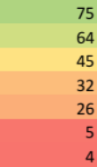









A
B
C
D
E
F
N/A
G
H
N/A
N/A
100%
Enrichment
0%
Figure S3

Slide 4
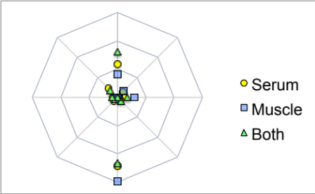
A
Gradient metabolites before HFD
Gradient metabolites after HFD
%
Amino acids
%
Amino acids
60
Xenobiotics
Peptides
60
Xenobiotics
Peptides
40
40
20
Cofactors
and Vitamins
20
Cofactors
and Vitamins
0
Carbohydrates
0
Carbohydrates
Nucleotides
Energy
Nucleotides
Energy
Lipids
Lipids
B
Gradient metabolites before HCD
Gradient metabolites after HCD
%
Amino acids
%
Amino acids
100
Xenobiotics
Peptides
60
Xenobiotics
Peptides
75
40
50
20
25
Cofactors
and Vitamins
Carbohydrates
Cofactors
and Vitamins
Carbohydrates
0
0
Nucleotides
Energy
Nucleotides
Energy
Lipids
Lipids
C
Changed metabolites by HFD in the morning
Changed metabolites by HFD in the evening
%
Amino acids
%
Amino acids
80
Xenobiotics
Peptides
80
Xenobiotics
Peptides
60
60
40
40
20
Cofactors
and Vitamins
Carbohydrates
20
Cofactors
and Vitamins
Carbohydrates
0
0
Nucleotides
Energy
Nucleotides
Energy
Lipids
Lipids
D
Changed metabolites by HCD in the morning
Changed metabolites by HCD in the evening
%
Amino acids
%
Amino acids
80
Xenobiotics
Peptides
80
Xenobiotics
Peptides
60
60
40
40
20
Cofactors
and Vitamins
Carbohydrates
20
Cofactors
and Vitamins
Carbohydrates
0
0
Nucleotides
Energy
Nucleotides
Energy
Lipids
Lipids
Figure S4

