Slide 1
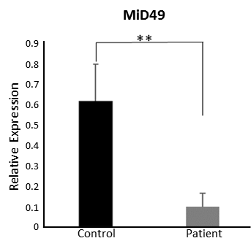
Supplementary Figure 1
A
B
C1
C2
P
MID49
Mfn2
OPA1
1.6
1.9
C1
C2
P
1.4
1.8
1.2
GAPDH
Relative protein level
Relative protein level
Mfn2
1.0
1.7
0.8
0.6
1.6
0.4
1.5
OPA1
0.2
1.4
0
Control
Patient
Control
Patient
Drp1
0.9
0.8
Drp1
MID51
MID51
0.7
1.4
0.6
1.2
0.5
1.0
0.4
0.8
GAPDH
Relative protein level
Relative protein level
0.3
0.6
0.2
0.4
0.1
0.2
0
0
Control
Patient
Control
Patient

