Slide 1
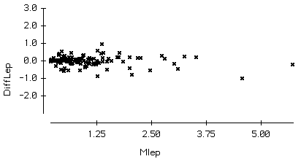
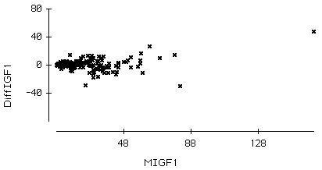
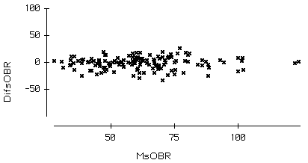
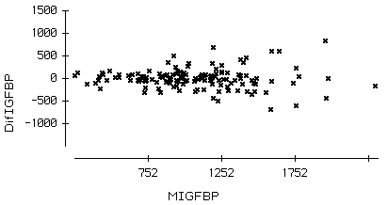
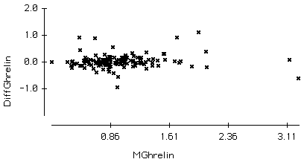
3.0
A
80
D
2.0
40
1.0
0.0
0
-1.0
-40
-2.0
1.25
2.50
3.75
5.00
48
88
128
100
B
E
50
1000
500
Pre-post difference
0
0
-50
-500
-1000
50
75
100
750
1250
1750
2250
2.0
C
Pre-post mean
1.0
0.0
-1.0
0.8
1.6
2.4
3.2
Pre-post mean

