Slide 1
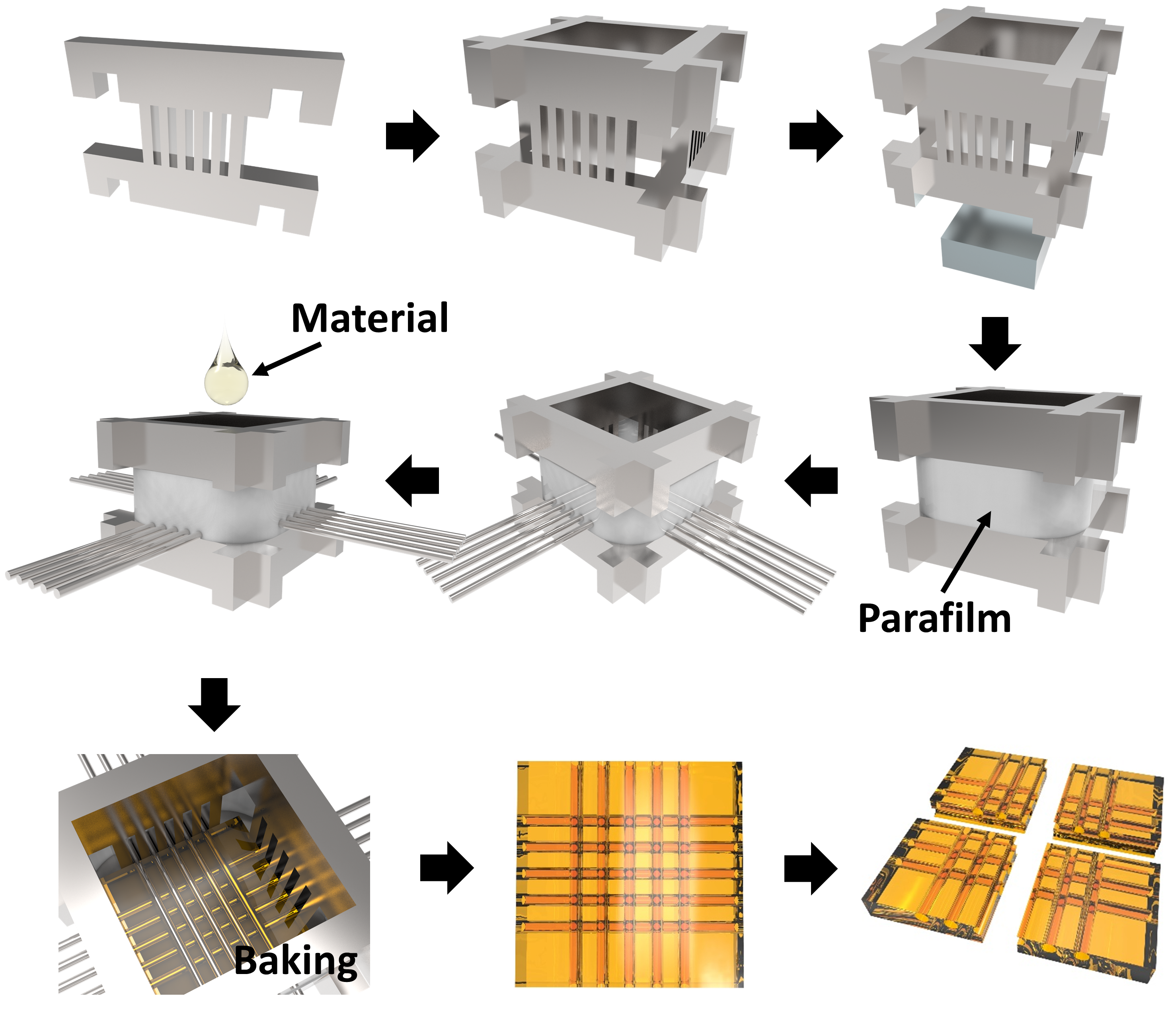
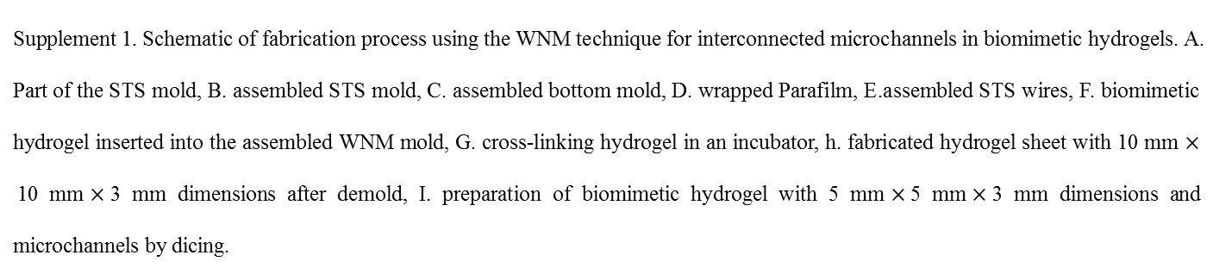
A.
B.
C.
F.
E.
D.
G.
H.
I.
Supplement 1. Schematic of fabrication process using the WNM technique for interconnected microchannels in biomimetic hydrogels. A. Part of the STS mold, B. assembled STS mold, C. assembled bottom mold, D. wrapped Parafilm, E.assembled STS wires, F. biomimetic hydrogel inserted into the assembled WNM mold, G. cross-linking hydrogel in an incubator, h. fabricated hydrogel sheet with 10 mm $×$10 mm$×$3 mm dimensions after demold, I. preparation of biomimetic hydrogel with 5 mm$×$5 mm$×$3 mm dimensions and microchannels by dicing.

