Slide 1
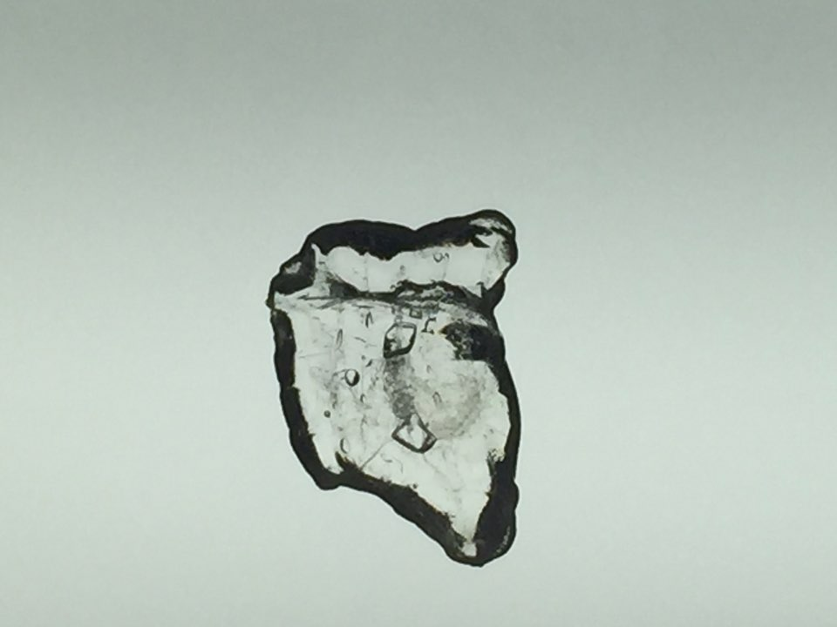
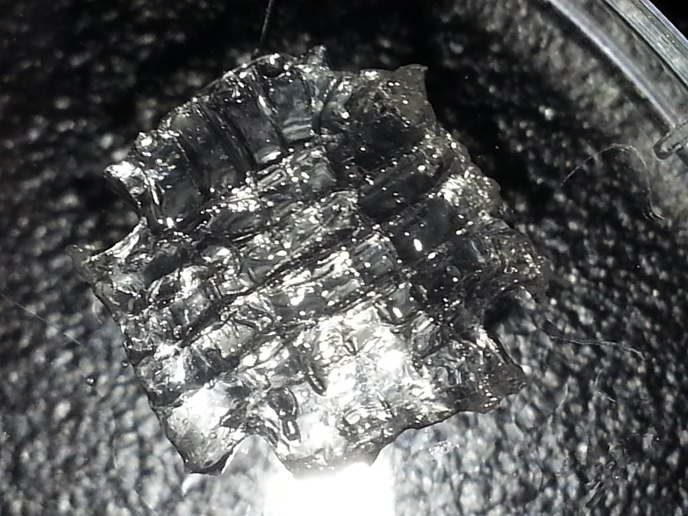
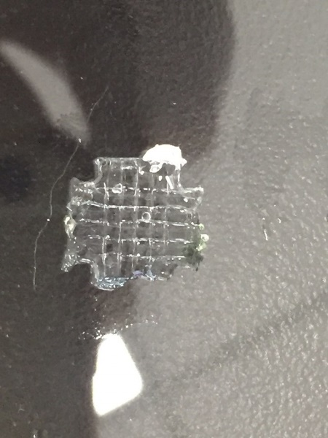
50kDa HA, 5wt%
50kDa HA, 10wt%
200kDa HA, 3wt%
Supplement 2. Optimization of biomimetic hydrogel concentration for microchannel formation.

