Slide 1
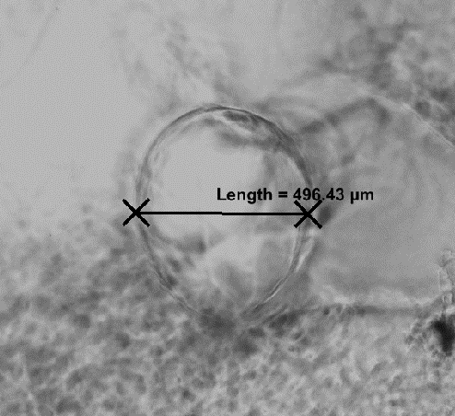
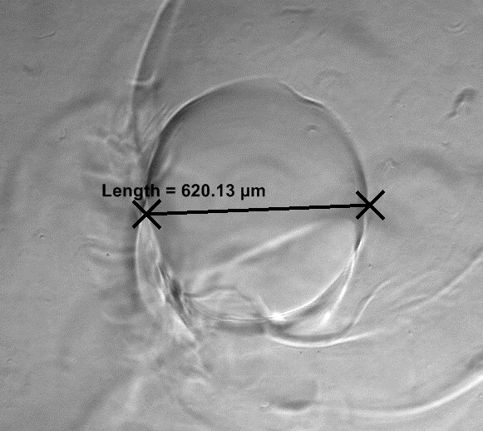
Supplement 3
A.
Before
B.
After
Supplement 3. Measurement of microchannel diameter in a fabricated biomimetic hydrogel. A. microchannel before swelling and B. microchannel after swelling.

