Slide 1
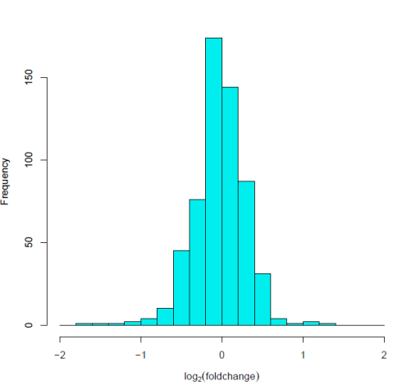
A total 627 proteins
Ratio<0.767
n = 43
Ratio > 1.3
n = 69
Ratio<0.667
n = 8
Ratio > 1.5
n = 19
Frequency
Log₂(fold-change)

