Slide 1
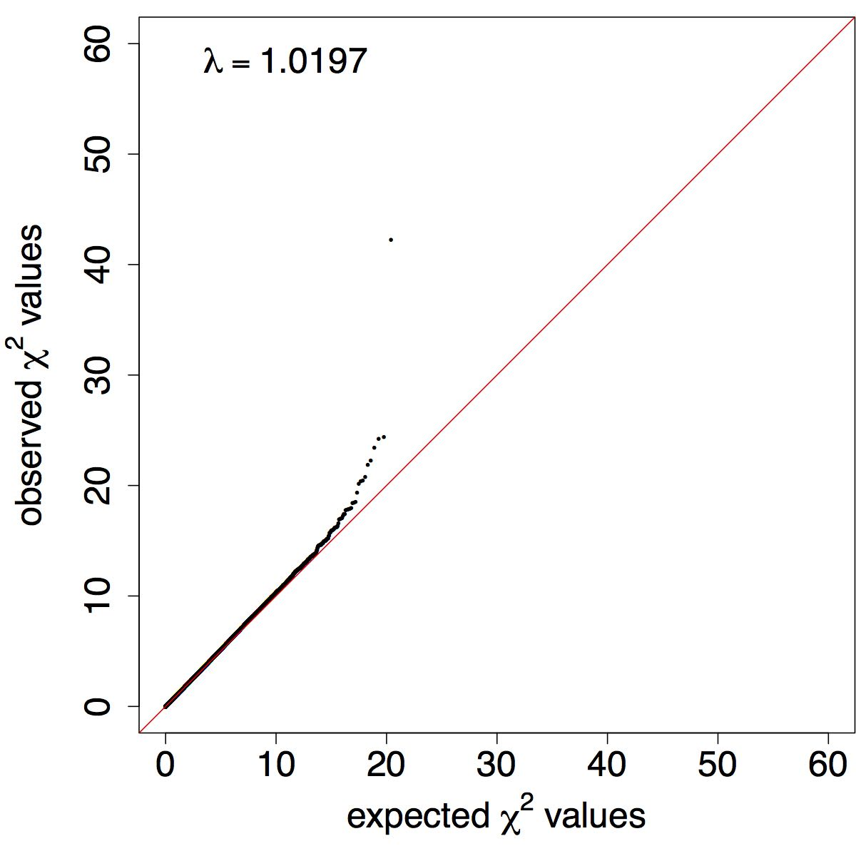
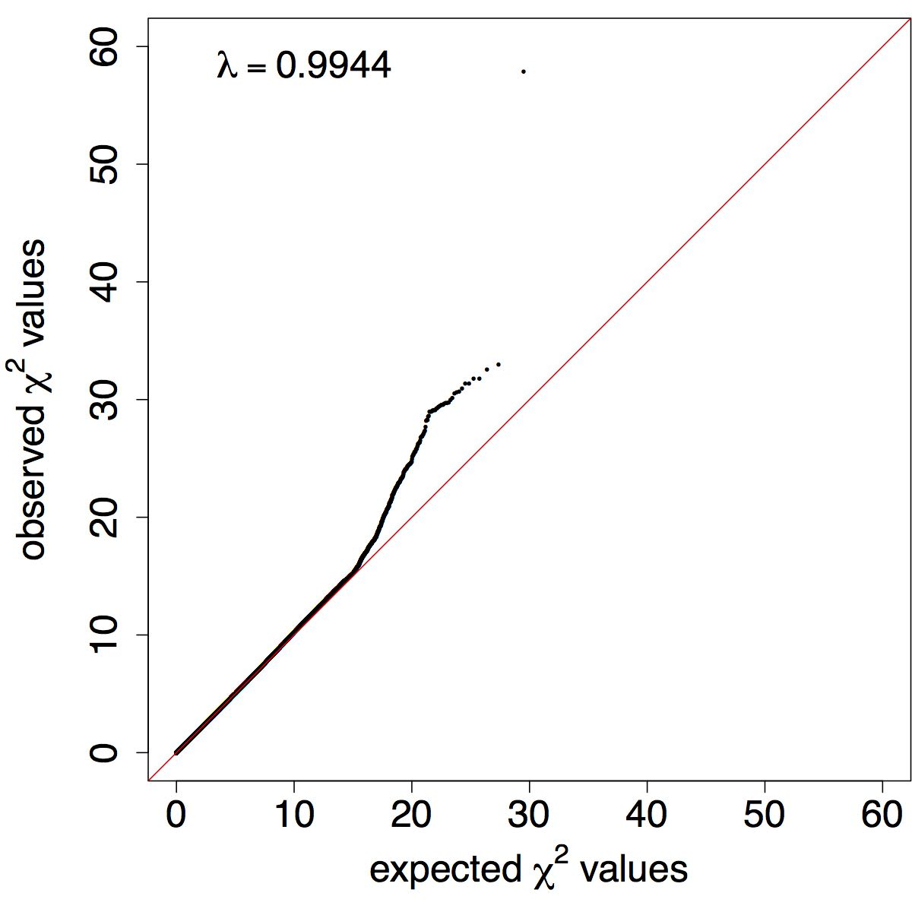
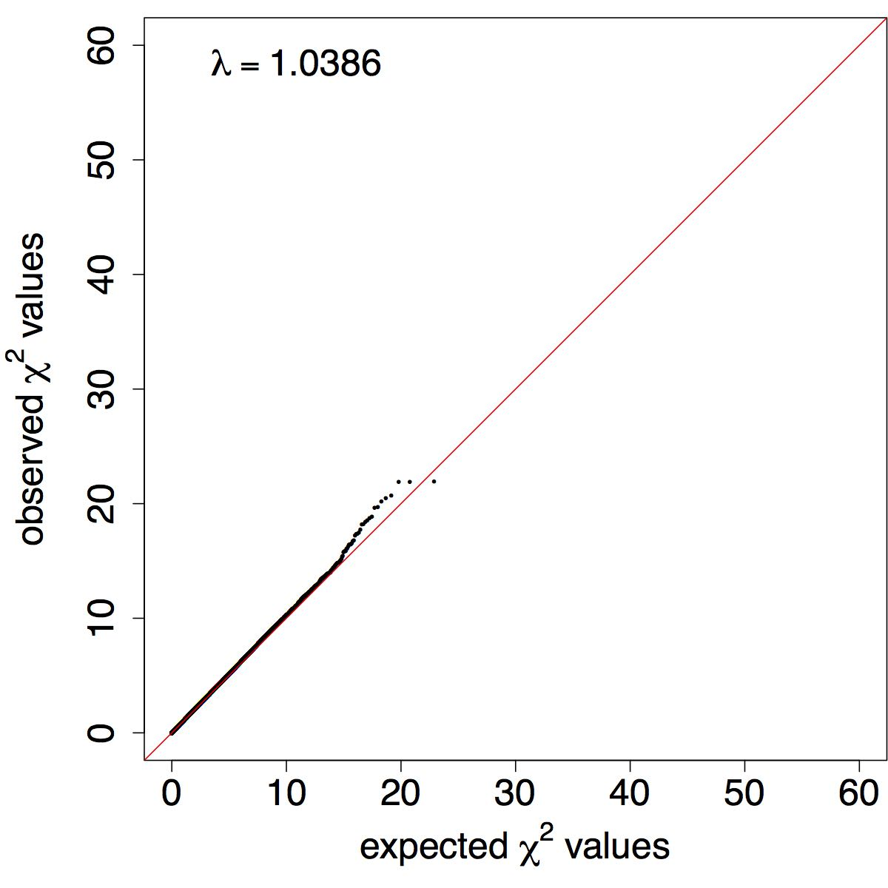
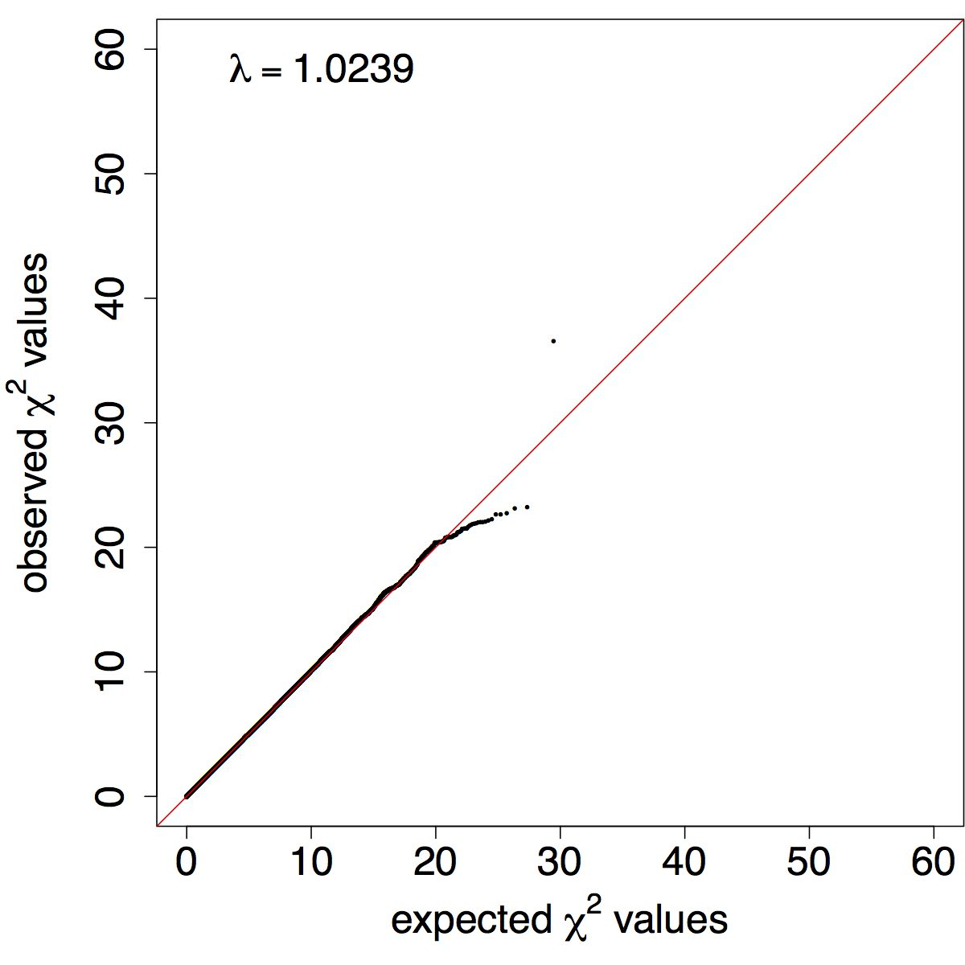
Supplementary Figure 1: Quantile-Quantile (Q-Q) plots of observed and expected χ² values of association between meningioma risk and SNP genotype. German-GWAS (adjustment carried out on first two principle components): a) genotyped and b) imputed SNPs. USA-GWAS (adjustment carried out on the first three principle components): c) genotyped and d) imputed SNPs. Red line represents the null hypothesis of no true association.
a)
b)
German-GWAS
c)
d)
USA-GWAS

Slide 2
Supplementary Figure 2: PCA plots of the GWAS data sets. Cases and controls from each series were merged with three HapMap version II populations and PCA was conducted on the merged individuals. German-GWAS showing a) cases, controls and three HapMap populations and b) cases, controls and only the CEU HapMap population. USA-GWAS showing c) cases, controls and three HapMap populations and d) cases, controls and only the CEU HapMap population.
a)
b)
German-GWAS
c)
d)
USA-GWAS

