Slide 1
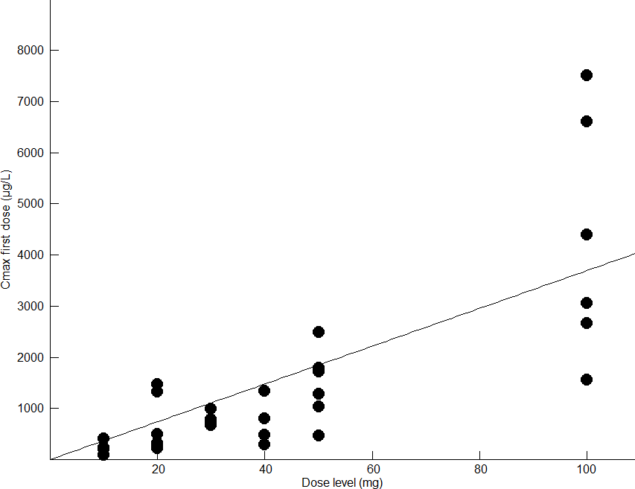
ONA C_{max} vs first dose level

