Slide 1
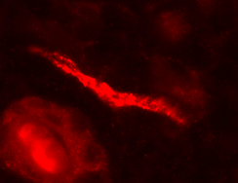

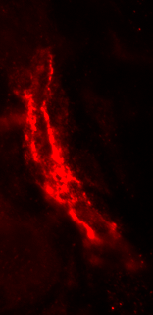
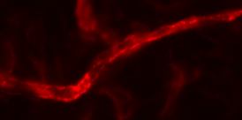
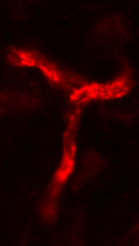
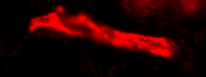
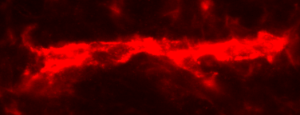

Vehicle
IBM-X
1
1
2
2
3
3
4
4
Figure S4

Slide 2
Figure S4. Capillary blood vessels in vehicle- vs. IBM-X-treated skin.
The structure of capillary vessels in the skin was examined by anti-CD31 immunofluorescence 48 hours after intradermal injection of IBM-X or vehicle. Scale bar 10 µm.

