Slide 1
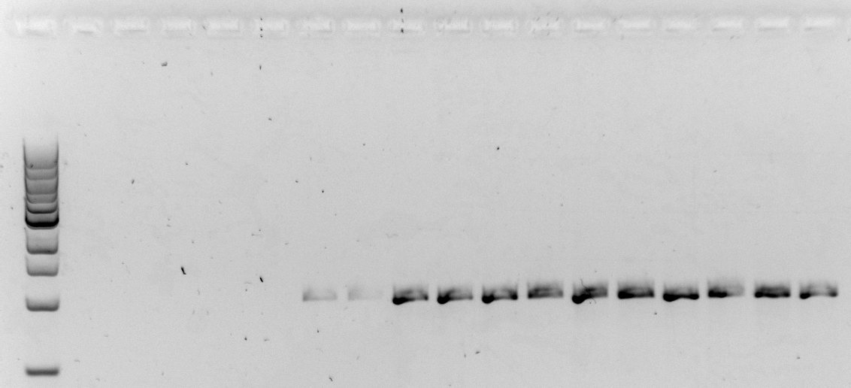
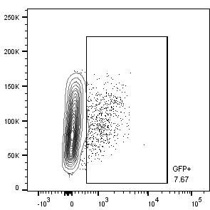



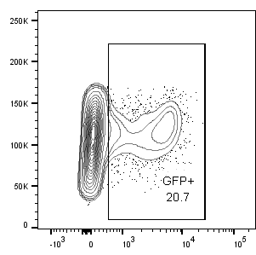
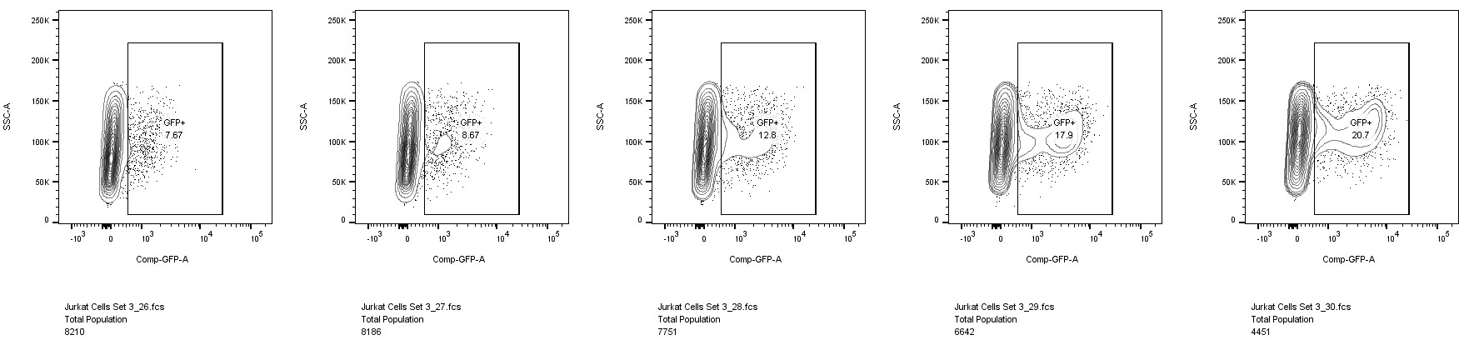
A)
TALEN 2
TALEN 3
TALEN 1
Exon 1
CD40L
B)
TALEN 1
TALEN 2
TALEN 3
Fwd
TALEN binding site
C)
Promoter
GFP-pA
Exon1
CD40LG
Gene
Promoter
Exon1
Rev
Donor
5’-HA
GFP-pA
3’-HA
D)
Donor
only
E)
F)
TALEN
only
Fwd
Neg.
[TALEN+Donor]
Promoter
GFP-pA
Exon1
Rev
TALEN (ng)
250
500
750
Expected: 979 bp
GFP Donor (ng)
2500
5000
7500
G)
No PHA
0.1 ug/mL PHA
0.3 ug/mL PHA
1 ug/mL PHA
3 ug/mL PHA
SSC
GFP
Supplemental Figure 1. TALENs allow targeted integration of a promoterless GFP cassette at the 5’UTR of the human CD40LG gene in cell lines, Related to Figure 1.
a) Binding sites for three TALEN pairs that cleave within the 5’UTR of CD40LG. b) Expression plasmids encoding TALEN pairs 1, 2 or 3 were electroporated into K562 cells using 500 ng or 750 ng of plasmid. Allelic disruption at the CD40LG 5’ UTR was quantified using surveyor nuclease assay. Data were analyzed by Kruskal-Wallis Test to assess overall significance and the Dwass-Steel-Critchlow-Fligner method for multiple pairwise tests. Data are presented as mean ± SD. *p ≤0.05. n=4-6 biological replicates.
c) Schematic of a promoterless GFP - polyadenylation signal (pA) cassette donor flanked by homology arms (HA) that parallel the TALEN cut site. d) The schema and primer locations for ‘In-Out’ PCR to detect site-specific integration of the GFP donor in the CD40LG 5’ UTR is shown at the top. K562 cells were electroporated with a dose range (250-750 ng) of TALEN plasmid and five- to ten-fold weight ratio of plasmid containing the GFP donor and assayed for site-specific integration by In-Out PCR. e) Jurkat T cells, a CD40L expressing human T cell line, were electroporated with 250, 500 or 750 ng of the TALEN expression plasmid and ten-fold weight ratio of the GFP donor plasmid. Stability of GFP expression over one month and f) response to immune stimulation with phytohemagglutinin (PHA) was determined by flow cytometry. (n=2 biological replicates) g) Representative flow cytometric plots of Jurkat T cells treated with 500 ng TALEN plasmid and 5000 ng donor GFP plasmid with increasing doses of PHA.
Notes:
TALEN 1 = 19
TALEN 2= 10
TALEN 3= 79
D. K562 cells day 7

Slide 2
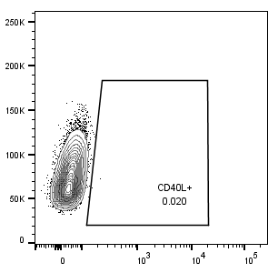
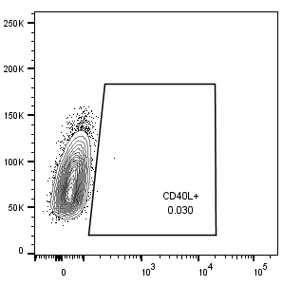
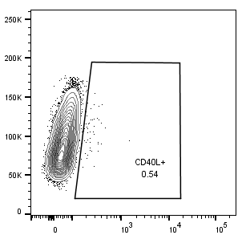
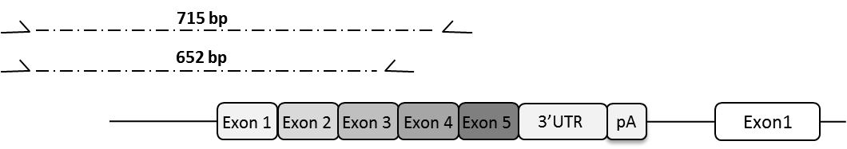
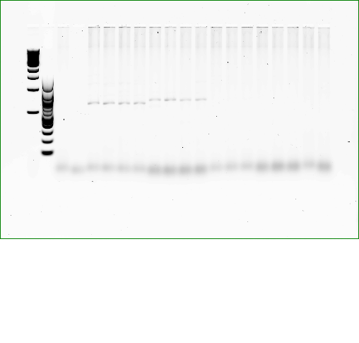
715 bp
652 bp
Exon 1
Exon 2
Exon 3
Exon 4
Exon 5
3’UTR
pA
Exon1
A)
B)
Mock
TALEN Only
TALEN + cDNA IDLV Donor
SSC
PE-CD40L
C)
D)
Neg.
TALEN + Donor
Exon 3-4
spanning
TALEN + Donor
Exon 4-5
spanning
cDNA
IDLV
only
Mock
TALEN Only
Supplemental Figure 2. Targeted integration in XHIM T cells of a CD40 ligand cDNA donor delivered by an integration-defective lentiviral vector (IDLV), Related to Figure 1.
a) Primary XHIM patient CD4+ T cells were stimulated with antibodies to CD3/CD28 and assessed for permissiveness to IDLV transduction using a GFP-expressing IDLV at a range of MOI. b) XHIM CD4+ T cells were electroporated with TALEN mRNA and transduced with an IDLV carrying a codon-optimized CD40L cDNA (MOI 100). CD40L expression was measured by flow cytometry 3-5 days later. c) In-Out PCR using primers spanning two adjacent exons within the CD40L cDNA was used to detect the presence of site-specific cDNA integrants (n=4 biological replicates). d) Site-specific integrations of the cDNA donor were quantified using ddPCR. Data are presented as mean ± SD. *p ≤0.05, **p≤0.01 (unpaired t-test). n=2-4 biological replicates.

Slide 3
A)
B)
C)
TALEN (ug)
-
1.5
-
1.5
TALEN (ug)
-
1.5
-
1.5
TALEN (ug)
-
1.5
-
1.5
1.5
1.5
1.5
1.5
AAV (MOI)
-
-
3e5
1e4
AAV (MOI)
-
-
3e5
1e4
AAV (MOI)
-
-
3e5
1e4
3e4
1e5
3e5
1e6
D)
E)
TALEN (ug)
-
1.5
-
1.5
1.5
1.5
1.5
1.5
TALEN (ug)
-
1.5
-
1.5
1.5
1.5
1.5
1.5
AAV (MOI)
-
-
3e5
1e4
3e4
1e5
3e5
1e6
AAV (MOI)
-
-
3e5
1e4
3e4
1e5
3e5
1e6
Supplemental Figure 3. Viability and fold expansion of primary XHIM CD4 T cells after electroporation with TALEN mRNA and AAV6 cDNA transduction, Related to Figure 1, 2.
a) Viability and b) Fold expansion of primary XHIM CD4 T cells treated with TALEN mRNA and AAV6 codon optimized cDNA donor. c) Quantification of gene integration by ddPCR of T cells electroporated with TALEN mRNA and treated with a range of MOI of AAV6 cDNA donor. 24 hours after treatment, d) viability and e) fold expansion were measured by trypan blue (n=8-10 biological replicates). Bar graphs are presented as means ± SD. Data were analyzed by Kruskal-Wallis test. NS = not significant.

Slide 4
A)
B)
C)
TALEN (ug)
-
-
4
4
4
4
TALEN (ug)
-
-
4
4
4
4
TALEN (ug)
-
-
4
4
4
4
AAV (MOI)
3e4
-
3e5
-
1e5
3e5
AAV (MOI)
-
3e5
-
3e4
1e5
3e5
AAV (MOI)
-
3e5
-
3e4
1e5
3e5
D)
E)
TALEN (ug)
-
4
-
4
4
TALEN (ug)
-
4
-
4
4
AAV (MOI)
-
-
1e5
1e5
1e5
AAV (MOI)
-
-
1e5
1e5
1e5
F)
G)
CRISPR gRNA (ug)
-
5
-
5
5
9
9
4.5
CRISPR gRNA (ug)
-
5
-
5
5
9
9
4.5
Cas9 mRNA (ug)
-
5
-
5
5
-
-
-
Cas9 mRNA (ug)
-
5
-
5
5
-
-
-
Cas9 prot (pmol)
-
-
-
-
-
200
200
100
Cas9 prot (pmol)
-
-
-
-
-
200
200
100
AAV (MOI)
-
-
1e5
1e5
1e5
-
1e5
1e5
AAV (MOI)
-
-
1e5
1e5
1e5
-
1e5
1e5
Supplemental Figure 4. Evaluation of nuclease reagents in primary human PBSC, Related to Figure 4.
a) Gene integration rates in PBSC treated with TALENs and different MOI of the AAV6 cDNA donor is AAV6 dose responsive. b) Viability and c) fold expansion by trypan blue counting 24 hours after treatment. Viability and fold expansion by trypan blue in TALEN- (d-e), and CRISPR- (f-g) treated samples in PBSC 24 hours after electroporation and transduction. Samples treated with adenoviral helper proteins are depicted with checkered bars (n=6-20 biological replicates, 4 different PBSC donors). Bar graphs are presented as means ± SD. Data were analyzed by unpaired t test in a-c and Wilcoxon Rank-sum Test in d-g. *p≤0.05, **p≤0.01, ***p≤0.001, NS = not significant.

Slide 5
D)
A)
B)
Supplemental Figure 5. Analysis of thymi harvested from NSG mice 12-20 weeks after transplant with gene modified PBSC, Related to Figure 5.
a) Distribution of CD4+SP, CD8+SP, CD4+8+DP, and CD4-8-DN subsets in the thymi of mice with hCD45+ engraftment. Data were analyzed by Kruskal-Wallis test. NS = not significant. b) TCR Vb repertoire of human T lymphocytes isolated from the thymi of mice transplanted with gene-modified cells as measured by flow cytometry.

Slide 6
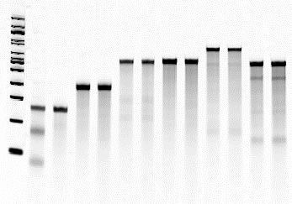
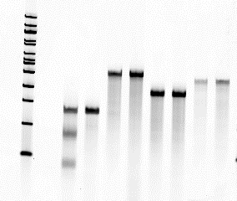
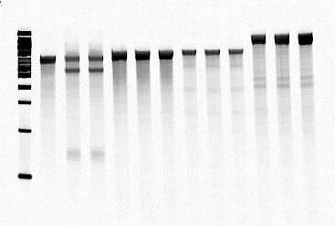
a)
b)
c)
On-target (CD40L)
OT1 (chr. 1)
OT2 (chr. 1)
OT3 (chr. 8)
On-target (CD40L)
OT1 (chr. 13)
OT2 (chr. 14)
OT3 (chr. 2)
OT4 (chr. 11)
OT5 (chr. 12)
On-target (CD40L)
OT1 (chr. 5)
OT2 (chr. 2)
OT3 (chr. 14)
TALEN
+
-
+
-
+
-
+
-
+
-
+
-
+
-
+
-
+
-
+
-
-
+
+
-
+
+
-
+
+
-
+
+
TALEN
CRISPR
Supplemental Figure 6. Surveyor nuclease assay (CEL I) of TALEN and CRISPR Off-Target Sites, Related to Figure 6.
Surveyor nuclease assay (CEL I) of off-target (OT) sites for TALENs a) predicted in silico by PROGNOS or b) identified by GFP IDLV trapping experiments. For each OT, the first lane is from K562 cells treated with TALEN while the second lane is mock treated. c) Cel-1 of CRISPR 3 off-target sites predicted in silico. For each site analyzed, the first lane is mock treated followed by CRISPR treated in biological replicates.
Notes:
1: CD40L On target 2: CD40L GFP only 3: Chr 14 off target with TALEN 4: Chr 14 off target with GFP only 5: Chr 5 off target with TALEN 6: Chr 5 off target with GFP only 7: Chr 2 off target with TALEN 8: Chr 2 off target with GFP only
TAL off target from 7/29/2014 team meeting PPT

