Slide 1
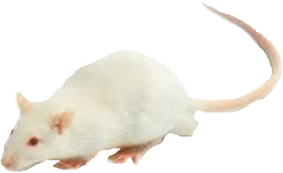
GBE
Ultrasonication process
UGBE
S.D. Rat
D-GalN/LPS – induced acute toxicity model
Sacrificing
- Liver (SOD, GPx, CAT, GSH, iNOS, NO, HO-1, TLR4 and histopathology)
- Serum (ALT, AST, T.bilirubin and TNF-α)
Survival rate
Silymarin 150 mg/kg, GBE 250 mg/kg
UGBE 100, 250, 500 mg/kg
24 h
4 weeks
D-GalN (300 mg/kg) / LPS(30 µg/kg)
Supplementary Figure 1. The overall procedure and experimental design of experiments.

