Slide 1
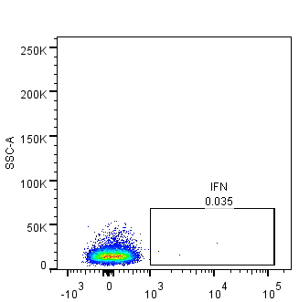
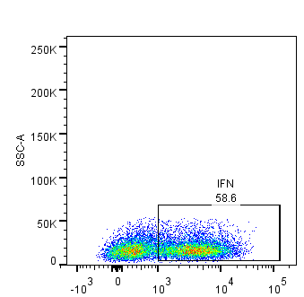
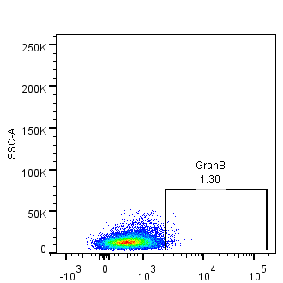
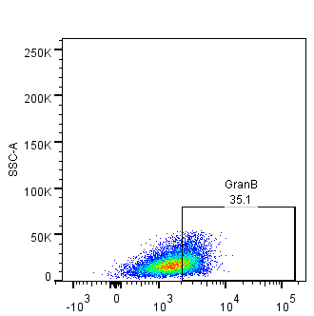
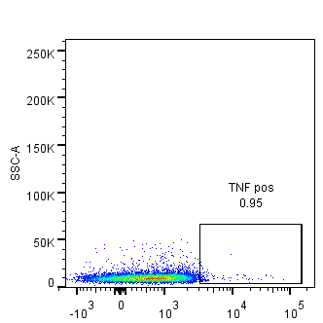
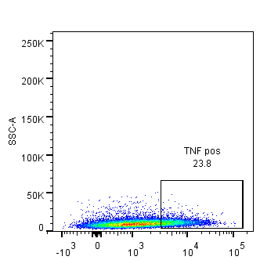
Figure S2.
A. Isotype control
B. Cytokine antibody
IFN-γ
APC Rat IgG1 k isotype
APC Anti mouse IFN-γ
Granzyme B
Percp-eF710 Rat IgG2a k isotype
Percp-eF710 Anti mouse GzB
TNF-α
PE/cy7 Rat IgG1 k isotype
PE/cy7 Rat Anti mouse TNF-α

