Slide 1
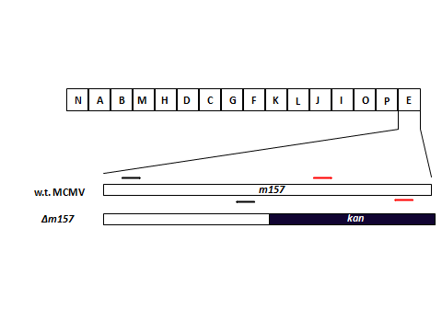
Figure S3.
MCMV-WT
MCMVΔ157
Primer sites
C
A
A
B
B
C

