Slide 1
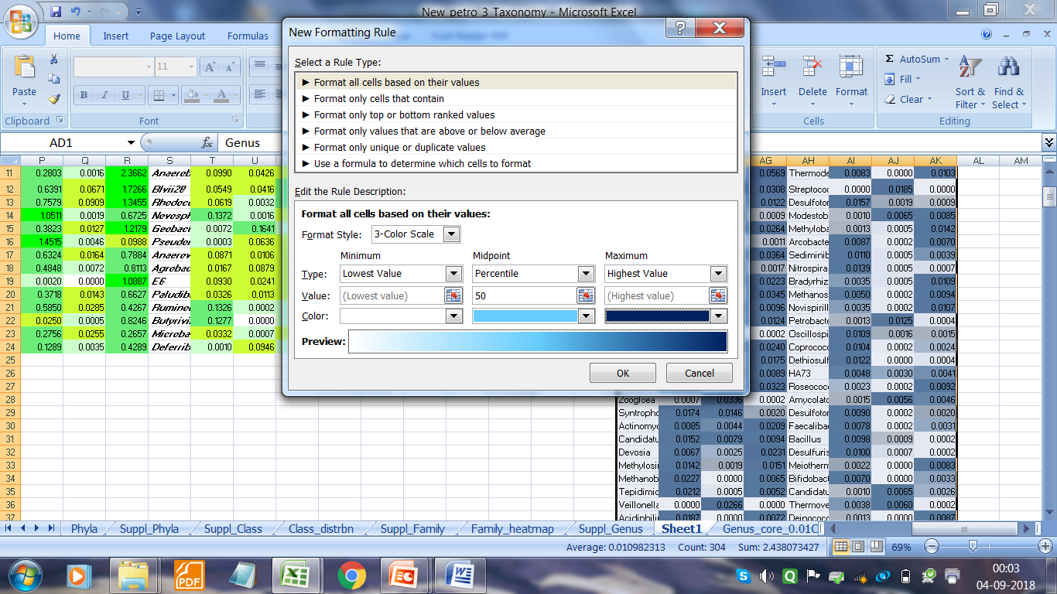
Genus | GR1 | GR3 | DB2 | Genus | GR1 | GR3 | DB2
Parvibaculum |  |  |  | Kaistia
Acetobacterium |  |  |  | Stenotrophomonas
Sphingobium |  |  |  | Pelotomaculum
Propionibacterium |  |  |  | Neisseria
Thauera |  |  |  | Luteimonas
Caloramator |  |  |  | Dechloromonas
Magnetospirillum |  |  |  | Fusibacter
Sulfuricurvum |  |  |  | Caldicoprobacter
Sporanaerobacter |  |  |  | LCP-6
Pleomorphomonas |  |  |  | Thermodesulfobium
Thermus |  |  |  | Streptococcus
Aeromicrobium |  |  |  | Desulfotomaculum_Desulfovirgula
Prevotella |  |  |  | Modestobacter
Flavobacterium |  |  |  | Methylobacterium
Brevibacterium |  |  |  | Arcobacter
Dietzia |  |  |  | Sediminibacterium
Thermoanaerobacter |  |  |  | Nitrospira
Pedomicrobium |  |  |  | Bradyrhizobium
Sphingomonas |  |  |  | Methanosaeta
Moorella |  |  |  | Novispirillum
Corynebacterium |  |  |  | Petrobacter
Desulfosporosinus |  |  |  | Oscillospira
Pseudonocardia |  |  |  | Coprococcus
Cloacibacterium |  |  |  | Dethiosulfatibacter
Sedimentibacter |  |  |  | HA73
Telmatospirillum |  |  |  | Roseococcus
Zoogloea |  |  |  | Amycolatopsis
Syntrophomonas |  |  |  | Desulfotomaculum
Actinomyces |  |  |  | Faecalibacterium
Candidatus Solibacter |  |  |  | Bacillus
Devosia |  |  |  | Desulfurispora
Methylosinus |  |  |  | Meiothermus
Methanobacterium |  |  |  | Bifidobacterium
Tepidimicrobium |  |  |  | Candidatus Koribacter
Veillonella |  |  |  | Thermovenabulum
Acidiphilium |  |  |  | Deinococcus
Propionicimonas |  |  |  | Garciella
0
Percent Abundance
0.1

