Slide 1
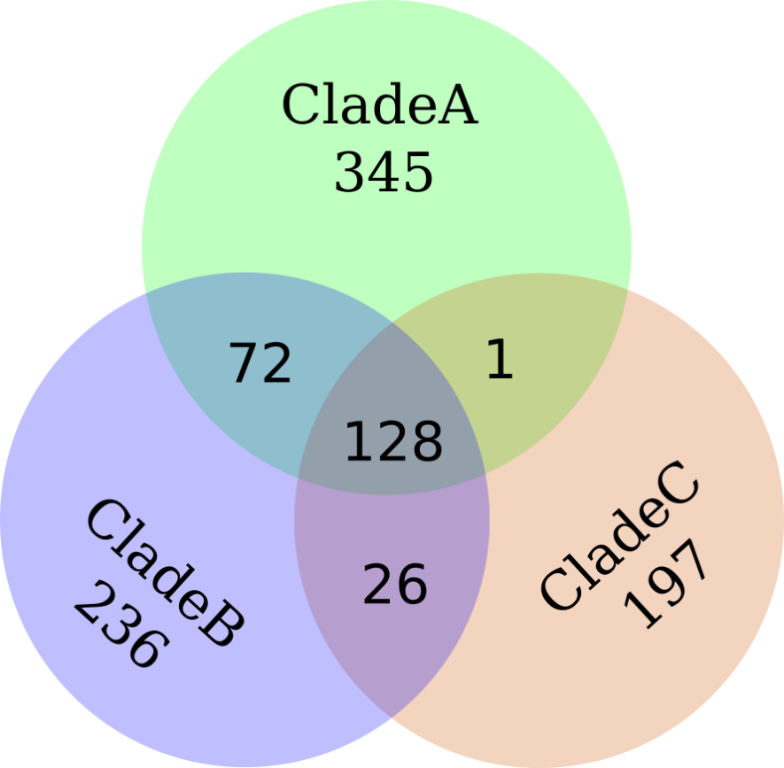
Clade C
Clade B
Clade A
Figure S2. Venn diagram of clade-unique and clade-shared amino acid substitutions.

