Slide 1
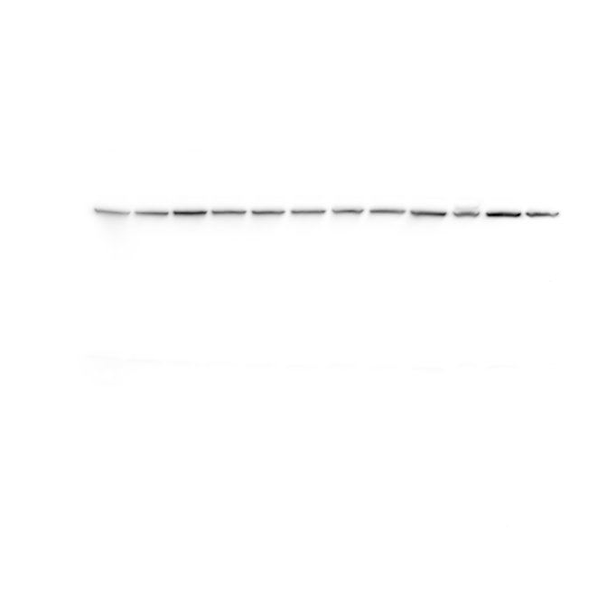
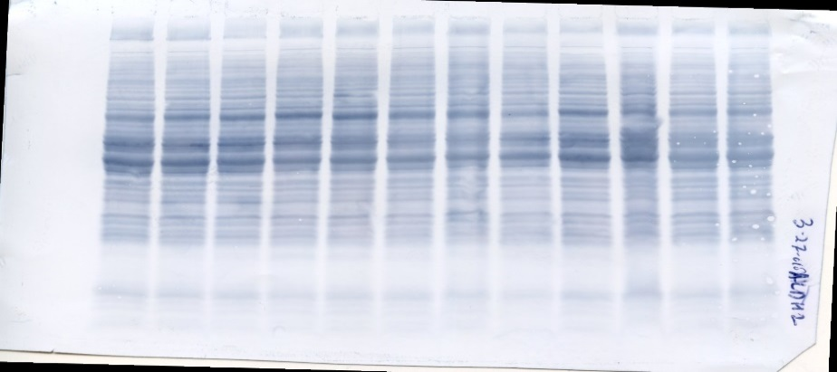
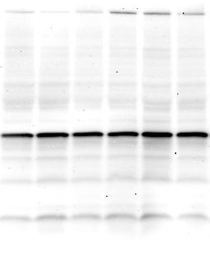
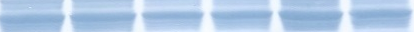
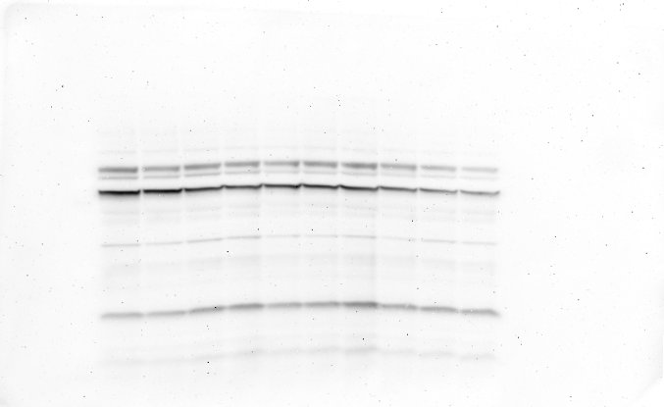
Supplemental Fig.I
B
WT
A
WT AR-null
AR-null
kDa
Sham TAC TAC Sham
55
ALDH2
50
AB
C
WT AR-null
kDa
250
150
100
Sham TAC
75
D
50
250 kDa 40 kDa 30kDa 25kDa
37
Band Intensity (Arbitrary units)
25
E
AB
kDa
WT AR-null
TAC TAC TAC TAC
75
F
75 kDa 60kDa 15kDa
50
37
25
AB
TAC TAC TAC

Slide 2
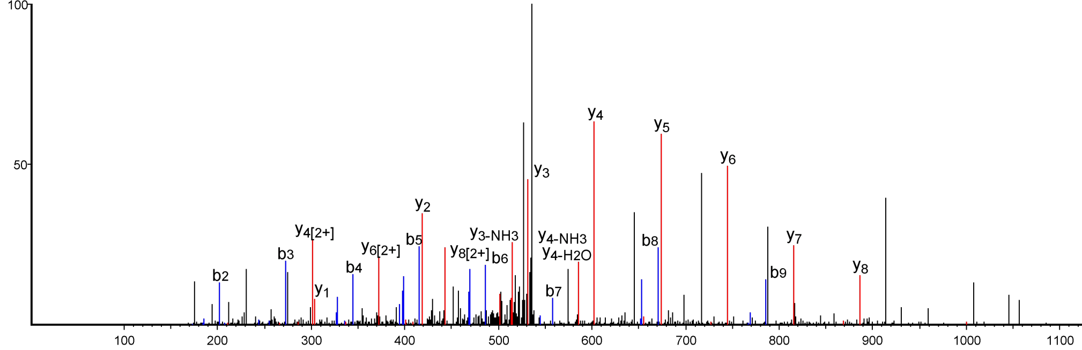
Supplemental Fig.II
SNAAAALDk (+156.12)
Intensity (%)
m/z

Slide 3
Supplemental Table I
 | Baseline |  | 4 week TAC |  | 8 week TAC |  | 16 week TAC
 | WT | AR-null | WT | AR-null | WT | AR-null | WT | AR-null
LVIDd(mm) | 3.66±0.04 | 3.97±0.06 | 4.02±0.08 | 3.97±0.13 | 4.31±0.61 | 4.46±0.16 | 4.55±0.28 | 4.61±0.47
LVIDs(mm) | 2.14±0.06 | 2.56±0.08# | 2.86±0.15* | 2.80±0.20 | 3.29±0.28 | 3.54±0.24* | 3.49±0.42 | 3.60±0.68
Endo EDV | 43±1 | 51±2# | 58±2* | 54±4 | 68±7 | 70±6 | 76±8 | 84±21
Endo ESV | 14±1 | 19±1# | 30±1* | 28±3* | 43±8 | 44±7* | 49±10 | 59±24
EF(%) | 69±1 | 63±1# | 48±3* | 48±3* | 41±5* | 40±5* | 42±8* | 37±10*
Heart rate | 483±5 | 457±5# | 507±9 | 503±14 | 543±9* | 504±15 | 571±16 | 517±24
SV | 30±1 | 32±1 | 27±1 | 25±2 | 25±2 | 26±2 | 27±3 | 24±4
CO | 14.42±0.52 | 14.87±0.66 | 13.88±0.84 | 12.87±0.64 | 13.28±1.11 | 13.07±0.90 | 15.67±1.73 | 12.28±1.56

Slide 4
Supplemental Table II
Sequence number | Accession number | Proteins | Location
1 | Q02566 | Myosin-6 | Unknown
2 | Q91Z83 | Myosin-7 | Unknown
3 | P62737 | Actin, aortic smooth muscle | Unknown
4 | Q03265 | ATP synthase subunit alpha, mitochondrial | Mitochondrial
5 | P68134 | Actin, alpha skeletal muscle | Unknown
6 | Q922U2 | Keratin, type II cytoskeletal | Unknown
7 | Q61781 | Keratin, type I cytoskeletal 14 | Unknown
8 | P60710 | Actin, cytoplasmic 1 | Unknown
9 | P50446 | Keratin, type II cytoskeletal | Unknown
10 | Q9JI91 | Alpha-actinin-2 | Unknown
11 | P15864 | Histone H1.2 | Unknown
12 | Q9QWL7 | Keratin, type I | Cytoskeletal
13 | O55143 | Sarcoplasmic/endoplasmic reticulum calcium ATPase | Unknown
14 | P04104 | Keratin, type II cytoskeletal | Unknown
15 | P43277 | Histone H1.3 | Unknown
16 | P56480 | ATP synthase subunit beta, | Mitochondrial
17 | Q3TTY5 | Keratin, type II cytoskeletal 2 | Unknown
18 | P43274 | Histone H1.4 | Unknown
19 | Q9Z331 | Keratin, type II | Unknown
20 | Q6IFX2 | Keratin, type I | Unknown
21 | E9Q557 | Desmoplakin | Unknown
22 | P20029 | 78 kDa glucose-regulated protein | Unknown
23 | Q99KI0 | Aconitate hydratase, mitochondrial | Mitochondrial
24 | Q9Z2K1 | Keratin,type I cytoskeletal 16 | Unknown
25 | O70468 | Myosin-binding protein C, cardiac-type | Unknown
26 | Q9DB77 | Cytochrome b-c1 complex subunit 2 | Mitochondrial
27 | P38647 | Stress-70 protein | Mitochondrial
28 | Q8BGZ7 | Keratin, type II cytoskeletal | Cyotskeletal

Slide 5
Supplemental Table III Continued
Sequence number | Accession number | Proteins | Location
29 | P58771 | Tropomyosin alpha-1 chain | Unknown
30 | Q3UV17 | Keratin, type II cytoskeletal 2 | Unknown
31 | Q6IME9 | Keratin, type II cytoskeletal | Cytoskeletal
32 | Q6IFZ6 | Keratin, type II cytoskeletal | Cytoskeletal
33 | P01868 | Ig gamma-1 chain C region secreted form | Unknown
34 | P01869 | Ig gamma-1 chain C region, membrane-bound form | Unknown
35 | P16125 | L-lactate dehydrogenase B chain | Unknown
36 | P018762 | Isoform 2 of Ig gamma-2B chain C region | Unknown
37 | P01867 | Ig gamma-2B chain C region | Unknown
38 | P63017 | Heat shock cognate 71 kDa protein | Unknown
39 | P3100 | Desmin | Unknown
40 | Q61414 | Keratin, type I cytoskeletal 15 | Unknown
41 | P08730 | Keratin, type I cytoskeletal 13 | Unknown
42 | Q02257 | Junction plakoglobin | Unknown
43 | Q8BWT1 | 3-ketoacyl-CoA thiolase, mitochondrial | Mitochondrial
44 | P01864 | Ig gamma-2A chain C region secreted form | Unknown
45 | P19001 | Keratin, type I cytoskeletal 19 OS | Unknown
46 | P07744 | Keratin, type II cytoskeletal 4 OS | Unknown
47 | Q8BMS1 | Trifunctional enzyme subunit alpha, mitochondrial | Mitochondrial
48 | P48962 | ADP/ATP translocase 1 | Unknown
49 | P16858 | Glyceraldehyde-3-phosphate dehydrogenase | Unknown
50 | P01837 | Ig kappa chain C region | Unknown
51 | Q6IFZ9 | Keratin, type II cytoskeletal 74 | Unknown
52 | P09542 | Myosin light chain 3 | Unknown
53 | P11679 | Keratin, type II cytoskeletal 8 | Unknown
54 | P03987 | Isoform 2 of Ig gamma-3 chain C region | Unknown
55 | P03987 | Ig gamma-3 chain C region | Unknown
56 | P04247 | Myoglobin | Unknown
57 | P54071 | Isocitrate dehydrogenase [NADP] | Mitochondrial

Slide 6
Supplemental Table III Continued
Sequence number | Accession number | Proteins | Location
58 | Q8VED5 | Keratin, type II cytoskeletal 79 | Unknown
59 | P01872 | Ig mu chain C region | Unknown
60 | P01872-2 | Isoform 2 of Ig mu chain C | Unknown
61 | P01635 | Ig kappa chain V-V region K2 | Unknown
62 | P10922 | Histone H1.0 | Unknown
63 | Q91VR2 | ATP synthase subunit gamma | Mitochondrial
64 | P51881 | ADP/ATP translocase 2 | Unknown
65 | P43276 | Histone H1.5 | Unknown
66 | P01673 | Ig kappa chain V-III region | Unknown
67 | P07310 | Creatine kinase M-type | Unknown
68 | P45952 | Medium-chain specific acyl-CoA dehydrogenase | Mitochondrial
69 | P01631 | Ig kappa chain V-II region 26-10 | Unknown
70 | P01843 | Ig lambda-1 chain C region | Unknown
71 | Q9Z2I9 | Succinate--CoA ligase [ADP-forming] subunit beta | Unknown
72 | P01942 | Hemoglobin subunit alpha | Unknown
73 | P19536 | Cytochrome c oxidase subunit 5B | Mitochondrial
74 | P02104 | Hemoglobin subunit epsilon-Y2 | Unknown
75 | P07356 | Annexin A2 | Unknown
76 | P01674 | Ig kappa chain V-III region PC 2154 | Unknown
77 | P01647 | Ig kappa chain V-V region HP 124E1 | Unknown
78 | P01643 | Ig kappa chain V-V region MOPC 173 | Unknown
79 | P01644 | Ig kappa chain V-V region HP R16.7 | Unknown
80 | P01645 | Ig kappa chain V-V region HP 93G7 | Unknown
81 | P23927 | Alpha-crystallin B chain | Unknown
82 | P01845 | Ig lambda-3 chain C region | Unknown
83 | P01844 | Ig lambda-2 chain C region | Unknown
84 | A6BLY7 | Keratin, type I cytoskeletal 28 | Unknown
85 | P62806 | Histone H4 | Unknown
86 | P14106 | Complement C1q subcomponent subunit B | Unknown
87 | O35129 | Prohibitin-2 | Unknown
88 | P18525 | Ig heavy chain V region 5-84 | Unknown
89 | P06151 | L-lactate dehydrogenase A chain | Unknown
90 | P01639 | Ig kappa chain V-V region MOPC 41 | Unknown
91 | Q99JY0 | Trifunctional enzyme subunit beta | Mitochondrial

Slide 7
Supplemental Table III Continued
Sequence number | Accession number | Proteins | Location
92 | P62983 | Ubiquitin-40S ribosomal protein S27a | Unknown
93 | P50544 | Very long-chain specific acyl-CoA dehydrogenase, | Mitochondrial
94 | Q8CAQ | MICOS complex subunit Mic60 | Unknown
95 | Q8CAQ8 | Isoform 5 of MICOS complex subunit Mic60 | Unknown
96 | P01636 | Ig kappa chain V-V region MOPC 149 | Unknown
97 | Q921G7 | Electron transfer flavoprotein-ubiquinone oxidoreductase, | Mitochondrial
98 | P04117 | Fatty acid-binding protein, | Unknown
99 | Q9DCW | Electron transfer flavoprotein subunit beta | Unknown
100 | Q64291 | Keratin, type I cytoskeletal 12 | Unknown
101 | P05064 | Fructose-bisphosphate aldolase A | Unknown
102 | Q99LC5 | Electron transfer flavoprotein subunit alpha, | Mitochondrial
103 | P01642 | Ig kappa chain V-V region L7 (Fragment) | Unknown
104 | P05202 | Aspartate aminotransferase, | Mitochondrial
105 | P68368 | Tubulin alpha-4A chain | Unknown
106 | P68373 | Tubulin alpha-1C chain | Unknown
107 | Q9JJZ2 | Tubulin alpha-8 chain | Unknown
108 | P05214 | Tubulin alpha-3 chain | Unknown
109 | P05213 | Tubulin alpha-1B chain | Unknown
110 | P68369 | Tubulin alpha-1A chain | Unknown
111 | P07724 | Serum albumin | Unknown
112 | Q8VHX6 | Isoform 2 of Filamin-C | Unknown
113 | Q8VHX6 | Filamin-C | Unknown
114 | P97350 | Plakophilin-1 | Unknown
115 | Q60932- 2 | Isoform Mt-VDAC1 of Voltage-dependent anion-selective channel protein | Unknown
116 | Q60932 | Voltage-dependent anion-selective channel protein 1 | Unknown
117 | Q9D6R2 | Isocitrate dehydrogenase [NAD] subunit alpha, mitochondrial | Mitochondrial
118 | P98086 | Complement C1q subcomponent subunit A | Unknown
119 | Q9D2G2 | Isoform 2 of Dihydrolipoyllysine-residue succinyltransferase component of 2-oxoglutarate dehydrogenase complex | Mitochondrial

Slide 8
Supplemental Table III Continued
Sequence number | Accession number | Proteins | Location
120 | Q9D2G2 | Dihydrolipoyllysine-residue succinyltransferase component of 2-oxoglutarate dehydrogenase complex | Mitochondrial
121 | P63038 | 60 kDa heat shock protein | Mitochondrial
122 | Q64475 | Histone H2B type 1-B | Unknown
123 | Q6ZWY9 | Histone H2B type1 | Unknown
124 | Q64525 | Histone H2B type 2-B | Unknown
125 | P10853 | Histone H2B type1 | Unknown
126 | Q8CGP2 | Histone H2B type 1-P | Unknown
127 | Q8CGP1 | Histone H2B type 1-K | Unknown
128 | P10854 | Histone H2B type 1-M | Unknown
129 | Q64478 | Histone H2B type 1-H | Unknown
130 | Q64524 | Histone H2B type 2-E | Unknown
131 | Q9D2U9 | Histone H2B type 3-A | Unknown
132 | Q8CGP0 | Histone H2B type 3-B | Unknown
133 | P70696 | Histone H2B type 1-A | Unknown
134 | Q8CGP2 | Isoform 2 of Histone H2B type 1-P | Unknown
135 | O70373 | Xin actin-binding repeat-containing protein 1 | Unknown
136 | P97447 | Isoform 2 of Four and a half LIM domains protein 1 | Unknown
137 | P97447 | Four and a half LIM domains protein 1 | Unknown
138 | Q8BFR5 | Isoform 2 of Elongation factor Tu, | Unknown
139 | Q8BFR5 | Elongation factor Tu | Unknown
140 | P06330 | Ig heavy chain V region AC38 205.12 | Unknown
141 | Q8BKZ9 | Pyruvate dehydrogenase protein X component | Mitochondrial
142 | P62631 | Elongation factor 1-alpha 2 | Unknown
143 | P24270 | Catalase | Unknown
144 | P10107 | Annexin A1 | Unknown
145 | Q9JLF6 | Protein-glutamine gamma-glutamyltransferase K | Unknown
146 | Q64522 | Histone H2A type 2-B | Unknown
147 | P27661 | Histone H2AX | Unknown
148 | Q60597 | Isoform 2 of 2-oxoglutarate dehydrogenase | Unknown
149 | Q60597 | 2-oxoglutarate dehydrogenase | Mitochondrial
150 | Q60597 | Isoform 4 of 2-oxoglutarate dehydrogenase, | Mitochondrial

Slide 9
Supplemental Table III Continued
Sequence number | Accession number | Proteins | Location
151 | Q60597 | Isoform 3 of 2-oxoglutarate dehydrogenase | Mitochondrial
152 | P47915 | 60S ribosomal protein L29 | Unknown
153 | P84099 | 60S ribosomal protein L19 | Unknown
154 | P01728 | Ig lambda-2 chain V region | Unknown
155 | P01723 | Ig lambda-1 chain V region | Unknown
156 | P01727 | Ig lambda-1 chain V region | Unknown
157 | P01726 | Ig lambda-1 chain V region | Unknown
158 | P01729 | Ig lambda-2 chain V region | Unknown
159 | Q6P8J7 | Creatine kinase S-type | Mitochondrial
160 | Q9CZ13 | Cytochrome b-c1 complex subunit 1 | Mitochondrial
161 | Q9EST1 | Gasdermin-A | Unknown
162 | Q7TNB8 | Isoform 2 of Protein strawberry notch homolog 2 | Unknown
163 | Q7TNB8 | Protein strawberry notch homolog 2 | Unknown
164 | P48678 | Prelamin-A/C | Unknown
165 | P11499 | Heat shock protein HSP 90-beta | Unknown
166 | P07901 | Heat shock protein HSP 90-alpha | Unknown
167 | Q06185 | ATP synthase subunit e | Unknown
168 | Q9DB20 | ATP synthase subunit O | Unknown
169 | Q0KK59 | Protein unc-79 homolog | Unknown
170 | P62827 | GTP-binding nuclear protein | Unknown
171 | P01638 | Ig kappa chain V-V region L6 (Fragment) | Unknown
172 | P01637 | Ig kappa chain V-V region T1 | Unknown
173 | P01750 | Ig heavy chain V region 102 | Unknown
174 | P01753 | Ig heavy chain V region 186-1 | Unknown
175 | P01754 | Ig heavy chain V region 1-62-3 | Unknown
176 | P06328 | Ig heavy chain V region VH558 B4 | Unknown
177 | P01751 | Ig heavy chain V region B1-8/186 | Unknown
178 | P01029 | Complement C4-B | Unknown
179 | P01633 | Ig kappa chain V19-17 | Unknown
180 | O54943 | Period circadian protein homolog 2 | Unknown
181 | Q64338-1 | Isoform 1 of Calcium/calmodulin-dependent 3,5’ cyclic nucleotide phosphodiesterase 1C | Unknown
182 | Q64338 | Calcium/calmodulin-dependent 3’,5’ cyclic phosphodiesterase 1C | Unknown

