Slide 1
Supplementary Fig. S1.

Slide 2
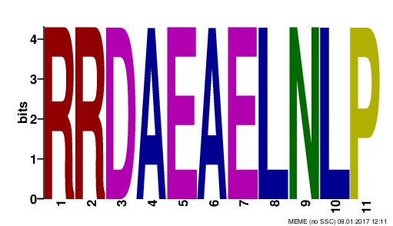
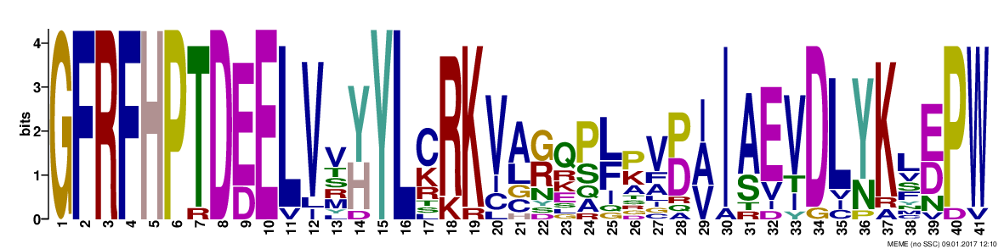
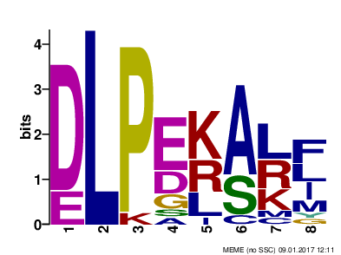
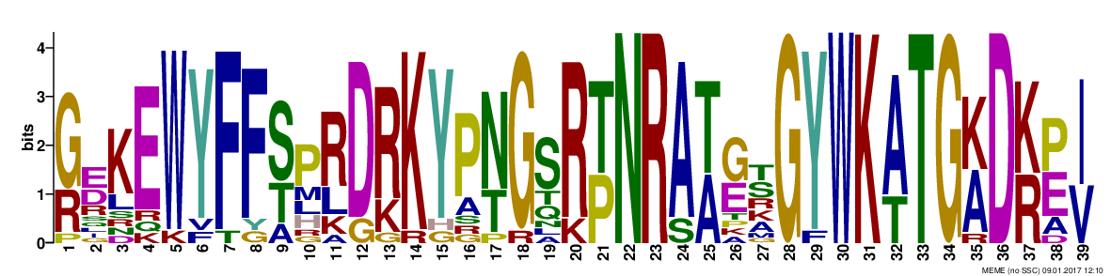
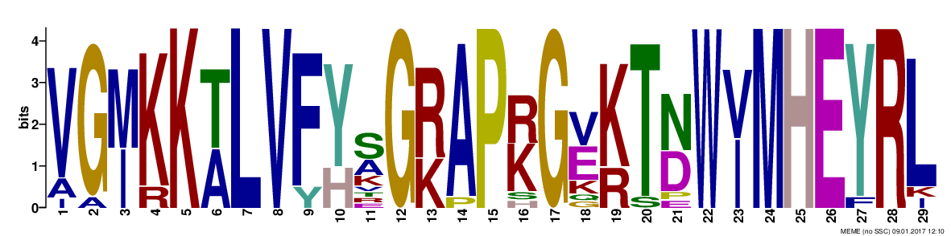
Supplementary Fig. S2

Slide 3
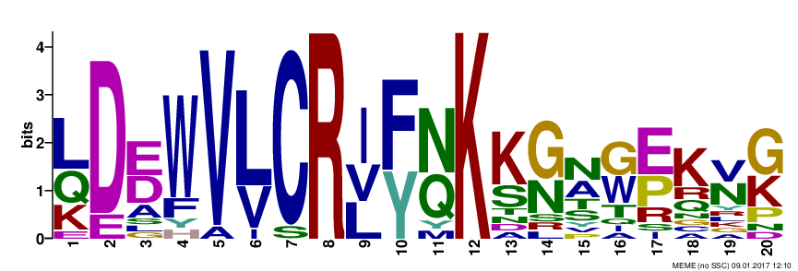
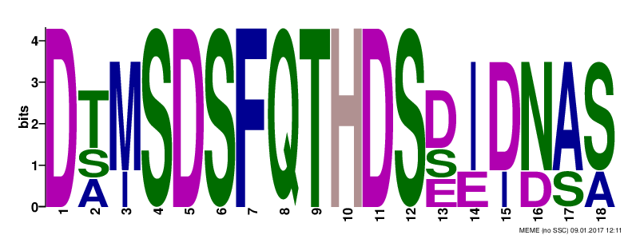
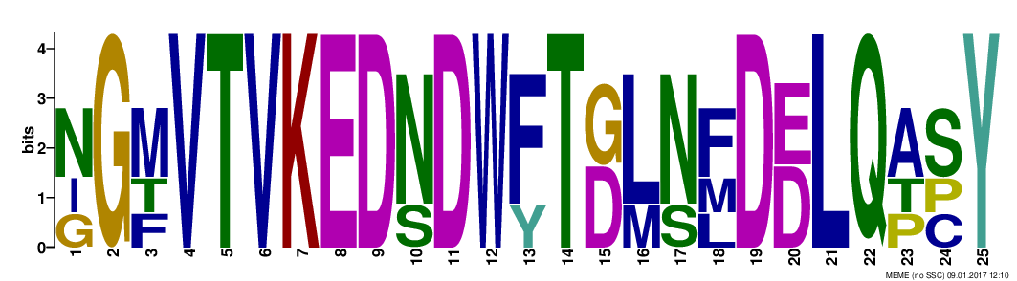
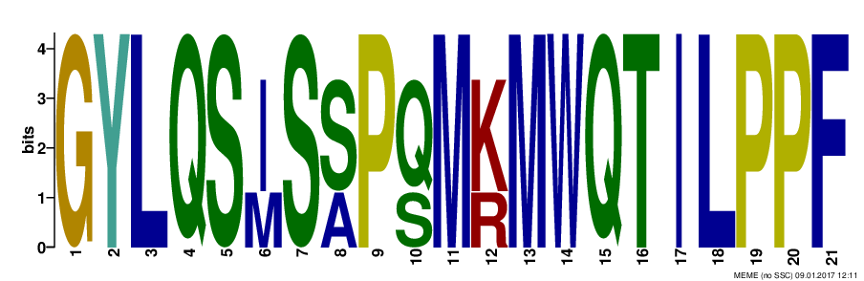
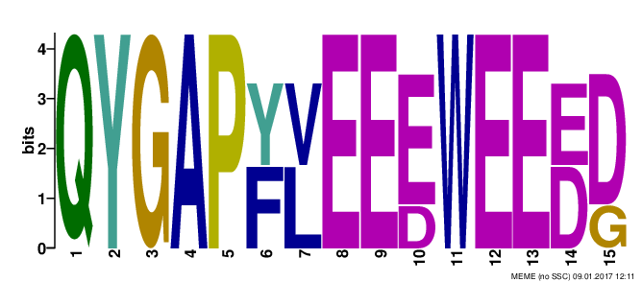
Supplementary Fig. S2.

Slide 4
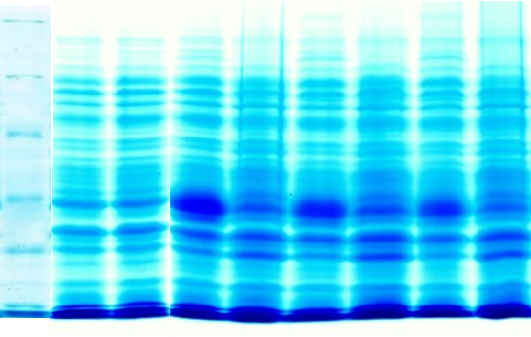
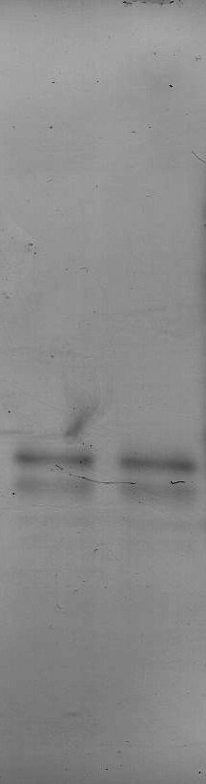
A.
Vector alone
Recombinant AlNAC4 protein
B.
C.
M
2 h
2 h
4 h
6 h
2 h
WB
kDa
I
Un
I
Un
I
Un
I
Un
PP1
PP2
PP1
PP2
116
1 2 3 4 5 6 7 8
66
45
AlNAC4
35
AlNAC4
25
18.4
Supplementary Fig. S3.

Slide 5
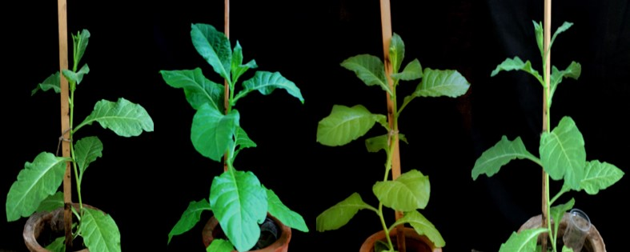
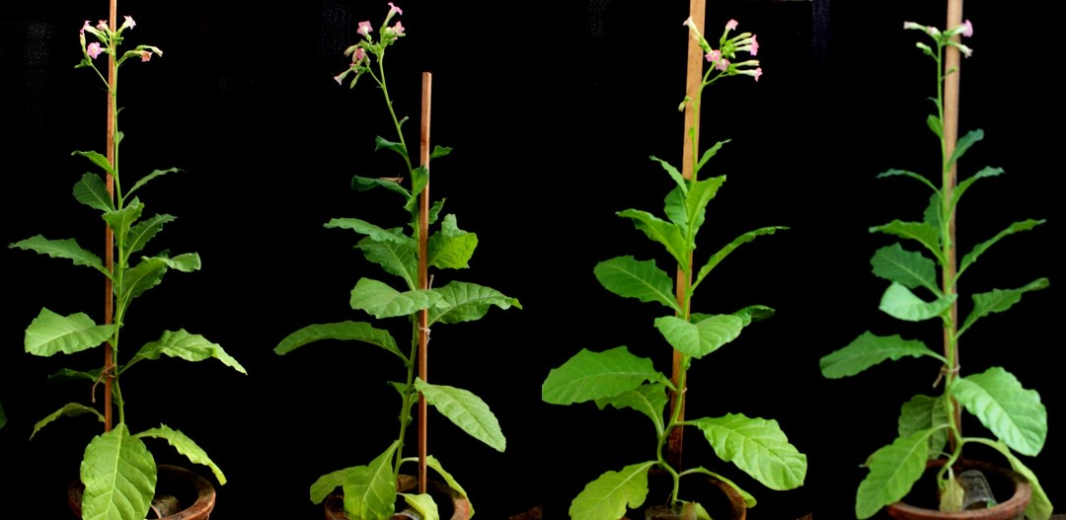
WT L33 L50 L64
A.
B.
Supplementary Fig. S4.

