Slide 1
Table S1– Demographics of the cohort for the additional cerebral blood flow (CBF) assessment
 | NC | MC | p-value
N (%) | 19 (63.3) | 11 (36.7) | -
Age, mean (SD) years | 41.8 (7.5) | 36.0 (8.9) | 0.16
EYO, mean (SD) years | -3.4 (9.4) | -13.6 (8.2) | 0.008 (**)
Education, mean (SD) | 15.3 (2.2) | 16.4 (2.9) | 0.62
Male, n (%) | 9 (47.4) | 9 (81.8) | 0.14
CDR > 0, n (%) | 0 | 2 (18.2) | 0.24
MCBP > 0.18, n (%) | 0 | 7 (63.6) | 0.0004 (***)
Table S1 – Demographics of the cohort for the additional cerebral blood flow (CBF) assessment
The 2 groups, non-carriers (NC) and mutation carriers (MC), were similar in age, education score, gender but not in estimated years to onset (EYO). The MC group has a significant higher proportion of subjects with amyloid deposition (MCBP > 0.18). Annotations: ** p-value < 0.01, *** p-value < 0.0005

Slide 2
Table S2 – Relationship between FDG and different early time-frame summarizations of PiB
Time-frame of PiB (duration) | Entire brain (mean R ± SD) | Cortical (mean R ± SD) | Subcortical (mean R ± SD)
0 – 5 min (5 min) | R=0.7832±0.0411 | R=0.6393±0.0560 | R=0.7534±0.0482
1 – 6 min (5 min) | R=0.7890±0.0397 | R=0.6521±0.0560 | R=0.7609±0.0469
1 – 7 min (6 min) | R=0.7938±0.0382 | R=0.6596±0.0546 | R=0.7665±0.0459
1 – 8 min (7 min) | R=0.7960±0.0378 | R=0.6638±0.0535 | R=0.7694±0.0460
1 – 9 min (8 min) | R=0.7969±0.0386 ★ | R=0.6657±0.0536 | R=0.7696±0.0468 ★
1 – 10 min (9 min) | R=0.7955±0.0379 | R=0.6659±0.0537 ★ | R=0.7688±0.0484
1 – 12 min (11 min) | R=0.7911±0.0391 | R=0.6635±0.0540 | R=0.7637±0.0527
Table S2 – Relationship between FDG and different early time-frame summarizations of PiB
Voxel-wise spatial correlation between ¹⁸F-FDG and different summarization of ¹¹C-PiB in all participants (n=110). Here are displayed the average of Pearson’s R in function of the different time frame sum on the entire brain, cortical, and subcortical areas. The time-frame of 1 to 9 minutes gives the maximal correlation for the entire brain. In the same time-frame, maximal correlation was found in subcortical regions.
Annotations: ★ maximum average correlations for each area.

Slide 3
Table S3 – Correlation of perfusion measures and FDG
 | PiB-R1 and FDG |  | ePiB and FDG
Region | rho | p-value | rho | p-value
Precuneus | 0.48 | 8.27x10⁻⁰⁷ | 0.08 | 0.399
Inferior Parietal | 0.42 | 2.76x10⁻⁰⁵ | 0.22 | 0.093
Superior Parietal | 0.55 | 2.52x10⁻¹⁰ | 0.28 | 0.016
Lateral Occipital | 0.37 | 3.21x10⁻⁰⁴ | 0.22 | 0.104
Hippocampus | 0.40 | 8.45x10⁻⁰⁵ | 0.52 | 5.95x10⁻⁰⁸
Table S3 – Correlation perfusion measures and FDG
Evaluation of correlation between the perfusion measures and FDG in all 110 participants. Spearman’s rank correlation coefficient (rho) and p-values are displayed for PiB-R1 and FDG, and for ePiB and FDG. There were significant correlations between PiB-R1 and FDG in all regions.

Slide 4
Table S4 – Correlation perfusion measures and MCBP
 | PiB-R1 and MCBP |  | ePiB and MCBP
Region | rho | p-value | rho | p-value
Precuneus | -0.19 | 0.229 | 0.59 | 8.95x10⁻¹¹
Inferior Parietal | -0.11 | 0.239 | 0.37 | 3.64x10⁻⁰⁴
Superior Parietal | -0.11 | 0.241 | 0.35 | 1.07x10⁻⁰³
Lateral Occipital | -0.10 | 0.289 | 0.27 | 0.024
Hippocampus | -0.002 | 0.98 | 0.006 | 0.95
Table S4 – Correlation perfusion measures and MCBP
Evaluation of correlation between the perfusion measures and mean cortical binding potential (MCBP) in all 110 participants. Spearman’s rank correlation coefficient (rho) and p-values are displayed for PiB-R1 and MCBP, and for ePiB and MCBP. EPiB correlated with MCBP while PiB-R1 did not.

Slide 5
Table S5 – Linear mixed model results of EYO effects on tracers (cross-sectional)
 |  | FDG and EYO |  |  | PiB-R1 and EYO |  |  | ePiB and EYO
Region |  | Estimate | SE | p-value | Estimate | SE | p-value | Estimate | SE | p-value
Precuneus | NC | -3.2e-3 | 4.09e-3 | 0.4356 | 4.84e-4 | 1.45e-3 | 0.7393 | 3.57e-4 | 1.36e-3 | 0.7942
 | MC | -1.47e-2 | 3.09e-3 | <.0001 | -2.19e-3 | 1.12e-3 | 0.0526 | 5.67e-3 | 1.47e-3 | 0.0003
 | EYO*Mutation | -1.15e-2 | 5.02e-3 | 0.0243 | -2.68e-3 | 1.83e-3 | 0.1469 | 5.31e-3 | 2.00e-3 | 0.0091
Inferior Parietal | NC | -3.26e-3 | 3.96e-3 | 0.4129 | -3.60e-4 | 1.51e-3 | 0.8123 | 3.7e-4 | 1.63e-3 | 0.821
 | MC | -1.67e-2 | 3.00e-3 | <.0001 | -2.49e-3 | 1.51e-3 | 0.0338 | 2.58e-3 | 1.24e-3 | 0.0404
 | EYO*Mutation | -1.35e-2 | 4.89e-3 | 0.0069 | -2.85e-3 | 1.90e-3 | 0.1368 | 2.21e-3 | 2.04e-3 | 0.2818
Superior Parietal | NC | -6.14e-3 | 3.58e-3 | 0.0926 | -1.94e-3 | 1.58e-3 | 0.2243 | -2.45e-3 | 1.48e-3 | 0.1052
 | MC | -1.44e-2 | 3.25e-3 | <.0001 | -2.58e-3 | 1.21e-3 | 0.0361 | 2.30e-3 | 1.53e-3 | 0.1369
 | EYO*Mutation | -8.27e-2 | 4.76e-3 | 0.0854 | -6.40e-4 | 1.99e-3 | 0.7479 | 4.76e-3 | 2.13e-3 | 0.0277
Lateral Occipital | NC | -4.5e-3 | 3.81e-3 | 0.2405 | -7.8e-4 | 2.22-3 | 0.7261 | -9.9e-4 | 1.73e-3 | 0.5685
 | MC | -9.13e-3 | 2.88e-3 | 0.002 | -1.02e-3 | 1.70e-3 | 0.5526 | 2.42e-3 | 1.32e-3 | 0.0692
 | EYO*Mutation | -4.63e-3 | 4.72e-3 | 0.3282 | -2.40e-4 | 2.80e-3 | 0.9332 | 3.41e-3 | 2.16e-3 | 0.1178
Hippocampus | NC | -2.36e-3 | 1.34e-3 | 0.0808 | -1.9e-4 | 1.04e-3 | 0.8520 | -6.8e-4 | 6.85e-4 | 0.3247
 | MC | -4.31e-3 | 1.01e-3 | <.0001 | -9.2e-4 | 8.01e-4 | 0.2540 | -1.05e-3 | 5.28e-4 | 0.0502
 | EYO*Mutation | -1.95e-3 | 1.66e-3 | 0.2421 | -7.20e-4 | 1.31e-3 | 0.5819 | 3.70e-4 | 8.65e-4 | 0.6709
Table S5 – Linear mixed model results EYO effects on tracers (cross-sectional)
General linear mixed models were employed to estimate the relationship of FDG, PiB-R1, and ePiB with estimated year to onset (EYO).

Slide 6
Table S6 – Estimated mean (SE) annual rate of change within individual in FDG and ePiB
 | Rate of change in FDG |  |  | Rate of change in R1 |  |  | Rate of change in ePiB
 | NC | MC | NC vs. MC | NC | MC | NC vs. MC | NC | MC | NC vs. MC
Region | Estimate (SE) | Estimate (SE) | p-value | Estimate (SE) | Estimate (SE) | p-value | Estimate (SE) | Estimate (SE) | p-value
Precuneus | -0.034 (0.024) | -0.076 (0.027) | 0.2609 | -0.014 (0.011) | -0.019 (0.012) | 0.7457 | -0.011 (0.008) | -0.013 (0.009) | 0.8943
Inferior Parietal | -0.041 (0.018) | -0.084 (0.029) | 0.2172 | -0.018 (0.011) | -0.021 (0.012) | 0.8765 | -0.013 (0.011) | -0.020 (0.012) | 0.6811
Superior Parietal | -0.045 (0.028) | -0.067 (0.030) | 0.6043 | -0.024 (0.013) | -0.036 (0.009) | 0.4511 | -0.018 (0.082) | -0.027 (0.013) | 0.5552
Lateral Occipital | -0.029 (0.025) | -0.043 (0.029) | 0.7334 | 0.001 (0.015) | -0.001 (0.012) | 0.9443 | -0.004 (0.010) | 0.004 (0.011) | 0.611
Hippocampus | 0.002 (0.005) | -0.010 (0.006) | 0.1143 | 0.001 (0.004) | 0.003 (0.005) | 0.8048 | 0.003 (0.003) | 0.006 (0.004) | 0.593
Table S6 – Estimated mean (SE) annual rate of change within individual in FDG and ePiB.
General linear mixed models were employed to estimate interaction between time from baseline and tracers in function of the mutation status. In the MC population, the annual rate of change in regional FDG SUVR was significantly different from zero, while it was not for regional ePiB SUVR. None showed significant interaction between rate change and mutation status (NC vs. MC), except for the caudate R1 and ePiB values (*). In bold, the p-values < 0.05 testing whether the annual rate of change slope is different from zero.

Slide 7
Fig. S1 – Workflow of the imaging quality control for the DIAN study
Fig. S1 – Workflow of the imaging quality control for the DIAN study
Mayo Clinic, Rochester MN (Clifford Jack, MD) for the support, management, and quality control (QC) for MRI, and for participant safety reads. University of Michigan, Ann Arbor, MI (Robert Koeppe) for the support, management, and QC for PiB PET and FDG PET participant sessions (UMICH QC system).
Once QC is passed, the MR and PET data are stored in the Central Neuroimaging Data Archive (CNDA) for processing and analysis (NIL ICL DIAN-Obs Imaging System). If QC is not passed, corrections are requested.

Slide 8
Fig. S2 – Evaluation of ePiB SUVR non corrected for atrophy with FDG, MCBP, and with disease progression
Fig. S2 – Evaluation of ePiB SUVR non corrected for atrophy with FDG, MCBP, and with disease progression
A - Scatter plots between ePiB SUVR non corrected for atrophy and FDG in the precuneus, the inferior parietal and the hippocampus. B - Scatter plots between ePiB SUVR non corrected for atrophy and mean cortical binding potential (MCBP) in the precuneus, the inferior parietal and the hippocampus. C - Plots of standardized estimated difference between mutation carriers (red) and non-carriers (blue) participants for ePiB non corrected for atrophy in the precuneus, the inferior parietal, and the hippocampus.

Slide 9
Fig. S3 – Relationship between FDG and different early time-frame summarizations of PiB
Fig. S3 – Relationship between FDG and different early time-frame summarizations of PiB
Voxel-wised spatial correlation between ¹⁸F-FDG and different summarization of ¹¹C-PiB in all participants (n=110). Here are displays the average of Pearson’s r in function of different durations (5, 6, 7, 8, 9 and 11min) for the entire brain. The time-frame sum from 1 minute to 9 minutes, with a duration of 8 minutes (grey diamond) gives the maximal correlation (R=0.797±0.039).

Slide 10
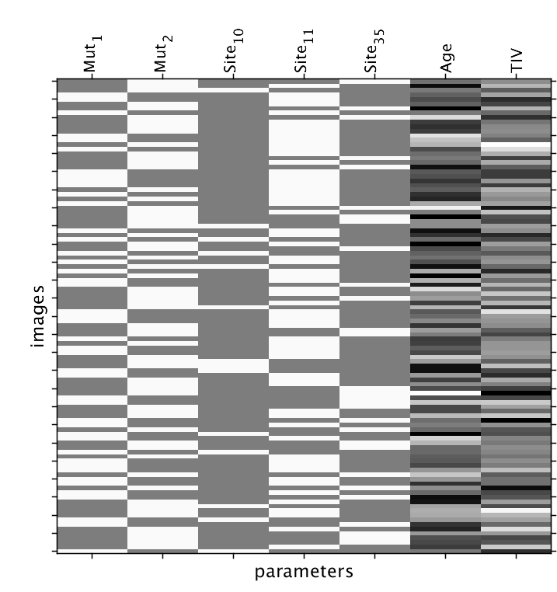
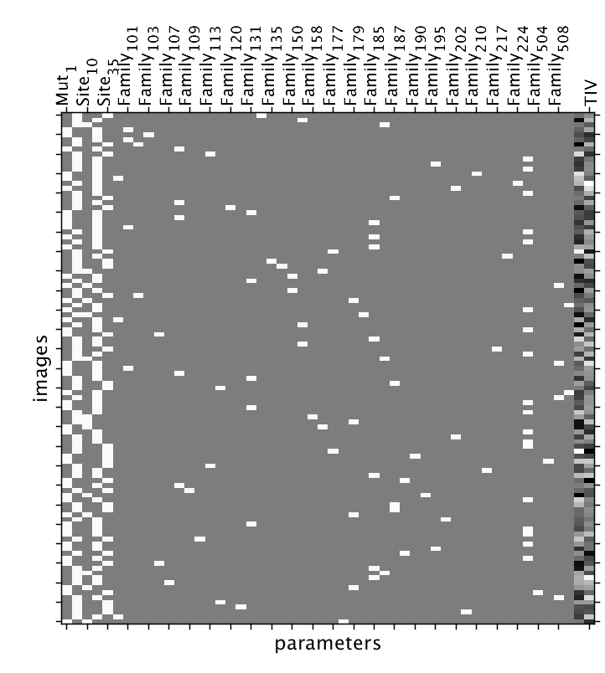
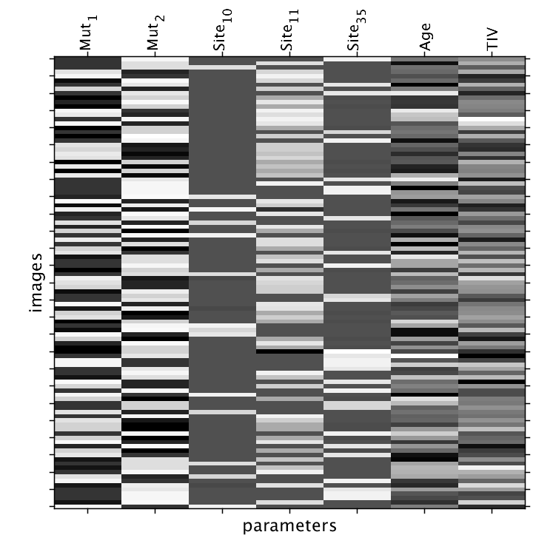
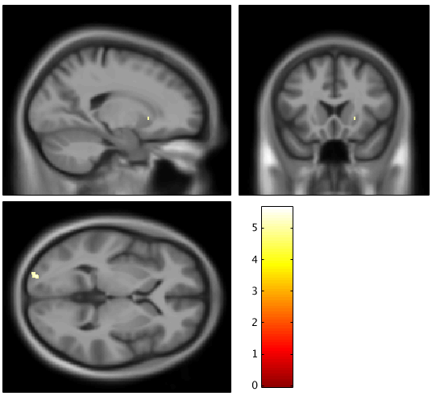
Fig. S4 – Voxel-Based Morphometry (VBM) between NC and MC groups
A
Model without family factor
Model with family factor
Model with family random effect
B
T-values family-wise error (FWE) corrected
Fig. S4 – Voxel-Based Morphometry (VBM) between NC and MC groups
The T1-weighted images were segmented into grey matter, white matter and CSF using SPM (Ashburner & Friston, 2005). Segmentations were then mapped to a template using geodesic shooting (Ashburner & Friston, 20011), warped, modulated and smoothed (6x6x6mm kernel). A – Flexible factorial model to determine any differences in grey matter between NC and MC was used while accounting for variation across sites, age, total intracranial volume (TIV) and family relations. B – SPM analysis results for the contrast NC > MC and p-values family-wise error (FWE) corrected. Few voxels survived the FWE correction except in Left Occipital Pole (T=5.63, p=0.003) and right putamen (T=4.96, p=0.038).
Scale bar = T-values.

Slide 11
Fig. S5 – Comparison of perfusion models versus MCBP across participants
Fig. S5 – Comparison of the perfusion models versus MCBP across participants.
Scatter plots between PiB-R1 and MCBP (top), and between ePiB and MCBP (bottom) in the precuneus (left panel), the inferior parietal (middle panel), and the hippocampus (right panel). Across all the 110 participants the ePiB positively correlated with MCBP in the precuneus and the inferior parietal.

