Slide 1
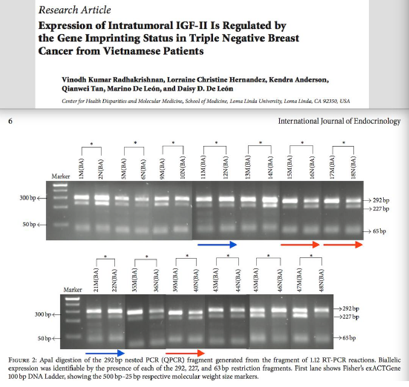
Allegation

Slide 2
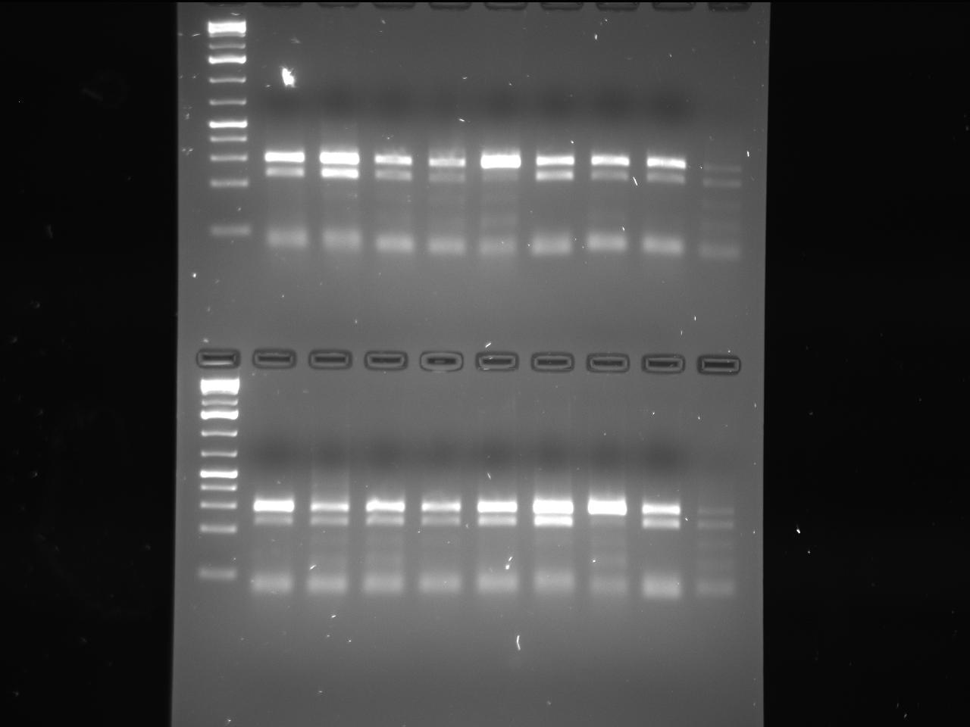
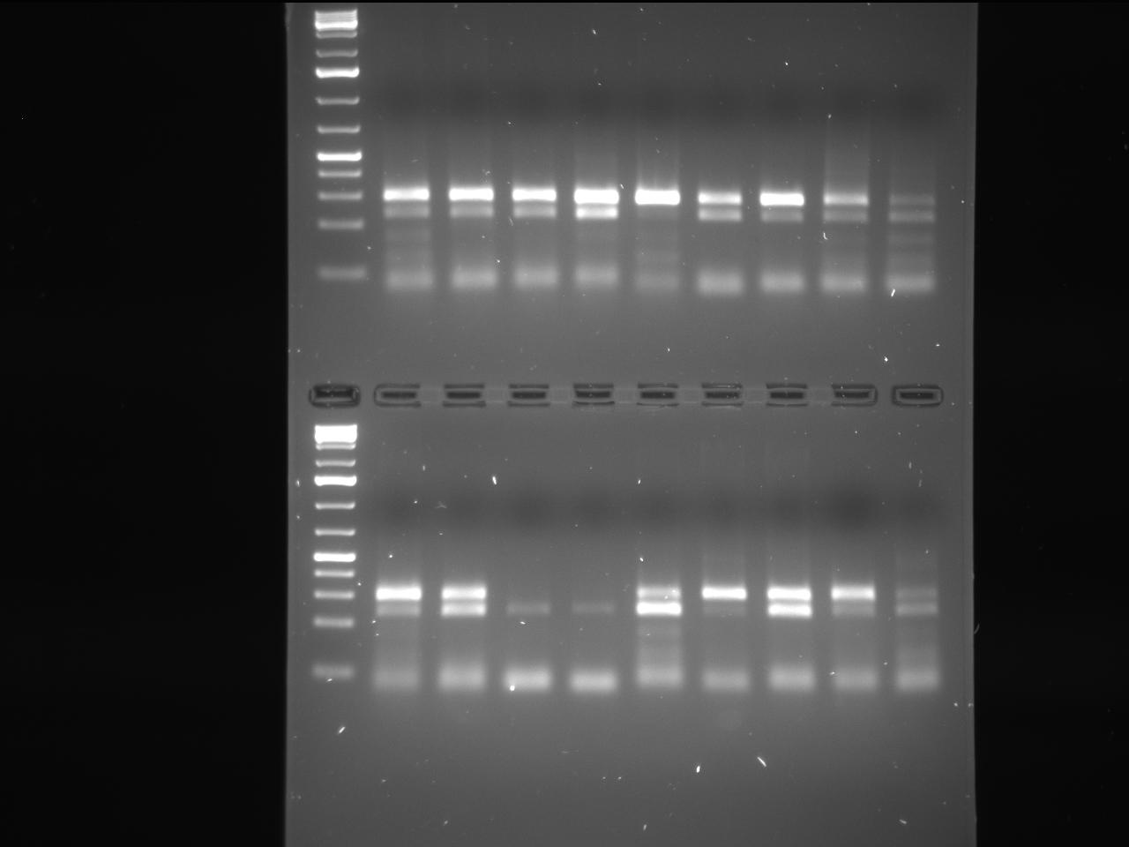
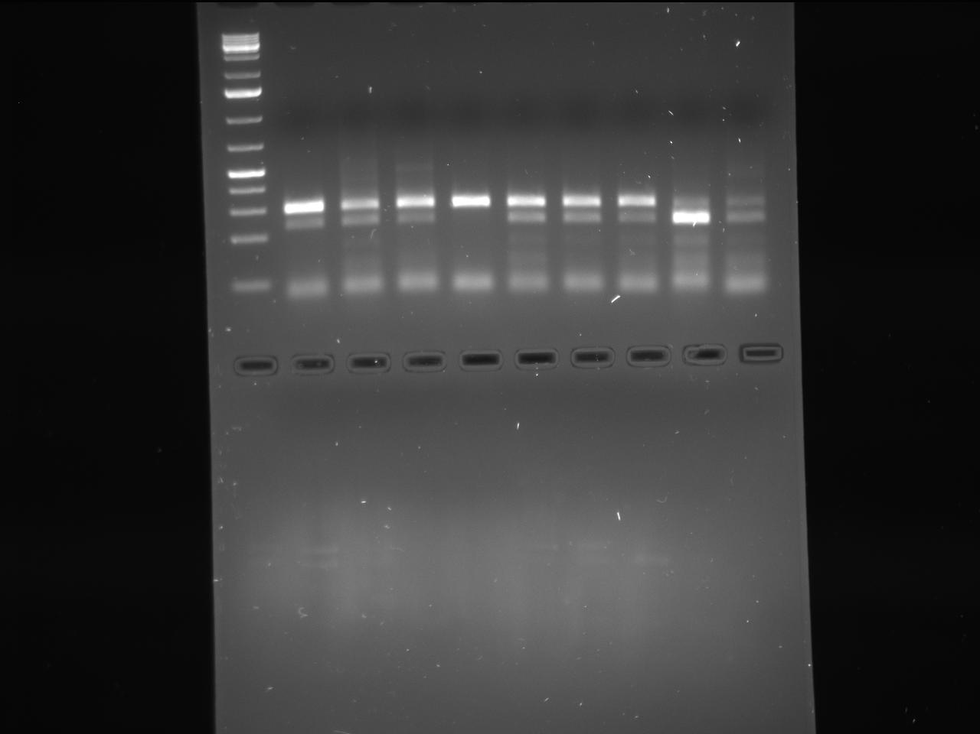
Raw Scanned data File generated after experiments from Gel Doc system
Gel 1
Gel 2
Top Gel
Top Gel
Bottom
Gel
Bottom Gel
Gel 3
Top Gel

Slide 3
Labeled Scanned data File generated after experiments from Gel Doc system
Gel 1
Gel 2
Top Gel
Gel 2
Marker
Top Gel
12N(BA)
14N(BA)
6N(MA)
11M(BA)
13M(BA)
5M(MA)
33M(BA)
1M(BA)
10N(BA)
43M(BA)
2N(BA)
9M(BA)
3N(MA)
34N(BA)
23M(MA)
44N(BA)
25M(BA)
26N(BA)
Marker
Marker
15M(BA)
19M(MA)
39M(BA)
41M(MA)
31M(MA)
48N(BA)
16N(BA)
21M(BA)
40N(BA)
17M(BA)
22N(BA)
42N(MA)
31N(BA)
18N(BA)
25M(BA)
45M(BA)
47M(BA)
26N(BA)
Marker
Bottom
Gel
Marker
Bottom Gel
Gel 3
Top Gel
36N(BA)
27M(MA)
29M(MAS)
35M(BA)
37M(BA)
39M(BA)
40N(BA)
46N(BA)
32N(BA)
Marker

Slide 4
Samples are named from the above respective Gel (1,2, and 3) Top and Bottom gels
*
*
*
*
*
*
Marker
1M(BA)
5N(MA)
3N(MA)
9M(BA)
10N(BA)
Marker
11M(BA)
14N(BA)
23M(MA)
44N(BA)
Gel 2
Top Gel
2N(BA)
6M(MA)
12N(BA)
13M(BA)
43M(BA)
300bp
292bp
300bp
292bp
227bp
227bp
Gel 1
Top Gel
65bp
65bp
*
*
*
*
*
$
27M(MA)
29M(MAS)
35M(BA)
36N(BA)
39M(BA)
46N(BA)
Marker
16N(BA)
37M(BA)
40N(BA)
15M(BA)
17M(BA)
18N(BA)
21M(BA)
22N(BA)
19M(MA)
Marker
300bp
292bp
300bp
292bp
Gel 3
Top Gel
227bp
227bp
Gel 1
Bottom Gel
65bp
65bp
*
*
*
Error while cropping and naming
the gel
$
Error while cropping and naming
the gel
39M(BA)
40N(BA)
41M(MA)
45M(BA)
Marker
31M(MA)
47M(BA)
42N(MA)
48N(BA)
300bp
292bp
227bp
Gel 2
Bottom Gel
Allegation Answer’s:
65bp
292bp
227bp
Since we have cropped all the double bands for biallelic samples and generating the respective images for Journal publication and placing them in the final image error occurred while generating the final image for sample (17,18) (21,22) (39,40) and above is the exact original gels what we have used and all the respective double band sample are biallelic, what we should have used for publication and discussion and this does not change the data anyways. The erratum can be raised to the journal and get it updated in the published journal if needed.
65bp

Slide 5
Allegation Figure2, Same highlighted bands marked in the below cropped gels are used duplicated for sample (11, 12) to (21 ,22) and triplicated for
samples (15,16) (17,18) and (39,40) in the Figure 2
*
*
*
*
*
*
*
Marker
1M(BA)
2N(BA)
5M(BA)
6N(BA)
9M(BA)
10N(BA)
11M(BA)
12N(BA)
13M(BA)
14N(BA)
15M(BA)
16N(BA)
17M(BA)
18N(BA)
300bp
292bp
227bp
50bp
65bp
Right Cropped
Right Cropped
Wrong Cropped
*
*
*
*
*
*
Marker
21M(BA)
22N(BA)
35M(BA)
36N(BA)
39M(BA)
40N(BA)
43M(BA)
44N(BA)
45M(BA)
46N(BA)
47M(BA)
48N(BA)
300bp
292bp
227bp
50bp
65bp
Wrong Cropped
Wrong Cropped

