Slide 1
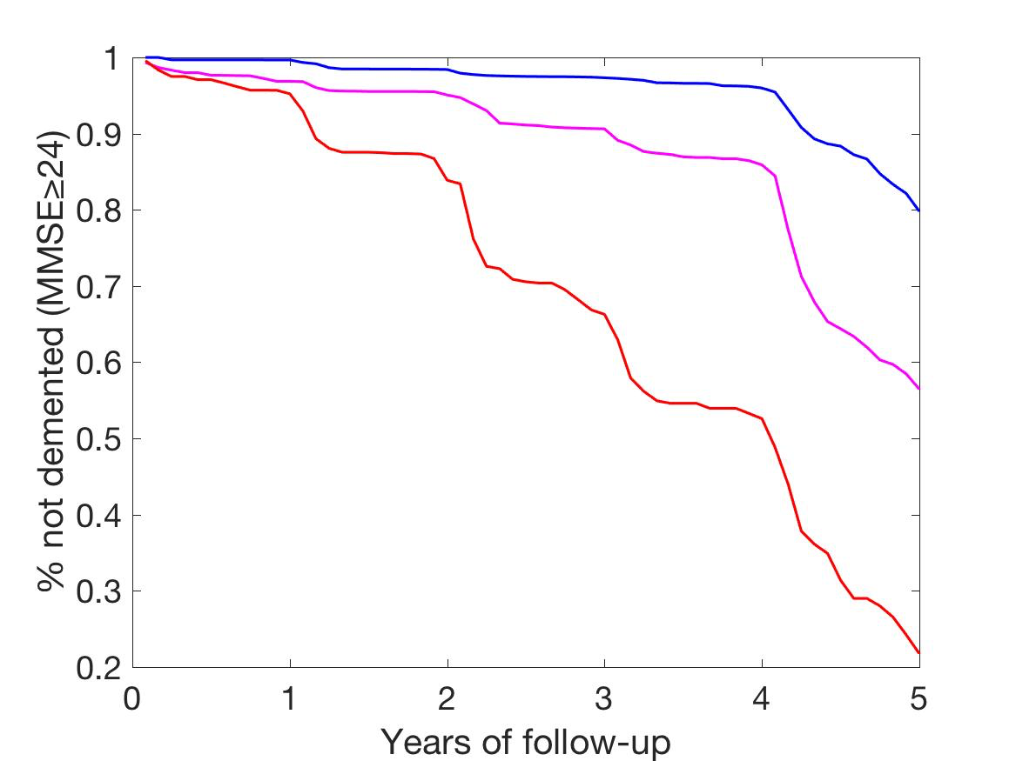
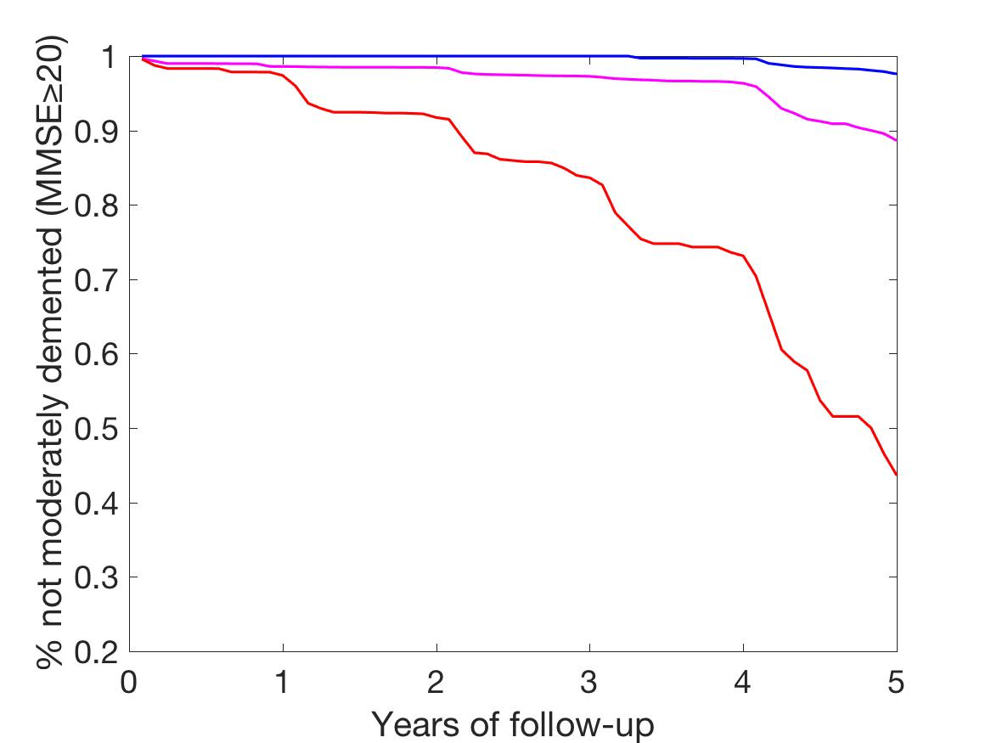
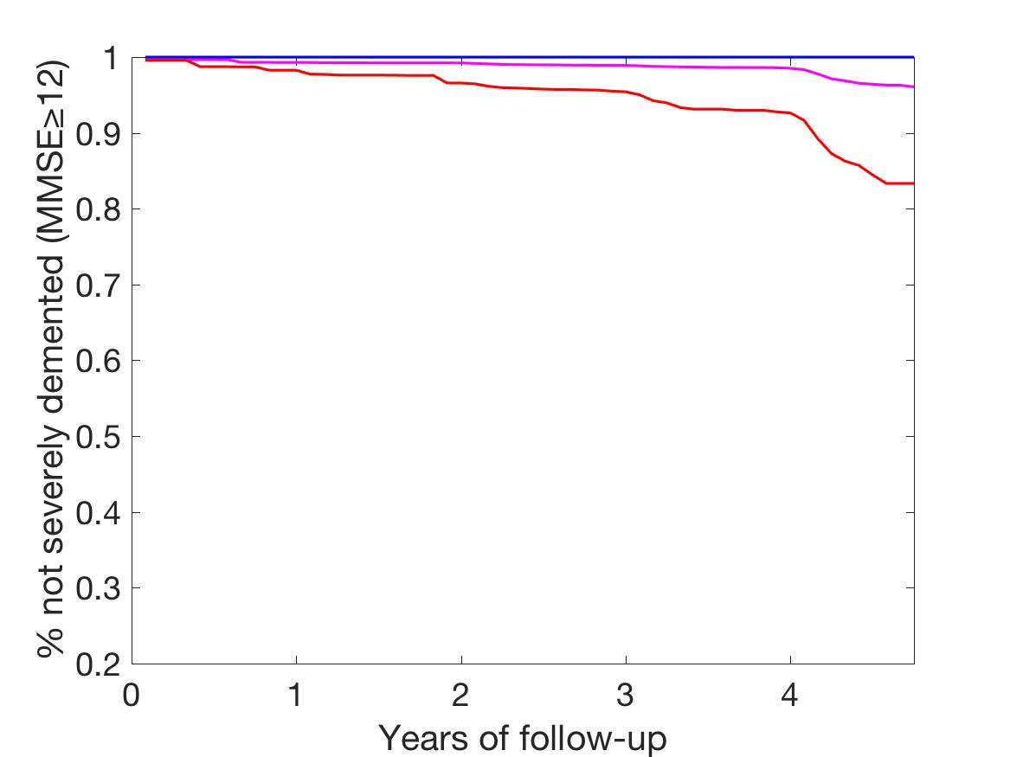
Mild Dementia
1216 non-demented individuals at baseline: 643CN and 573MCI
PET stages defined at baseline
Stage 0: low cortical, low striatal Aβ
Stage 1: high cortical, low striatal Aβ
Stage 2: high cortical, high striatal Aβ
Median Follow-up: 3.2 years
Moderate Dementia
Severe Dementia

