Slide 1
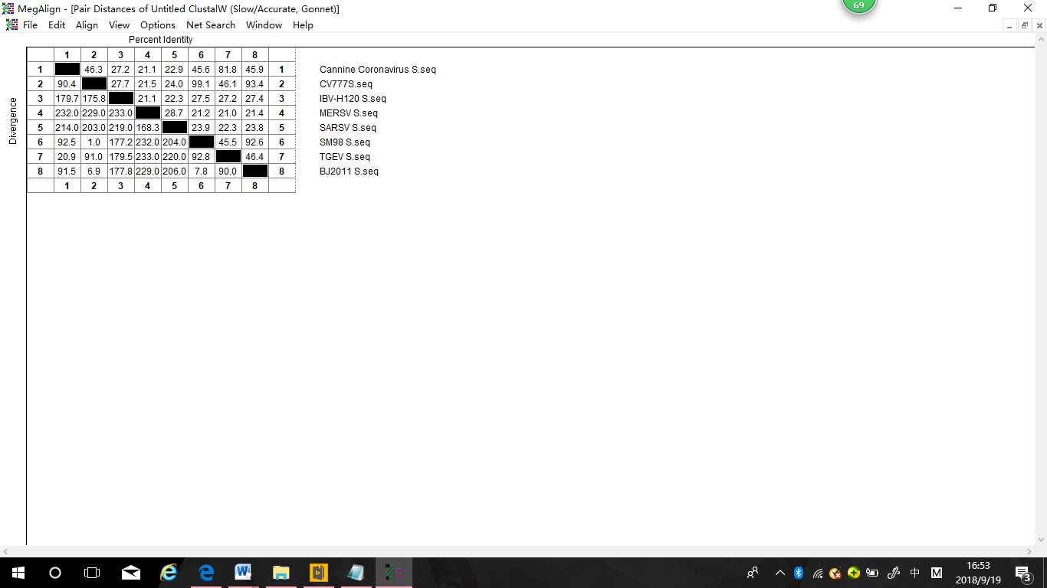
Fig. Sequence Distances and Phylogenetic Tree of Coronavirus S protein
A
B
Notes:
(A) Homology of S protein amino acid sequences divergent greatly, amongst PEDV CV777,SM98 and BJ2011 strains are 92.6%-99.1%, while amongst Cannine coronavirus,IBV,MERS,SARS,TGEV are 21.1%-81.8%;(B) The phylogenetic tree shows the genetic distance between these Coronaviruses.

