Slide 1
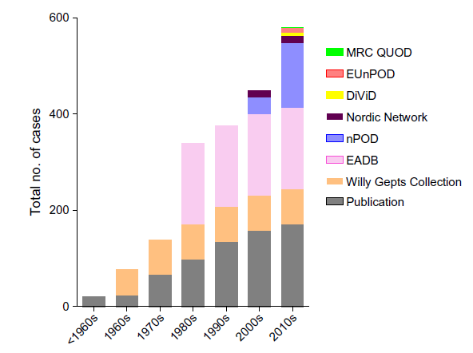
Cumulative number of type 1 diabetes cases that have become available for study over the past 50 years
Morgan and Richardson (2018) Diabetologia DOI 10.1007/s00125-018-4731-y
© The Authors. Distributed under the terms of the CC BY 4.0 Attribution License (http://creativecommons.org/licenses/by/4.0/)

Slide 2
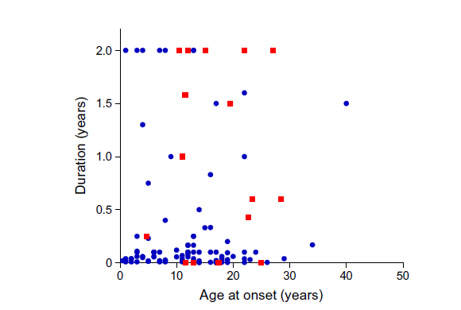
Comparison of pancreas samples available from donors with recent-onset (≤ 2 years)
type 1 diabetes in the two largest collections available for study
nPOD
EADB
Morgan and Richardson (2018) Diabetologia DOI 10.1007/s00125-018-4731-y
© The Authors. Distributed under the terms of the CC BY 4.0 Attribution License (http://creativecommons.org/licenses/by/4.0/)

Slide 3
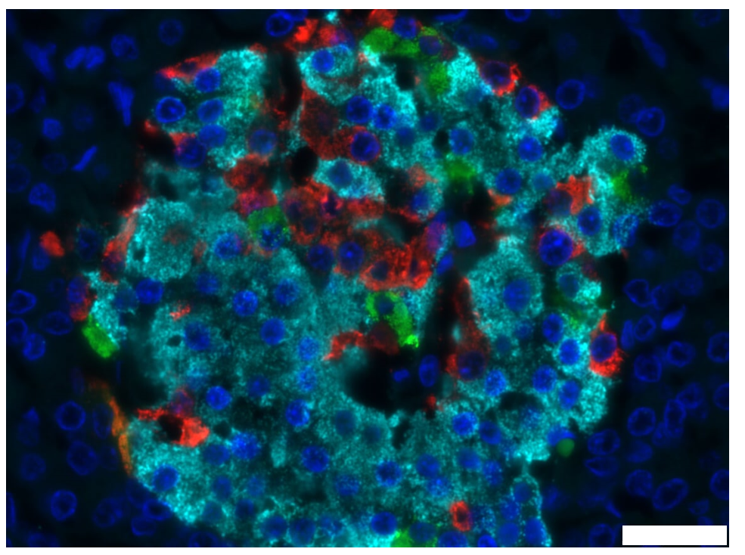
Cellular composition of a human islet of Langerhans from a healthy individual
Scale bar, 25 μm
Morgan and Richardson (2018) Diabetologia DOI 10.1007/s00125-018-4731-y
© The Authors. Distributed under the terms of the CC BY 4.0 Attribution License (http://creativecommons.org/licenses/by/4.0/)

Slide 4
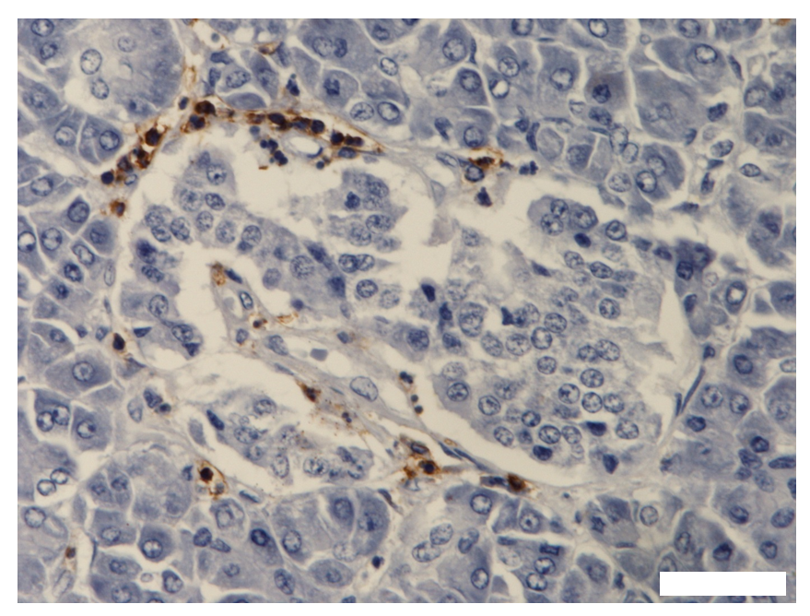
Example of an inflamed islet from a child newly diagnosed with type 1 diabetes
Scale bar, 20 μm
Morgan and Richardson (2018) Diabetologia DOI 10.1007/s00125-018-4731-y
© The Authors. Distributed under the terms of the CC BY 4.0 Attribution License (http://creativecommons.org/licenses/by/4.0/)

