Slide 1
 |  | DLD1 | HCT116 | LoVo
Condition | Phase | % | % | %
Control 0h (at the time of treatment) | G1 | 41.3 | 37.2 | 33.4
 | S | 37.6 | 46.7 | 37.2
 | G2 | 19.1 | 14.3 | 21.0
Control 24h | G1 | 53.1 | 42.9 | 47.7
 | S | 35.1 | 37.1 | 32.9
 | G2 | 10.6 | 18.4 | 14.6
Control 48h | G1 | 59.7 | 65.5 | 67.4
 | S | 33.6 | 20.8 | 16.1
 | G2 | 13.6 | 11.3 | 14.4
Crizotinib 24h | G1 | 50.9 | 49.5 | 47.9
 | S | 31.2 | 31.3 | 30.3
 | G2 | 17.2 | 18.3 | 16.8
Crizotinib 48h | G1 | 42.2 | 69.7 | 69.8
 | S | 37.3 | 18.0 | 19.0
 | G2 | 17.2 | 8.7 | 10.7
RT (4 Gy) 24h | G1 | 25.4 | 40.7 | 33.3
 | S | 28.7 | 25.3 | 17.6
 | G2 | 32.0 | 27.5 | 41.0
RT (4 Gy) 48h | G1 | 35.4 | 59.2 | 61.0
 | S | 37.1 | 17.9 | 9.9
 | G2 | 18.7 | 13.6 | 23.3
Crizotinib 1h -> RT -> 4h wash (cell cycle at 24h) | G1 | 28.8 | 30.6 | 32.6
 | S | 38.6 | 44.0 | 19.3
 | G2 | 25.5 | 20.3 | 44.4
Crizotinib 1h ->RT (cell cycle at 24h) | G1 | 30.6 | 44.8 | 40.8
 | S | 27.8 | 29.8 | 13.6
 | G2 | 33.2 | 19.3 | 40.9
Crizotinib 24h -> RT 4Gy (24h) ( total 48h) | G1 | 19.8 | 65.4 | 44.9
 | S | 21.4 | 6.4 | 9.4
 | G2 | 47.2 | 23.8 | 43.4
Suppl Table

Slide 2
1
0.9
n
o
i
t
c
a
0.8
r
F
Surviving Fraction
g
n
LoVo
i
v
i
v
0.7
r
u
S
HCT116
0.6
DLD1
0.5
0.5
0
20
40
60
80
100
Cetuximab (ug/ml)
Cetuximab μg/ml
Figure S1

Slide 3
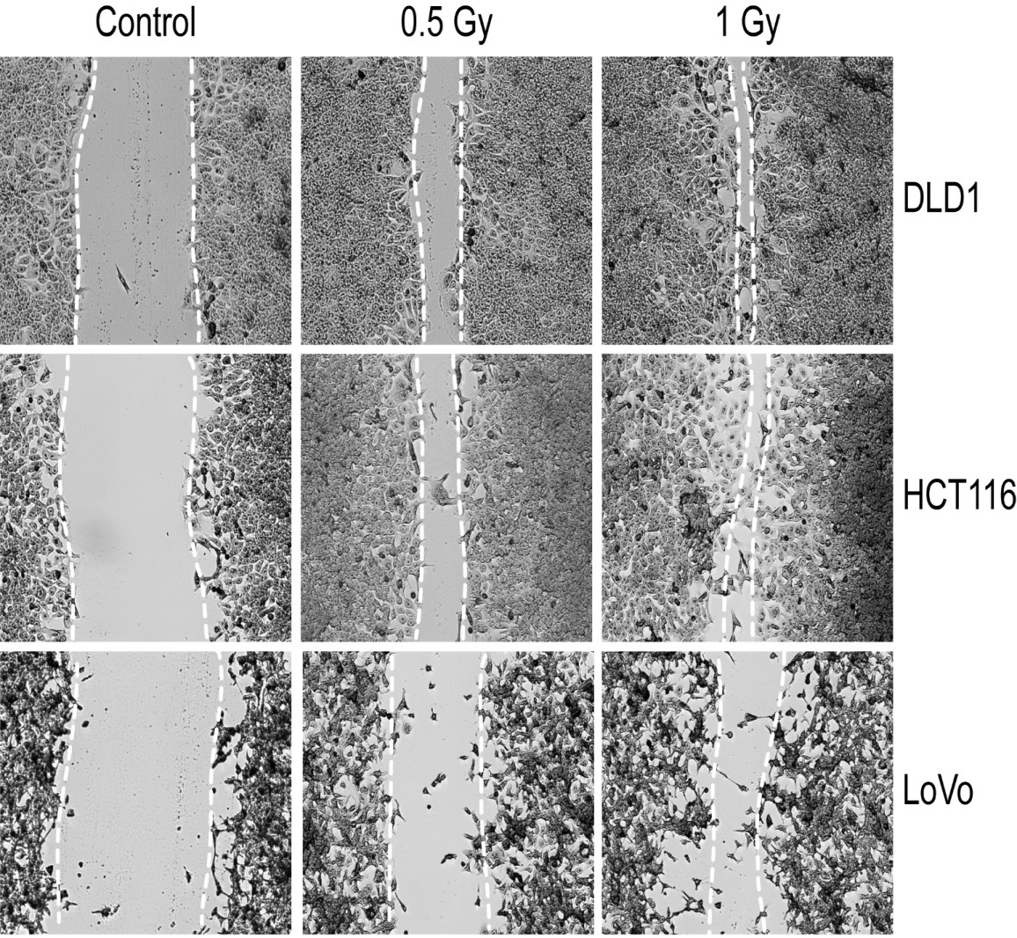
Figure S2

Slide 4
Supplemental Figure Legends
Figure S1. Effects of cetuximab on KRAS-mutant colorectal cancer cells lines. Three colorectal cancer cell lines with KRAS mutations were treated with different concentrations of cetuximab. The number of surviving colonies was determined for each cell line at various concentrations of cetuximab. All three cells lines tested were resistant to cetuximab.
Figure S2. Three colorectal cancer cell lines were plated and grown to approximately 80% confluency. A wound on the plate was created then the plates were treated with the indicated doses of radiation therapy. The plates were imaged 24 hours later. Low doses of radiation increased the migration of all cell lines tested.

