Slide 1
Supplementary Figure 1
PBMC
Cryopreservation
Batch staining
PBMC
CD3+ cells
CD3- cells
T cells
Non-T cells
CD4+
CD8+
TCRγδ+
CD19+
CD56+
CD14+
Th cell
Tc cell
γδ T cell
B cell
NK cell
Monocyte
CD45RO+
CD45RA+
CD16+
CD16-
Memory
Naïve
CD40, CD54, CD86,
HLA-DR
CD25^{low}
CD127+
CD25+
CD127^{low}
Activated monocyte
Treg
IL-17+ cells
IFNγ+ cells
TNFα+ cells
IL-10+ cells
FOXP3+
FOXP3-
Supplementary Figure 1. Preparation of PBMC from patients with periodontitis and healthy volunteers and identification of immune cell subsets by antibody staining. PBMC were isolated from peripheral blood from patients with periodontitis and healthy volunteers. Isolated PBMC were cryopreserved for batch staining at a later date. Upon thawing, PBMC were stained with fluorochrome-conjugated antibodies against the indicated markers for identification of immune cell subsets as indicated.
Cheng et al. Supplemental Figure 1

Slide 2
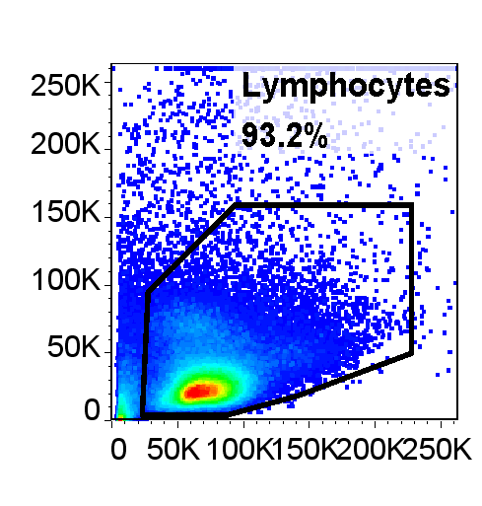
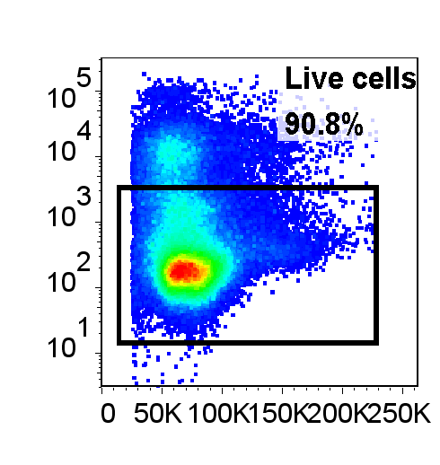
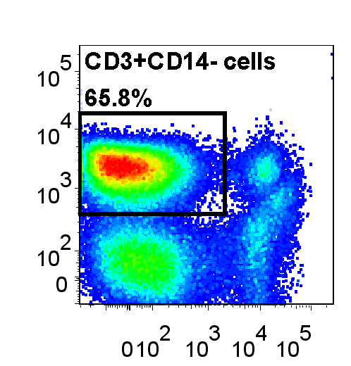
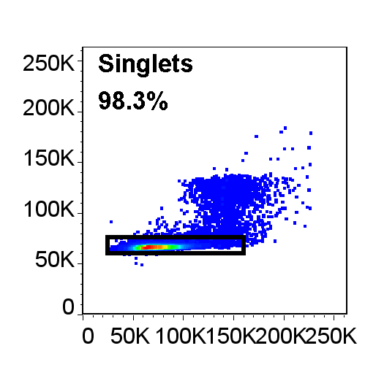
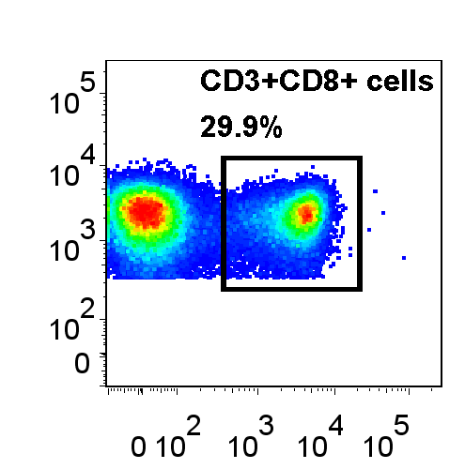
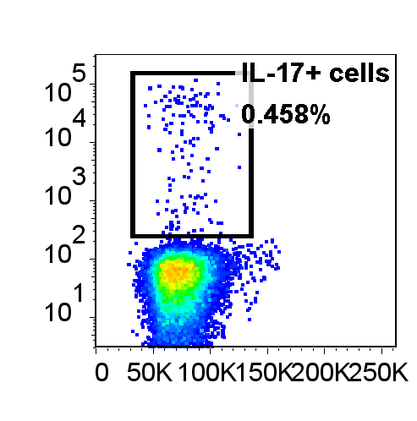
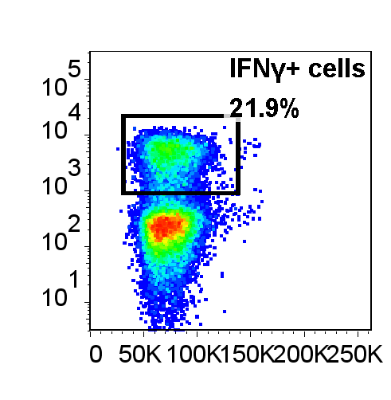
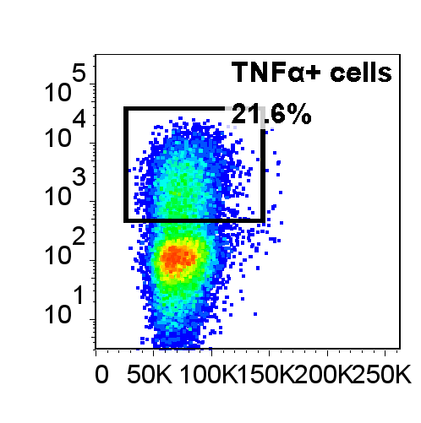
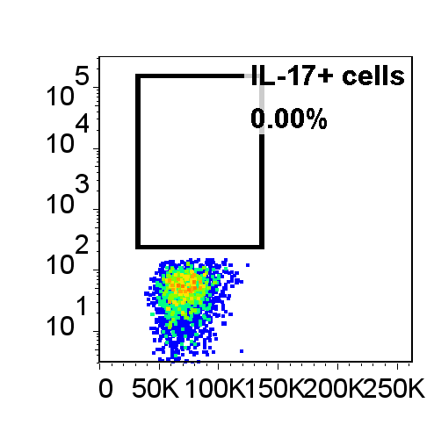
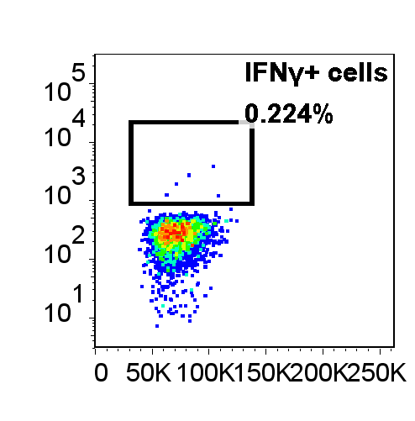
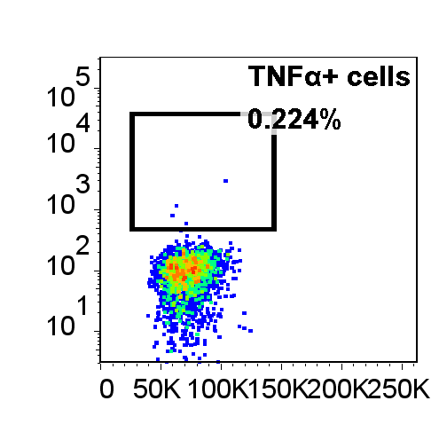
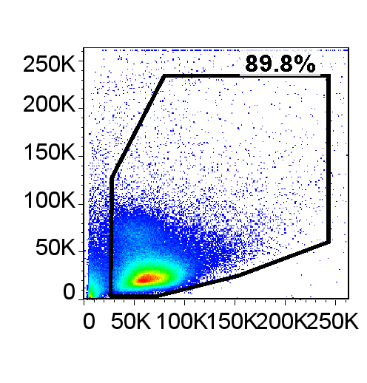
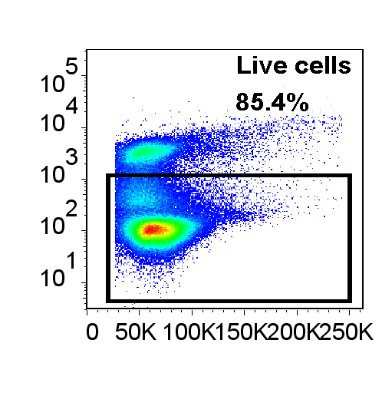
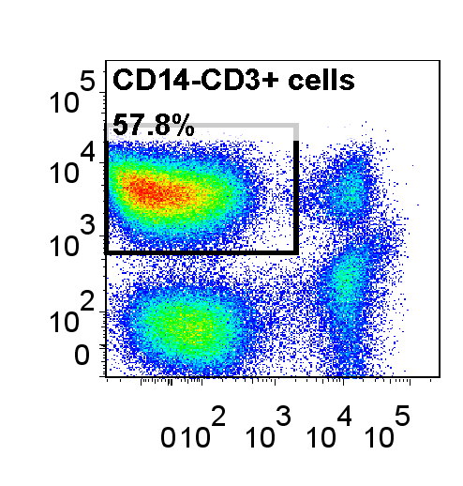
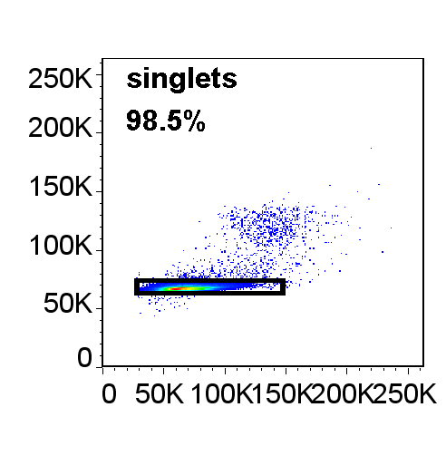
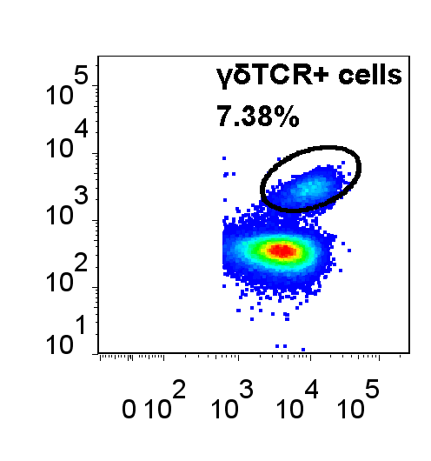
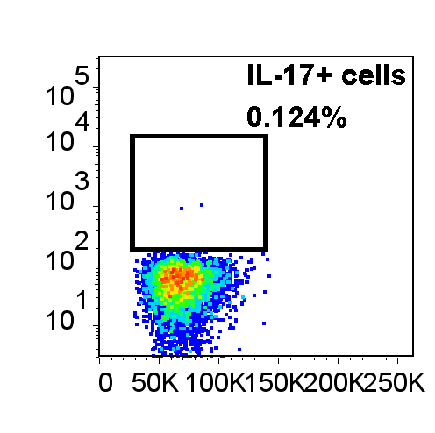
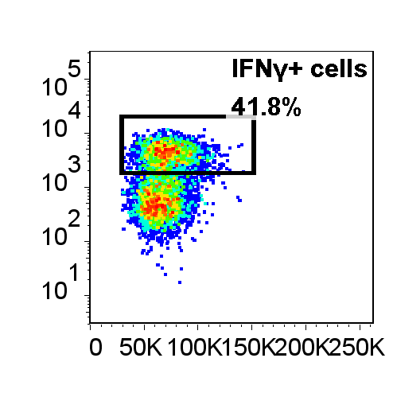
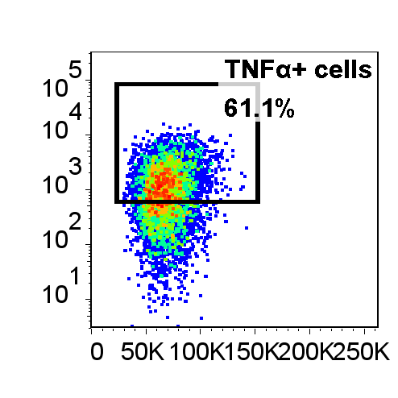
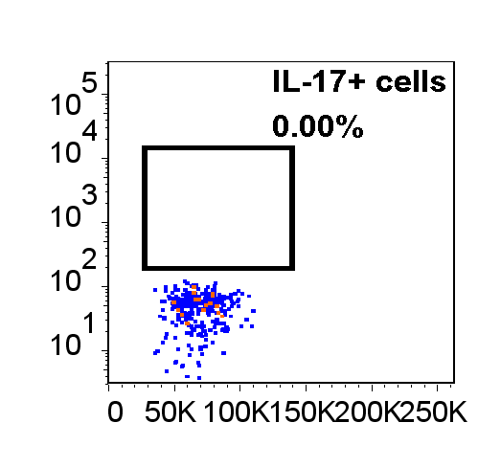
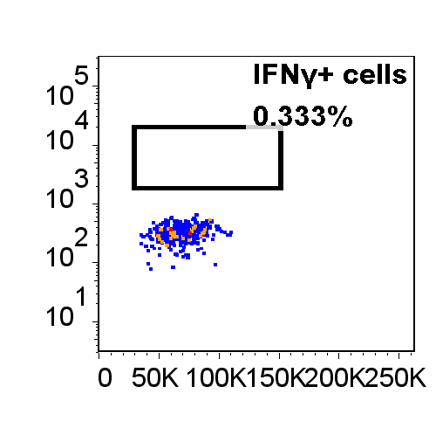
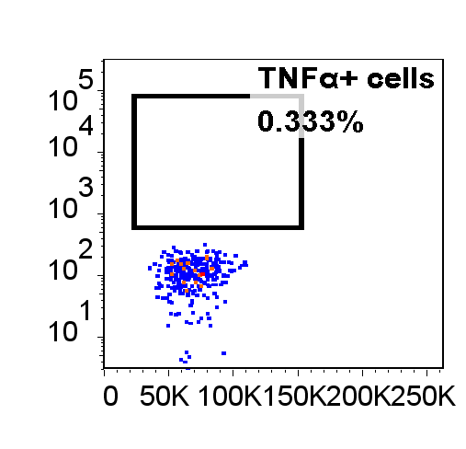
Supplementary Figure 2
A
SSC-A
Live/dead
FSC-W
CD3
CD3
FSC-A
FSC-A
CD14
FSC-A
CD8
TNFα
Cytokine stain
IL-17
IFNγ
FSC-A
FSC-A
FSC-A
IL-17
IFNγ
TNFα
FMO
FSC-A
FSC-A
FSC-A
B
SSC-A
Live/dead
FSC-W
CD3
CD3
FSC-A
FSC-A
CD14
FSC-A
CD8
TNFα
Cytokine stain
IL-17
IFNγ
FSC-A
FSC-A
FSC-A
IL-17
IFNγ
TNFα
FMO
FSC-A
FSC-A
FSC-A
Supplementary Figure 2. Gating strategy to identify IL-17, IFNγ or TNFα producing CD8+ or γδ T-cells in PBMC. PBMC were isolated from peripheral blood from patients with chronic periodontitis (CP, n=15) or aggressive periodontitis (AP, n=15) as well as periodontally healthy controls (HC, n=13). Cells were stimulated ex vivo with PMA and ionomycin for 3 hours prior to intracellular cytokine staining. A gate was set on cells that stained positive for the cytokines IL-17, IFNγ or TNFα, and subsequently the percentages of CD3+CD8+ (A) and CD3+γδ+ T cells (B) within these gates were determined. Representative gating strategy and typical dot plots for the CD3+CD8+ or γδ T cells within the cytokine-positive cells are shown.
Cheng et al. Supplemental Figure 2

