Slide 1
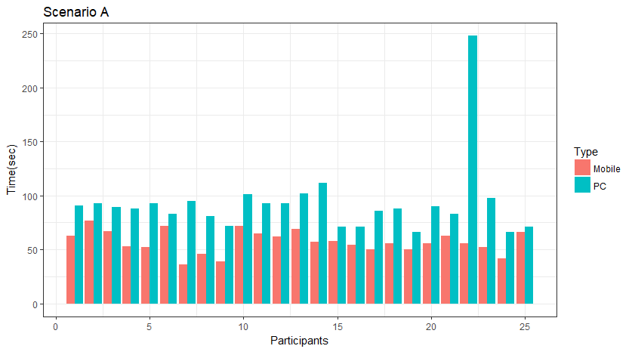
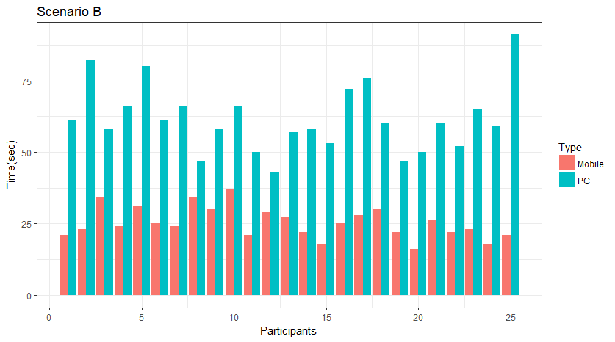
Appendix 3. Graphical comparison between mobile and PC scenario time of all participants.

