Slide 1
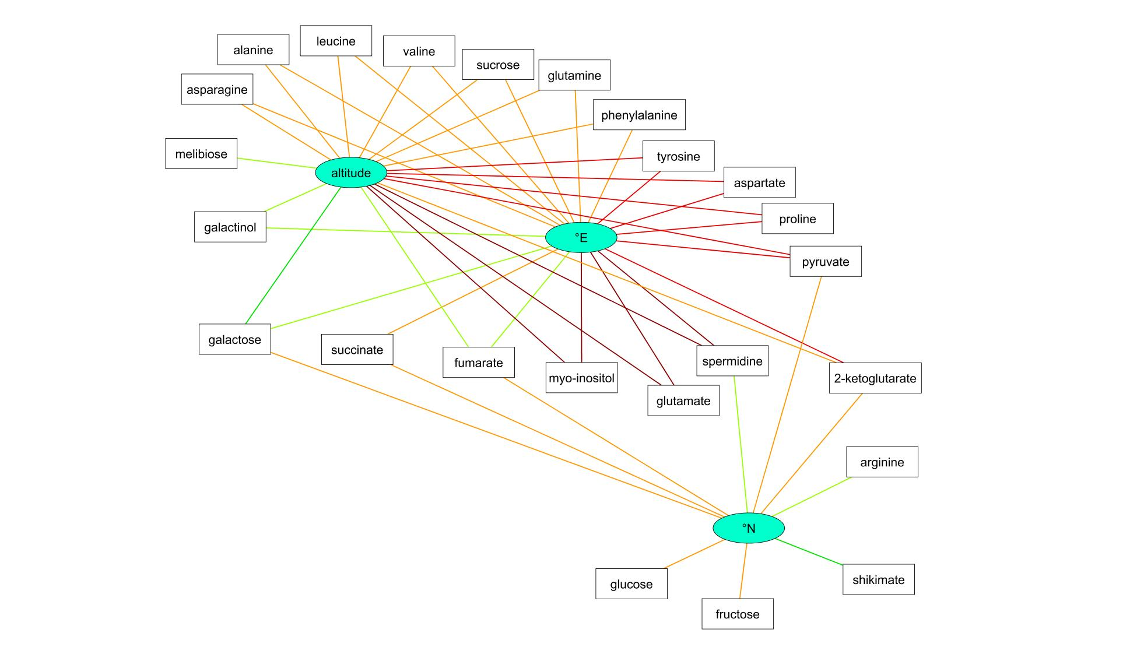
Figure S10: Correlation network of metabolites to three-dimensional geographic coordinates. Colors indicate grouped similarity measures (dark green: moderate negative correlation, green: weak negative correlation, light green: very weak negative correlation, orange: very weak positive correlation, red: weak positive correlation, dark red: moderate positive correlation

