Slide 1
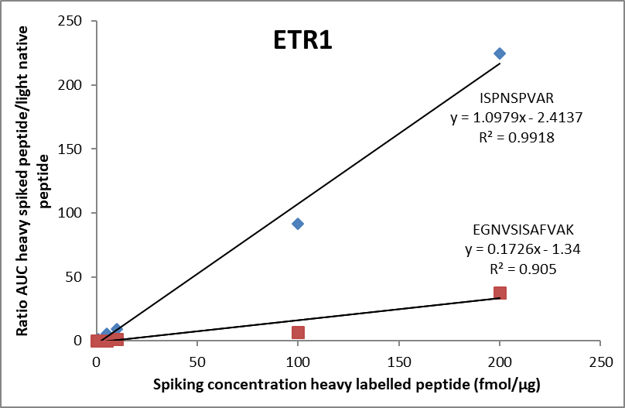
Supplementary figure 1.A
Notes:
Dilution curves for the PRM analysis of 0–200 fmol/μL of the two selected heavy labeled peptides for the protein SlETR1 and linearity expressed by coefficient of determination (R2).

Slide 2
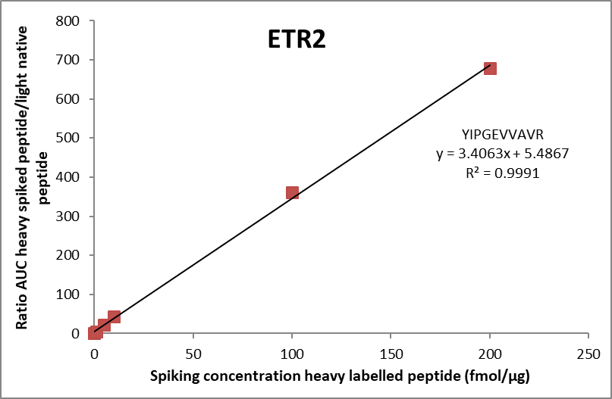
Supplementary figure 1.B
Notes:
Dilution curves for the PRM analysis of 0–200 fmol/μL of the selected heavy labeled peptide for the protein SlETR2 and linearity expressed by coefficient of determination (R2).

Slide 3
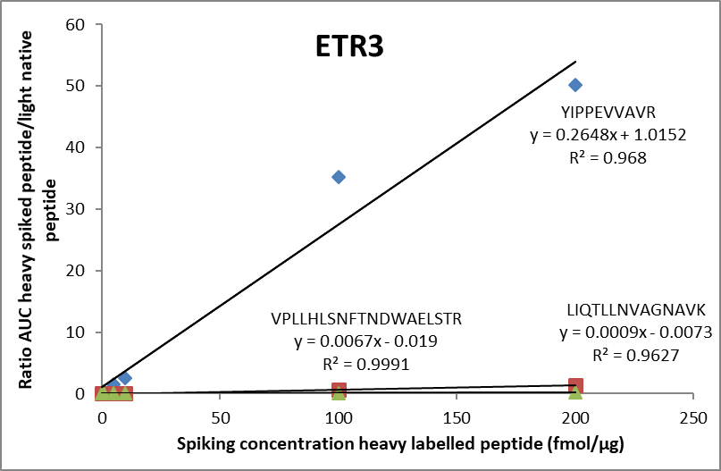
Supplementary figure 1.C
Notes:
Dilution curves for the PRM analysis of 0–200 fmol/μL of the three selected heavy labeled peptides for the protein SlETR3 and linearity expressed by coefficient of determination (R2).

Slide 4
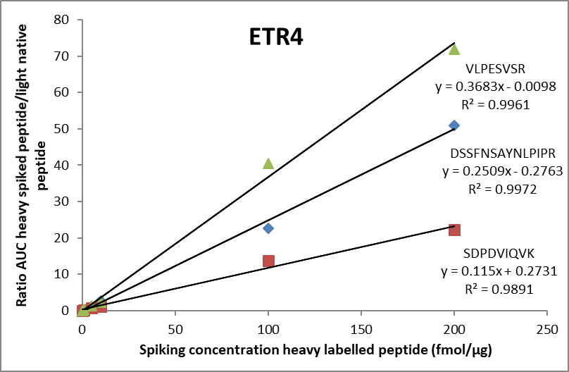
Supplementary figure 1.D
Notes:
Dilution curves for the PRM analysis of 0–200 fmol/μL of the three selected heavy labeled peptides for the protein SlETR4 and linearity expressed by coefficient of determination (R2).

Slide 5
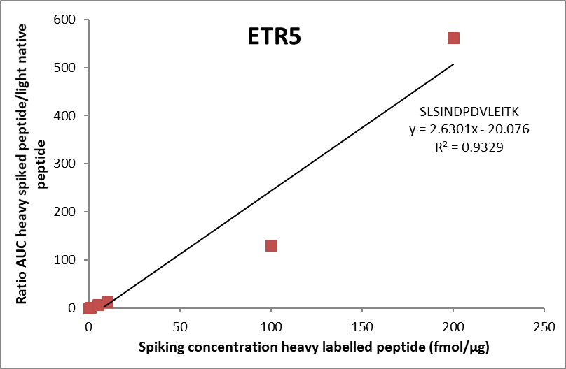
Supplementary figure 1.E
Notes:
Dilution curves for the PRM analysis of 0–200 fmol/μL of the selected heavy labeled peptide for the protein SlETR5 and linearity expressed by coefficient of determination (R2).

Slide 6
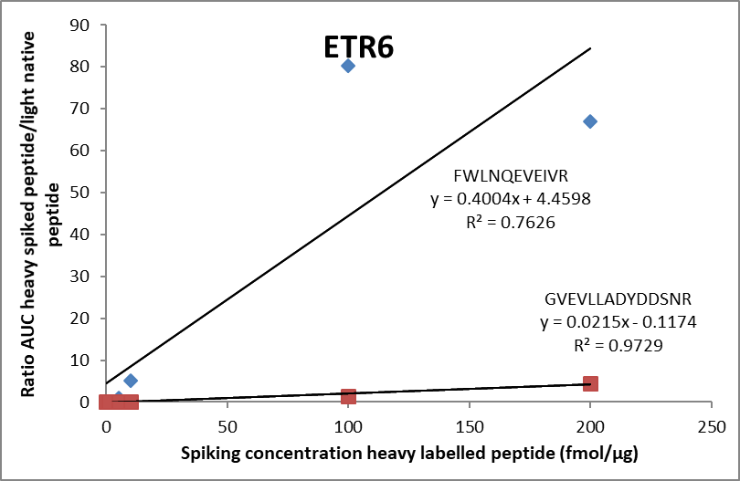
Supplementary figure 1.F
Notes:
Dilution curves for the PRM analysis of 0–200 fmol/μL of the two selected heavy labeled peptides for the protein SlETR6 and linearity expressed by coefficient of determination (R2).

Slide 7
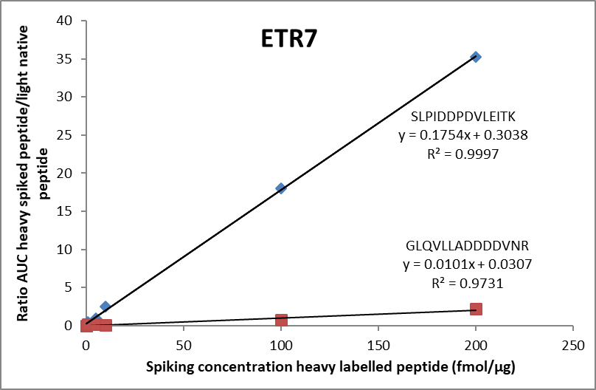
Supplementary figure 1.G
Notes:
Dilution curves for the PRM analysis of 0–200 fmol/μL of the two selected heavy labeled peptides for the protein SlETR7 and linearity expressed by coefficient of determination (R2).

Slide 8
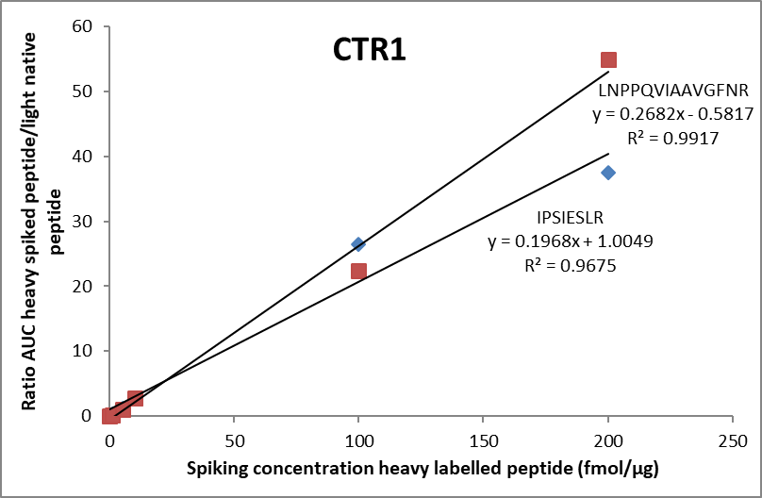
Supplementary figure 1.H
Notes:
Dilution curves for the PRM analysis of 0–200 fmol/μL of the two selected heavy labeled peptides for the protein SlCTR1 and linearity expressed by coefficient of determination (R2).

Slide 9
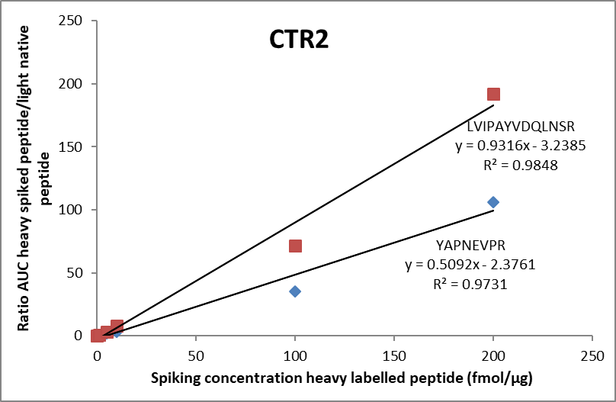
Supplementary figure 1.I
Notes:
Dilution curves for the PRM analysis of 0–200 fmol/μL of the two selected heavy labeled peptides for the protein SlCTR2 and linearity expressed by coefficient of determination (R2).

Slide 10
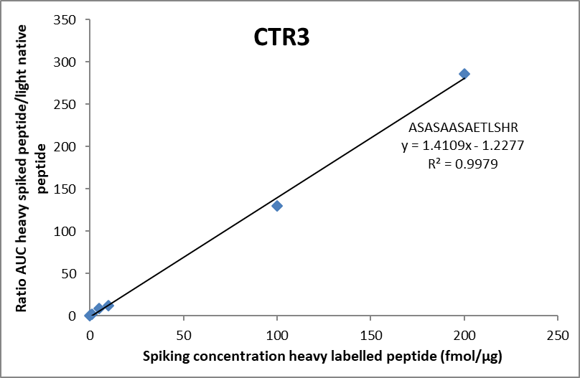
Supplementary figure 1.J
Notes:
Dilution curves for the PRM analysis of 0–200 fmol/μL of the selected heavy labeled peptide for the protein SlCTR3 and linearity expressed by coefficient of determination (R2).

Slide 11
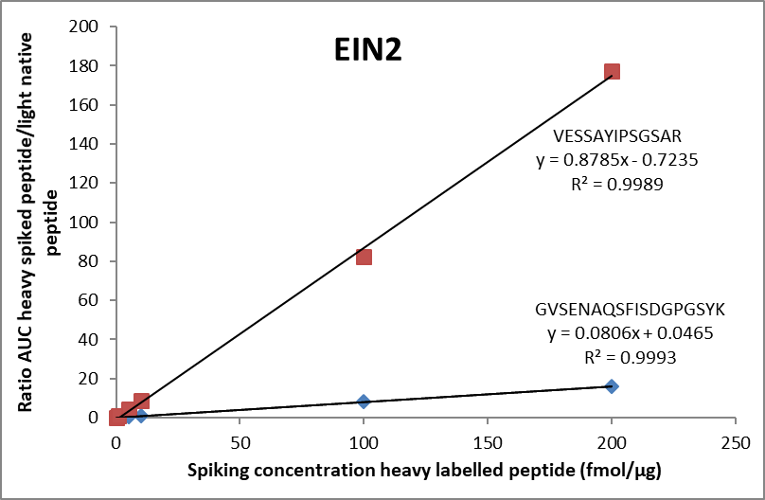
Supplementary figure 1.K
Notes:
Dilution curves for the PRM analysis of 0–200 fmol/μL of the two selected heavy labeled peptides for the protein SlEIN2 and linearity expressed by coefficient of determination (R2).

