Slide 1
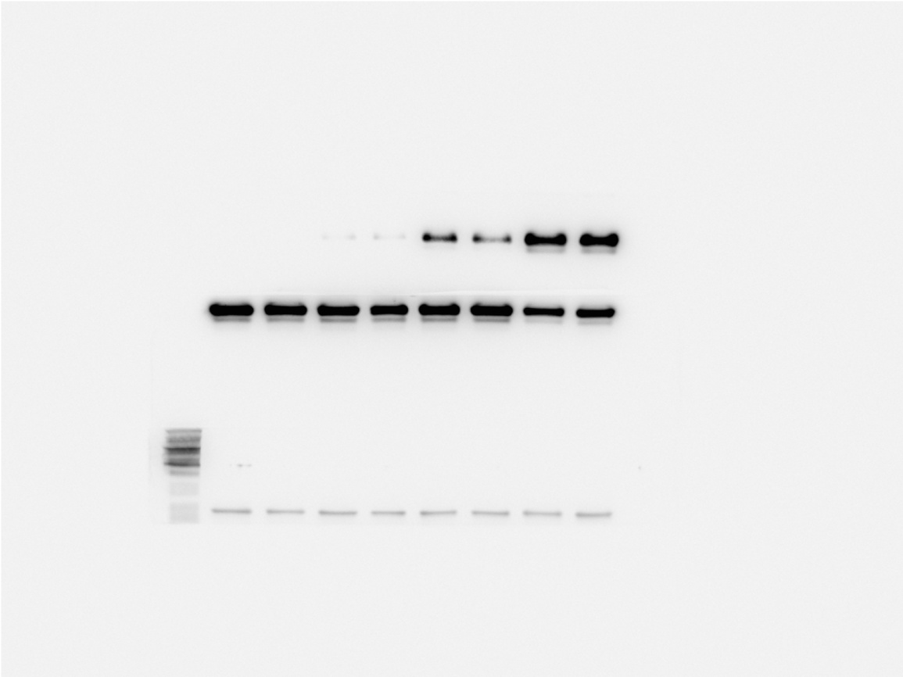
A
0h
4h
12h
24h
HMGB1-s
HMGB1-c
GAPDH
B
10
‡
†
(Fold changes)
5
Supernatant HMGB1/GAPDH
*
0
0h
4h
12h
24h
C
15
10
Intracellular HMGB1/GAPDH
(Fold changes)
5
0
0h
4h
12h
24h
Supplementary Figure 1. Time-course of HMGB1 release in LPS-stimulated macrophages. Cultured RAW 264.7 cells were stimulated with LPS (100 ng/ml). HMGB1 in supernatants (A, B) and cell lysates (A, C) were determined by western blot analysis at 0, 4, 12, and 24 hours after LPS challenge. Data are mean ± SD (n=3). *P＜0.05 vs 0h, †P＜0.05 vs 4h, ‡P＜0.05 vs 12h.

Slide 2
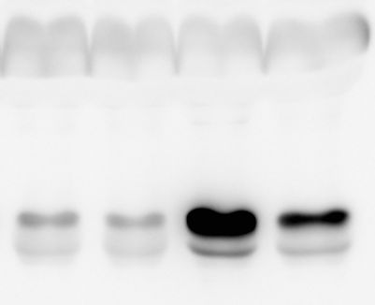
A
B
Macrophages
MCECs
Saline
LPS
3
Vehicle
*
Vehicle
NS-398
Vehicle
NS-398
NS-398
†
2
Caspase-3 activity
(Fold changes)
1
0
SCM
LCM
HMGB1
8
Vehicle
*
NS-398
6
Supernatant HMGB1 level
(Fold changes)
†
4
2
0
Saline
LPS
Supplementary Figure 2. Effects of NS-398 in macrophages and mouse cardiac endothelial cells (MCECs). (A) Macrophages (RAW264.7) were incubated LPS or saline in the presence of NS-398 (30 µM) or vehicle. Twenty-four hours later, HMGB1 release was determined in supernatants by western blot analysis. Upper panel, a representative western blot for HMGB1 protein in 10 µl of supernatants, and lower panel, quantification of HMGB1 protein. (B) MCECs were pretreated with NS-398 (30 µM) or vehicle for 12 hours, and then challenged with a conditioned medium from LPS-stimulated macrophages (LCM) or saline-stimulated medium (SCM). Six hours later, caspase-3 activity was assessed. Data are mean ± SD (n=3). *P＜0.05 vs vehicle + saline or vehicle+SCM, †P＜0.05 vs vehicle + LPS or vehicle + LCM.

Slide 3
4
Vehicle
*
NR (2mM)
†
‡
3
NR (5mM)
(Fold changes)
Caspase-3 activity
2
1
0
SCM
LCM
Supplementary Figure 3. Effect of NR on caspase-3 activity in pulmonary microvascular endothelial cells (PMECs). PMECs were pretreated with NR (2 µM or 5 µM) or vehicle for 12 hours, and then challenged with a conditioned medium from LPS-stimulated macrophages (LCM) or saline-stimulated medium (SCM). Six hours later, caspase-3 activity was assessed. Data are mean ± SD (n=3). *P＜0.05 vs vehicle+SCM, †P＜0.05 vs vehicle + LCM, and ‡P＜0.05 vs LCM + NR (2 µM).

