Slide 1
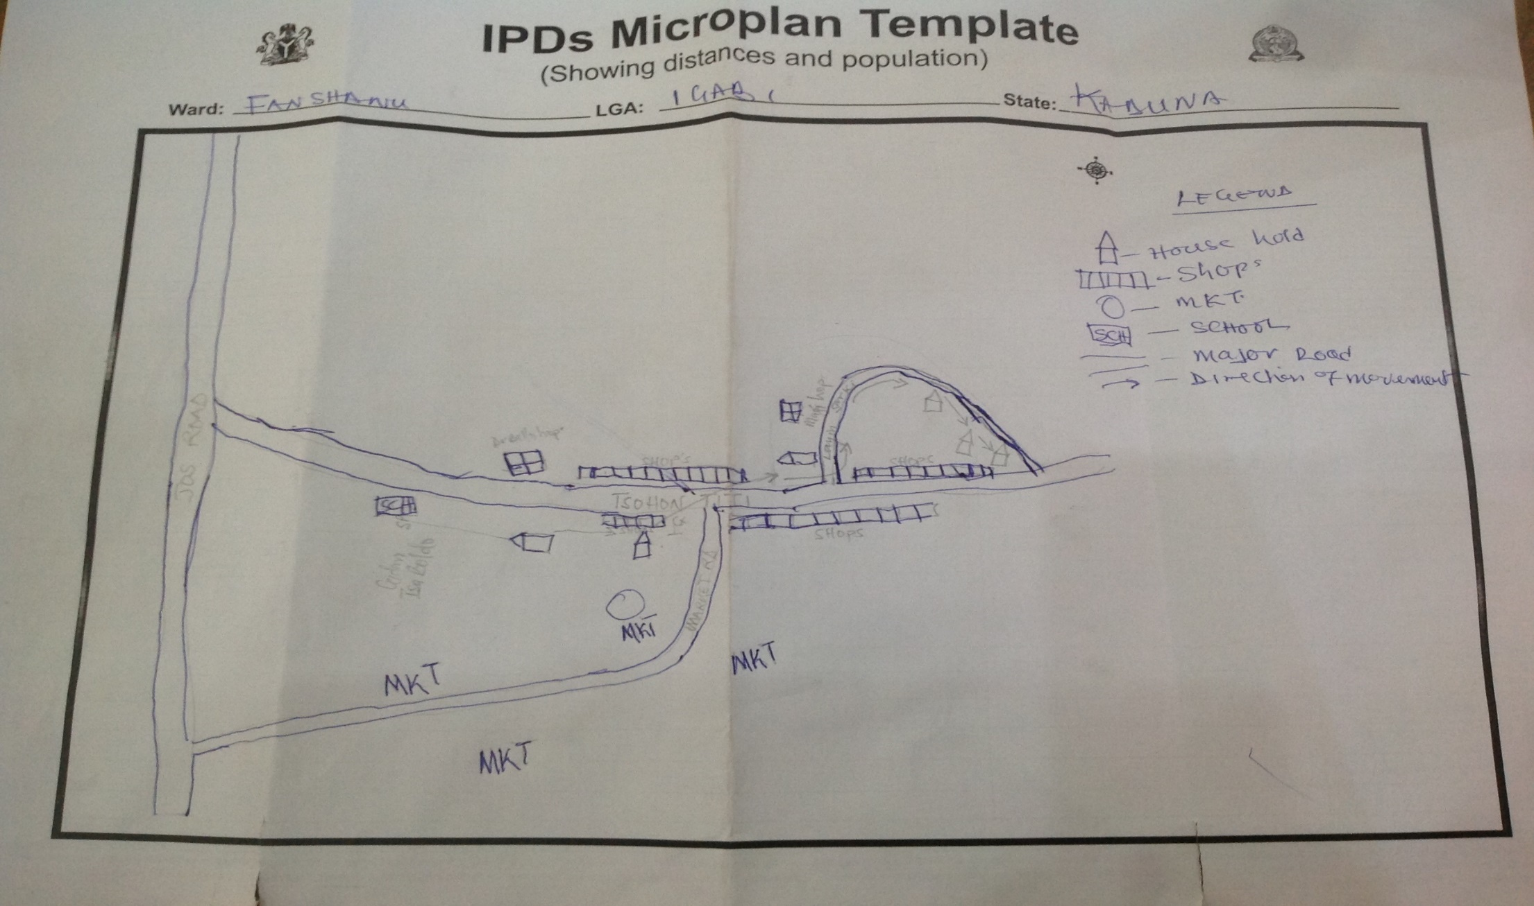
Catchment Area Map

