Slide 1
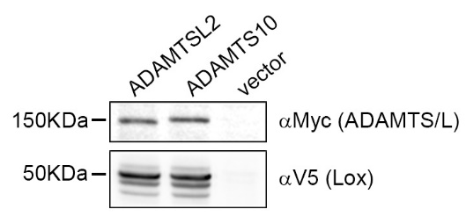
Supp. Figure 1. Expression of ADAMTSL2 and ADAMTS10. HEK293 cells were stably transfected with murine myc tagged ADAMTSL2 plus human V5-tagged LOX, myc-tagged human ADAMTS10 plus V5-tagged LOX, or with empty vector. Western blot of cell lysates is shown for anti-myc (top) and anti-V5 (bottom).

Slide 2
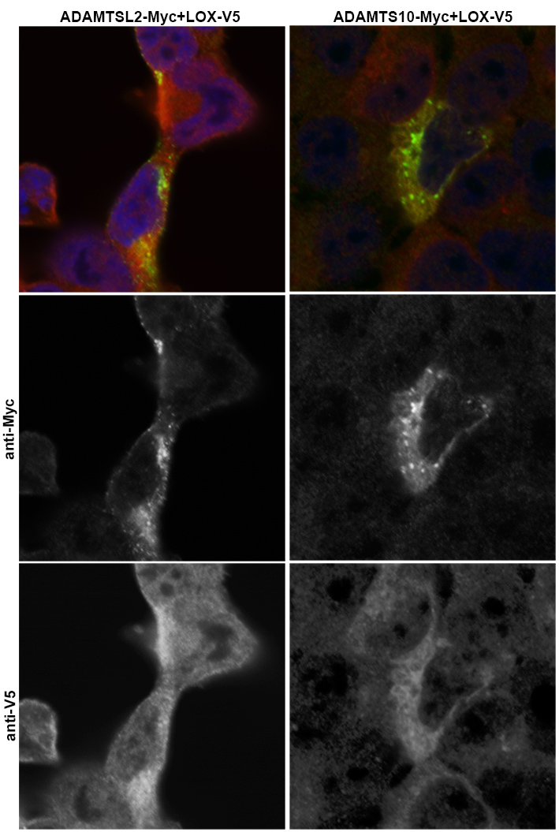
Supp. Figure 2. LOX colocalizes with ADAMTS proteins. Confocal images of HEK293 cells immunostained for V5 and myc highlighting LOX-V5 and ADAMTSL2-myc or ADAMTS10-myc demonstrate that the two proteins colocalize. Note that LOX expression in the cells is wider than that of the ADAMTS protein. Mander's correlation coefficient measuring the colocalization (ratios of 0.5-1.0 suggest two proteins colocalize) demonstrate a value >0.9 for the correlation of the ADAMTS protein vs. LOX.

Slide 3
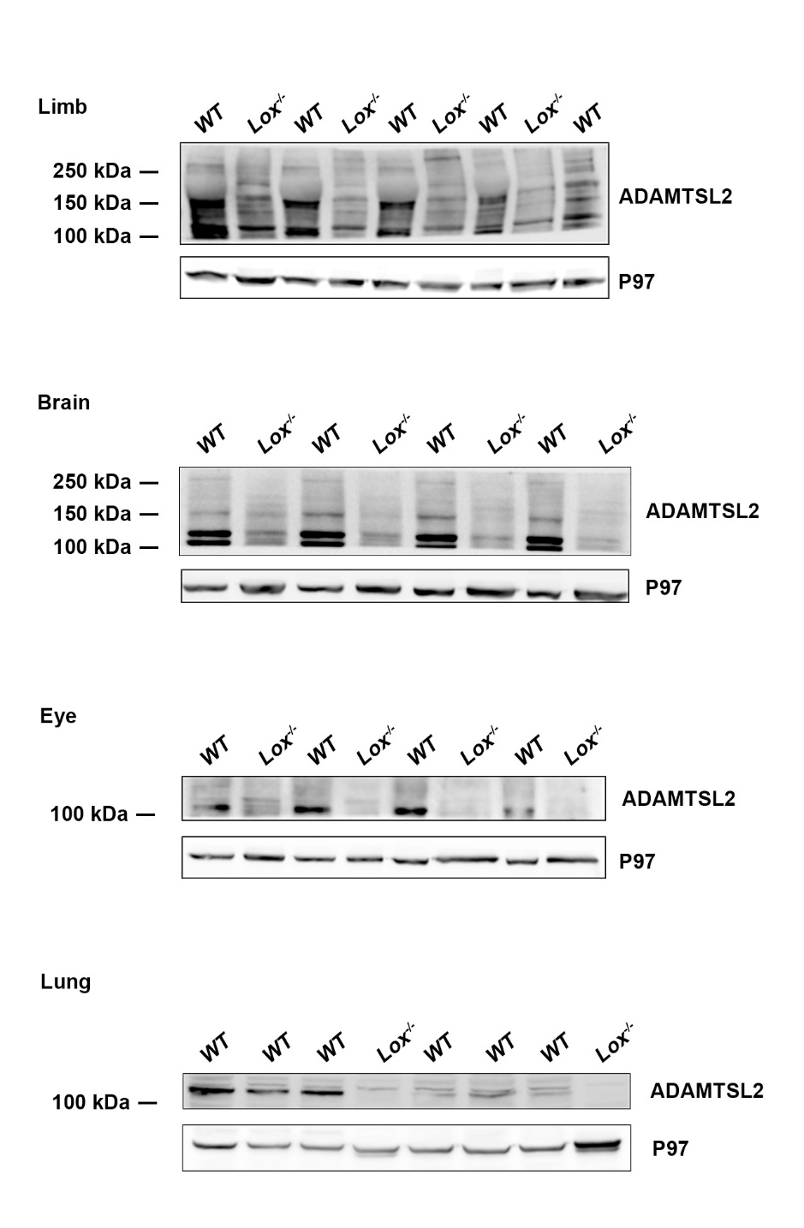
Supp. Figure 3. ADAMTSL2 is reduced in Lox mutant tissues. Lysates of E18.5 tissues from wt and Lox^{-/-} embryos were blotted for ADAMTSL2 and used for quantification.

Slide 4
Relative levels
Lox^{-/-}
wt
Supp. Figure 4. Lox does not regulate Adamtsl2 transcription. No significant changes in Adamtsl2 mRNA expression were identified using Taqman RT-PC in wt an Lox^{-/-} E18.5 embryonic brains.

Slide 5
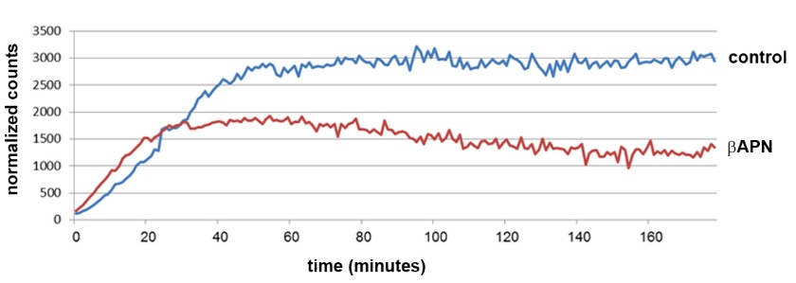
Supp. Figure 5. LOX activity is inhibited in aortas of βAPN treated mice. Aortas from mice treated for 4 weeks with βAPN (red line) or drinking water as control (blue line) were lysed and processed for a LOX activity assay.

Slide 6
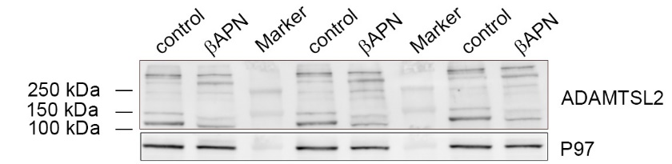
Supp. Figure 6. LOX enzymatic activity is required for maintaining ADAMTSL2 levels. ADAMTSL2 western blot of aortas from mice treated with βAPN or control (vehicle, distilled, deionized water) that were used for quantification.

Slide 7
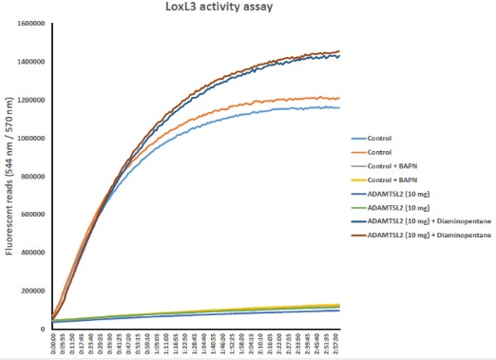
Supp. Figure 7. In vitro oxidation assay. In vitro oxidation assay with recombinant LOXL3 and ADAMTSL2. Diaminopentane is used as the control substrate, with or without ADAMTSL2. The blocking of the reaction upon βAPN addition demonstrates the reaction is LOXL3-dependent. Addition of LOXL3 and ADAMTSL2 does not alter the colorimetric reaction.

