Slide 1
Figure S1
Pparg mRNA levels in bone
Resistin mRNA levels in bone

Slide 2
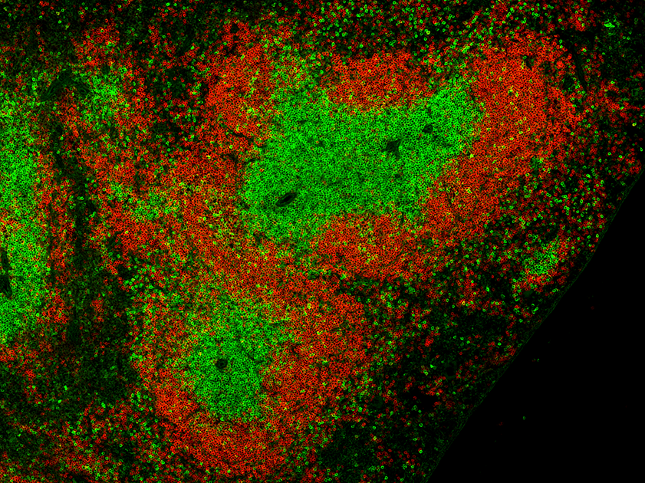
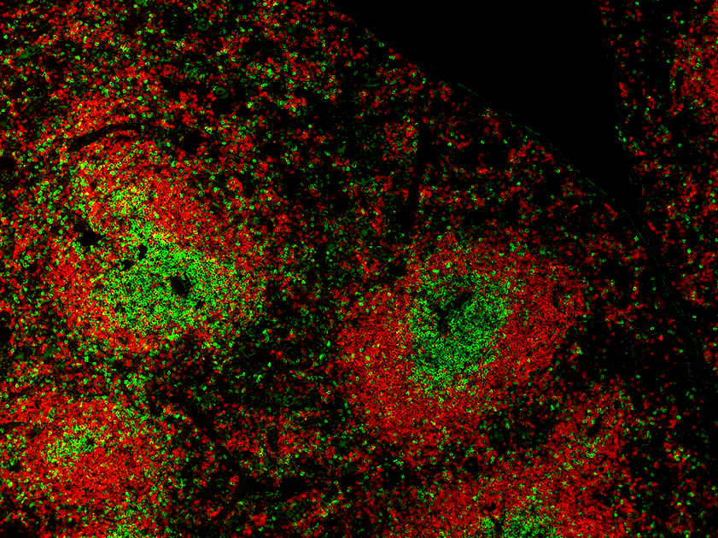
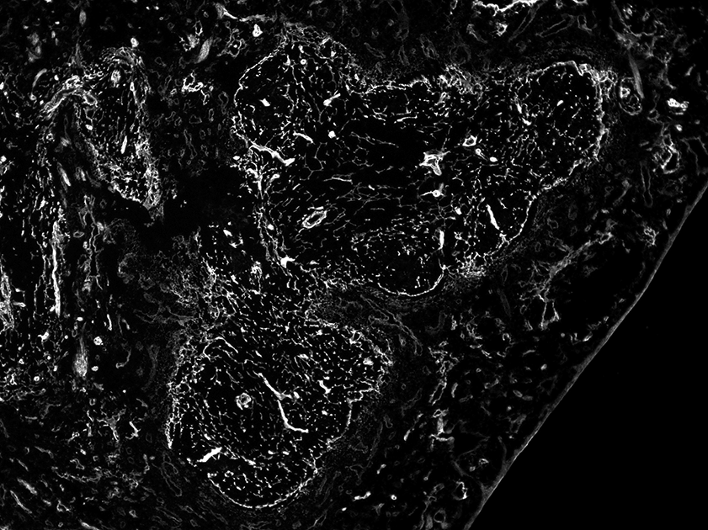
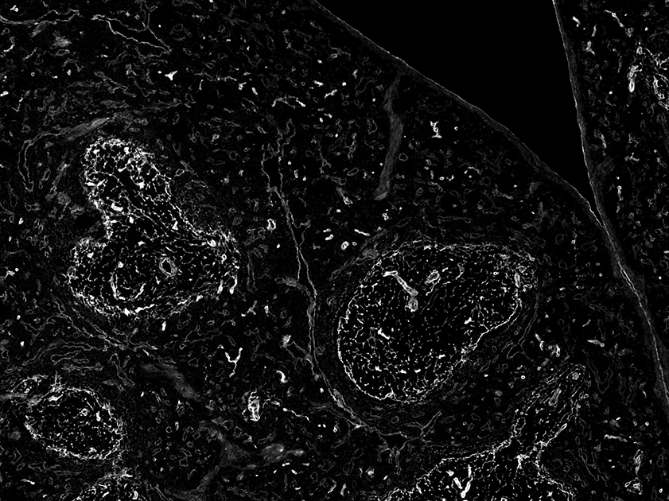
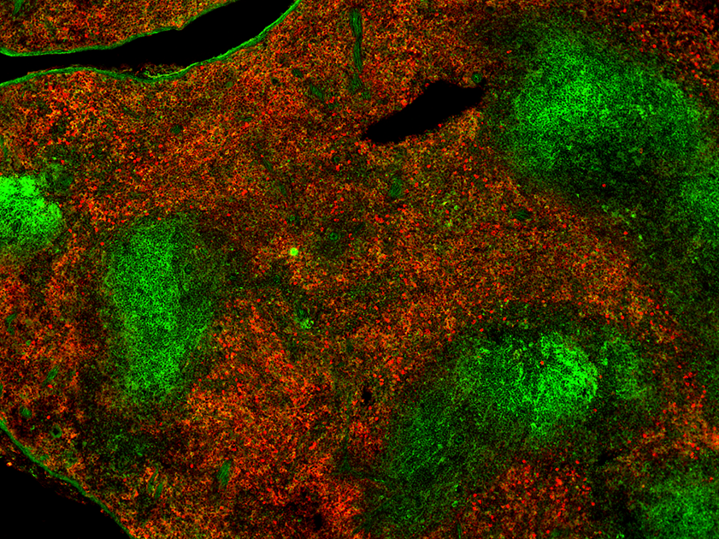
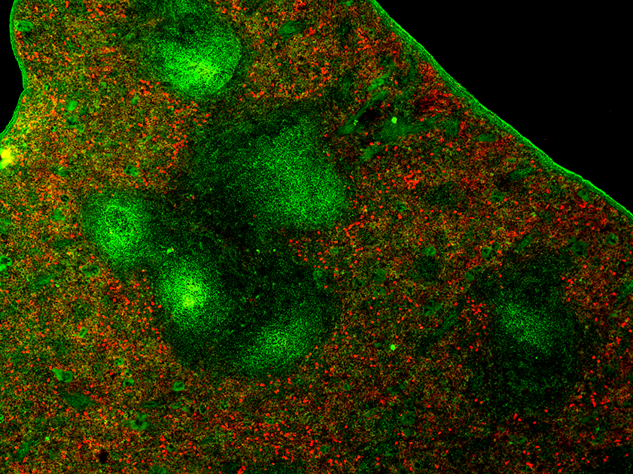
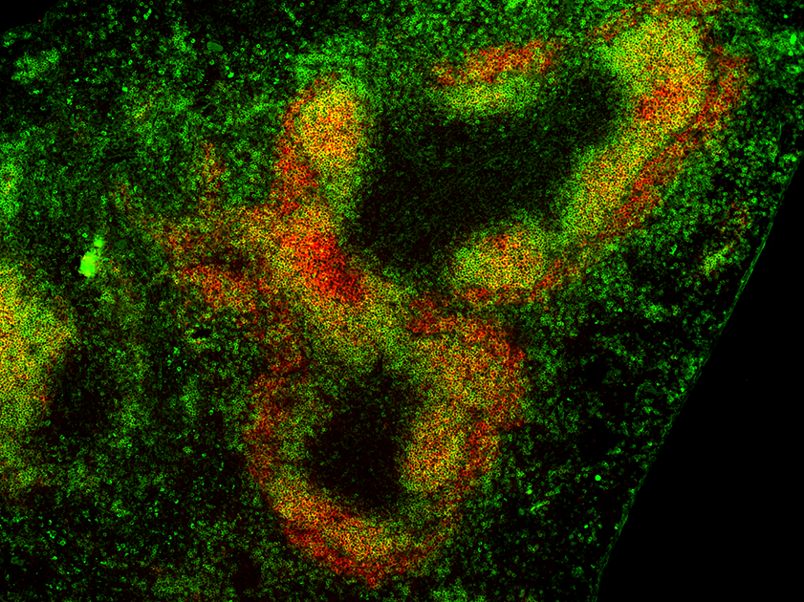
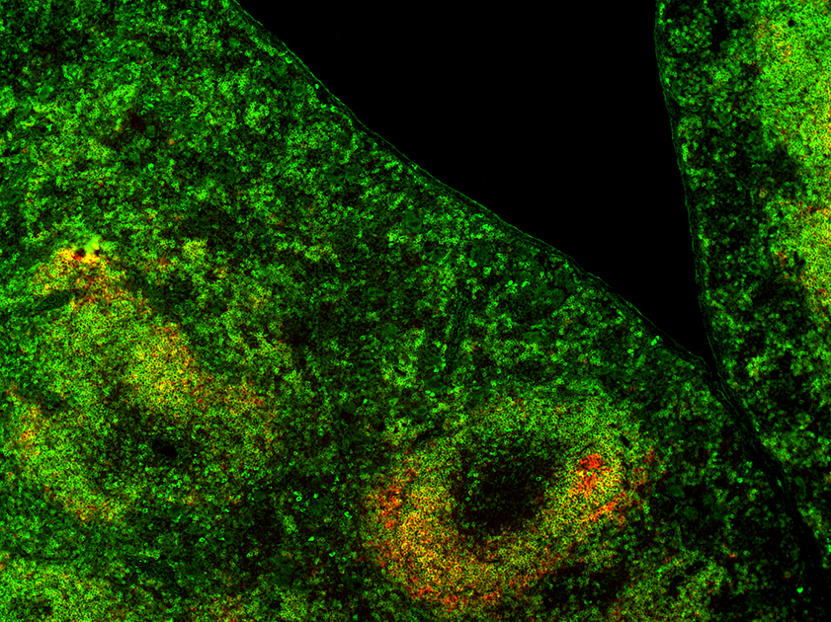
Figure S2
A.
CTL
γ^{Δ/Δ}
B.
CTL
γ^{Δ/Δ}
C.
CD3 B220
Laminin
D.
BP3 CD11b & F4/80
E.
IgD CD35

Slide 3
Figure S3
20
Leucocytes
12
Erythrocytes
160
Hemoglobin
60
Hematocrit
16
140
50
8
120
40
12
100
10^9/L
10^12/L
g/L
80
%
30
8
4
60
20
4
40
10
0
0
20
CTL
γ^{Δ/Δ}
CTL
γ^{Δ/Δ}
0
CTL
γ^{Δ/Δ}
0
CTL
γ^{Δ/Δ}
70
MCV
20
MCH
350
MCHC
20
RDW
60
0.001
0.03
300
0.03
50
16
250
16
fL
40
pg
12
g/L
200
%
12
30
8
150
8
20
4
100
4
10
50
0
CTL
γ^{Δ/Δ}
0
CTL
γ^{Δ/Δ}
0
CTL
γ^{Δ/Δ}
0
CTL
γ^{Δ/Δ}
600
Platelets
8
MPV
500
6
400
10^9/L
300
fL
4
200
2
100
0
CTL
γ^{Δ/Δ}
0
CTL
γ^{Δ/Δ}

Slide 4
Figure S4
LSK (Lin⁻Sca-1⁺cKit-r⁺)
LT-HS CD34⁻CD48⁻CD150⁺
MPP1 CD34⁺CD48⁻CD150⁺
MPP2 CD34⁺CD48⁺CD150⁺
MPP3/4 CD34⁺CD48⁺CD150⁻
LSK
LT-HSC
ST-HSC
(MPP2)
MPPs
LK
CMP
CLP
MEP
GMP
Mega
EB
Platelets
RBC
Gran
Mac
DC
NK
NKT
T cell
B cell
LK (Lin⁻Sca-1⁻cKit-r⁺)
MEP CD34⁻CD16/32⁻
CMP CD34⁺CD16/32⁻
GMP CD34⁺CD16/32⁺

Slide 5
Figure S5
A.
Chimaeras
B.
Reverse Chimaeras
Control or γ^{Δ/Δ} donor BM into WT recipient
WT donor BM into control or γ^{Δ/Δ} recipient

Slide 6
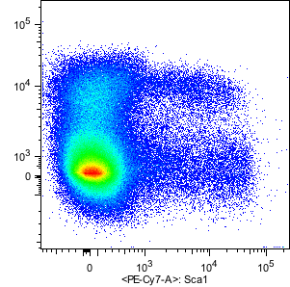
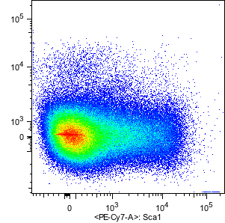
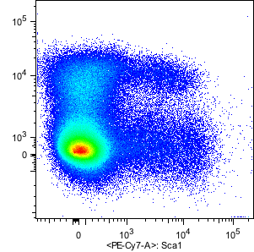
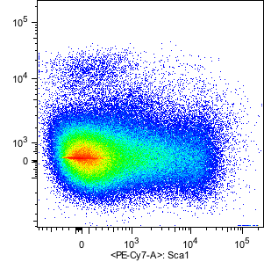
Figure S6
A.
B.
C.
ob/ob mice
D.
BM
Spleen
Liver
9.7%
1.5%
0.7%
0.3%
0.37%
0.38%
WT
9.1%
1.5%
0.8%
0.2%
0.39%
0.51%
ob/ob
CD117
Sca-1

