Slide 1
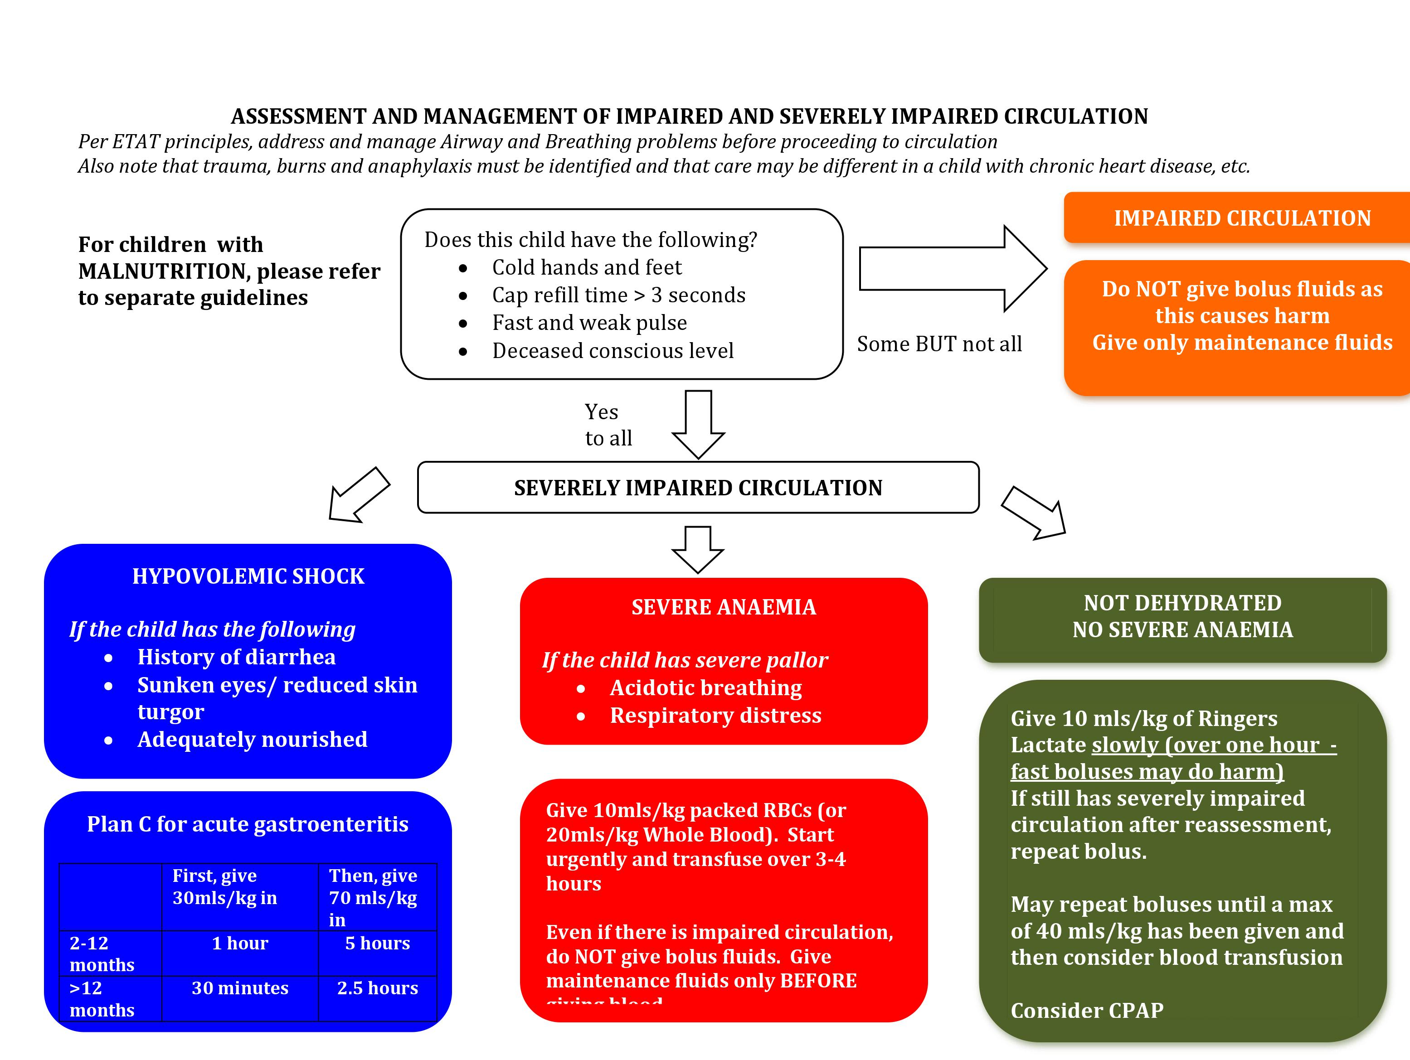
Queen Elizabeth Central Hospital, Malawi guidelines
for severely impaired circulation

Slide 2
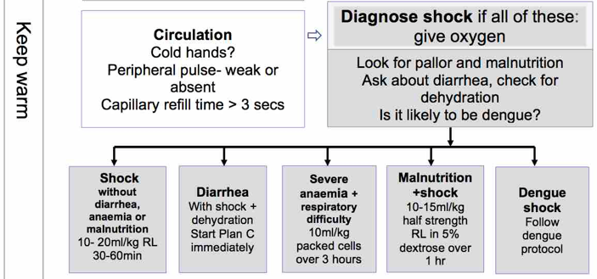
Fluid management based on WHO, ETAT+ and emergency treatment Myanmar

