Slide 1
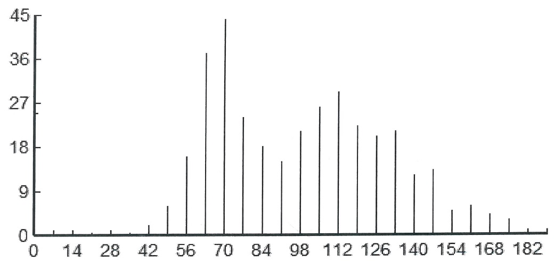

Supplemental Fig. 1A
Frequency

Slide 2
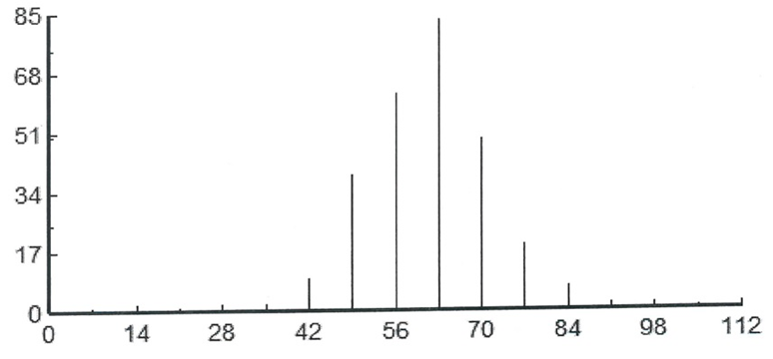

Supplemental Fig. 1B
Frequency

