Slide 1
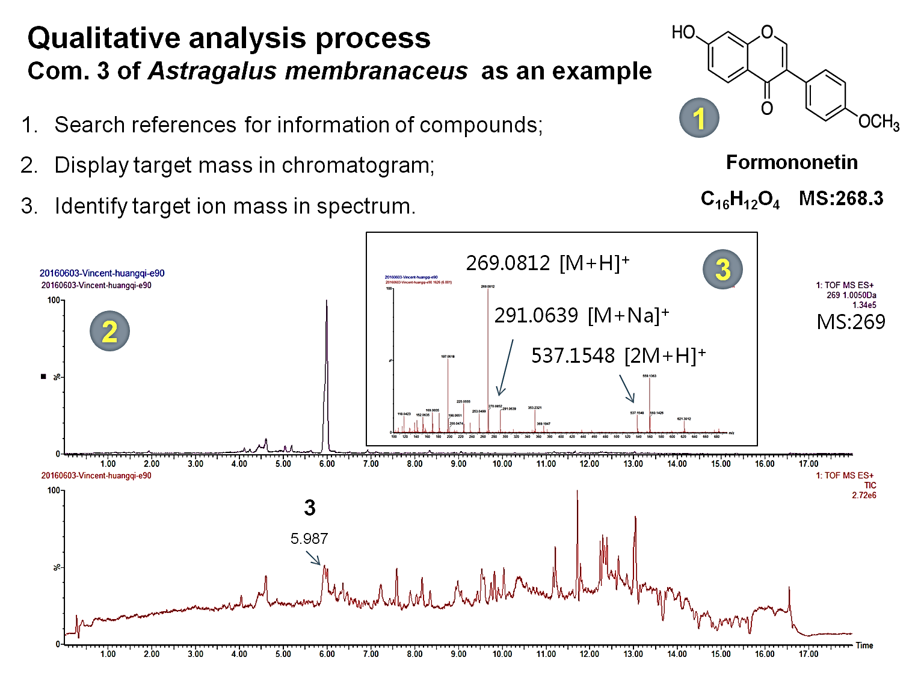
Supplementary Figure 1. General qualitative analysis process of the extracts.

Slide 2
Supplementary Figure 2. Herbal extracts-induced cell cytotoxicity in RAW 264.7 macrophages.

Slide 3
Supplementary Figure 3. The protective effects of the extracts to tBHP-induced cell cytotoxicity .

