Slide 1
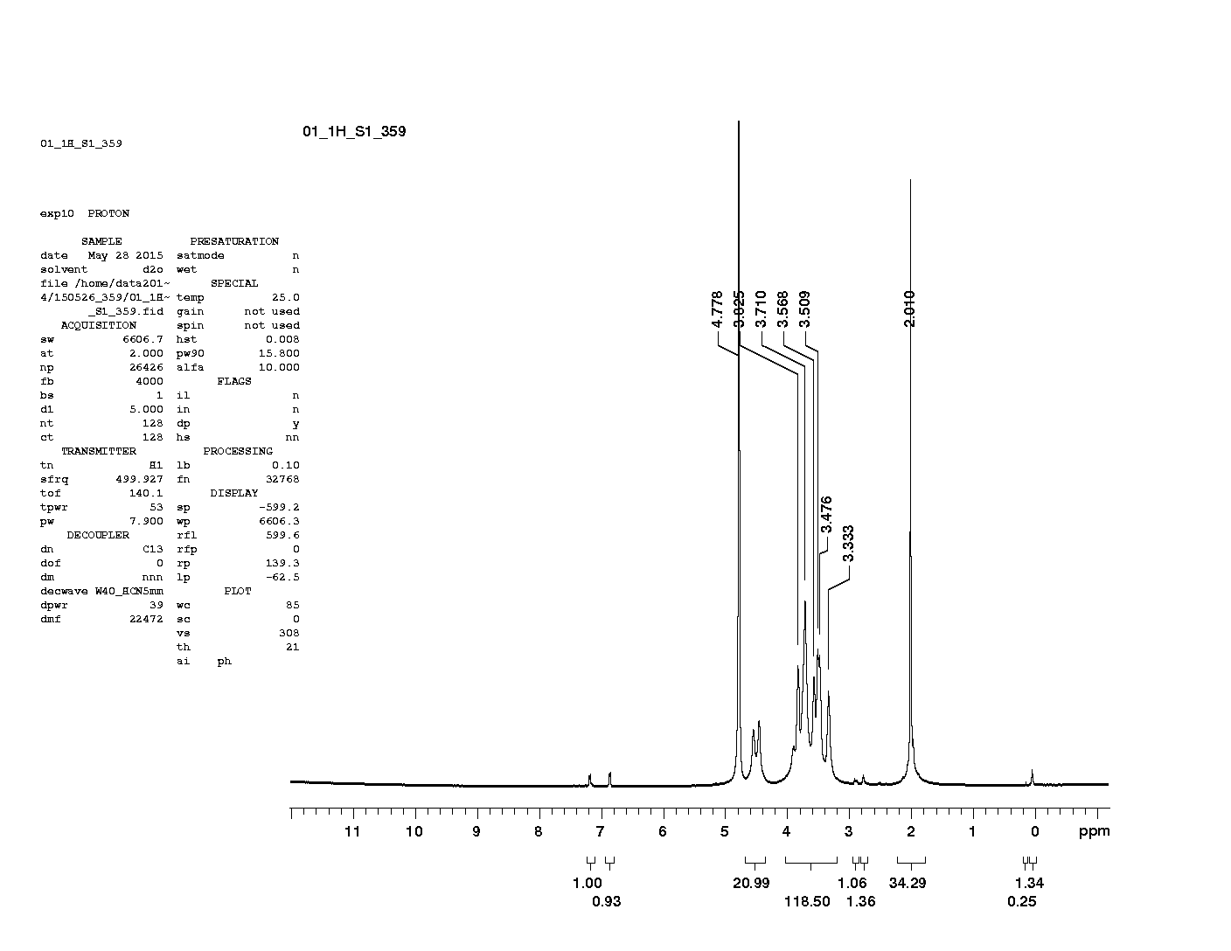
Figure S1. ¹H-NMR spectra of tyramine conjugated hyaluronic acid.

