Slide 1
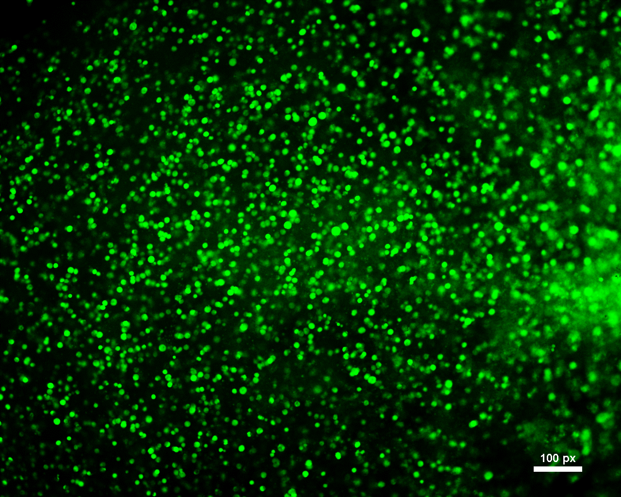
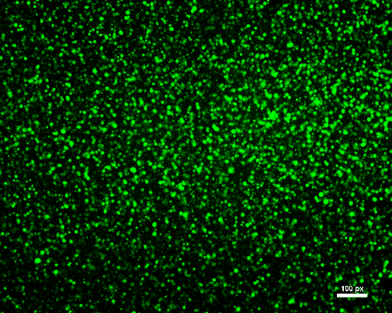
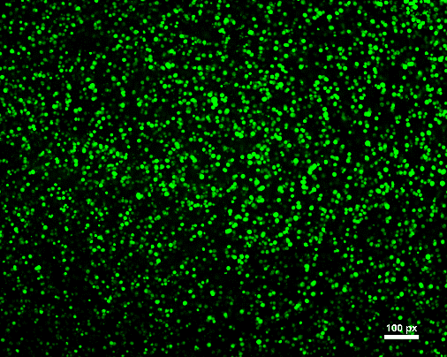
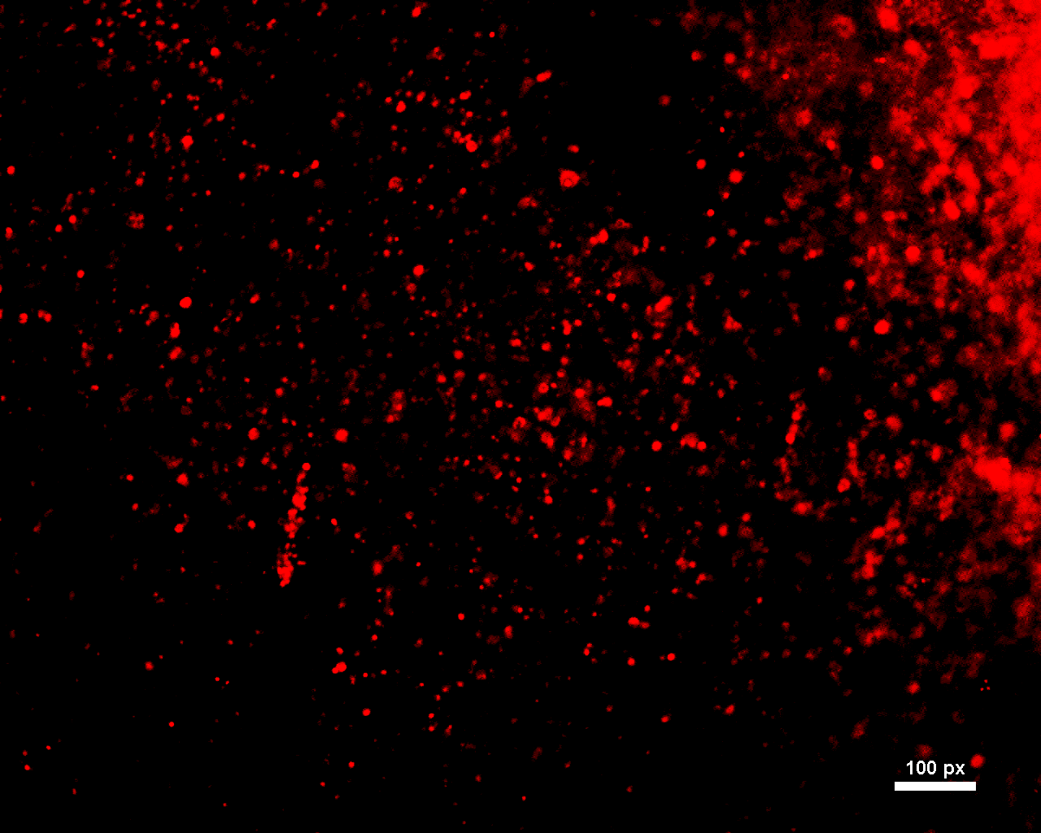
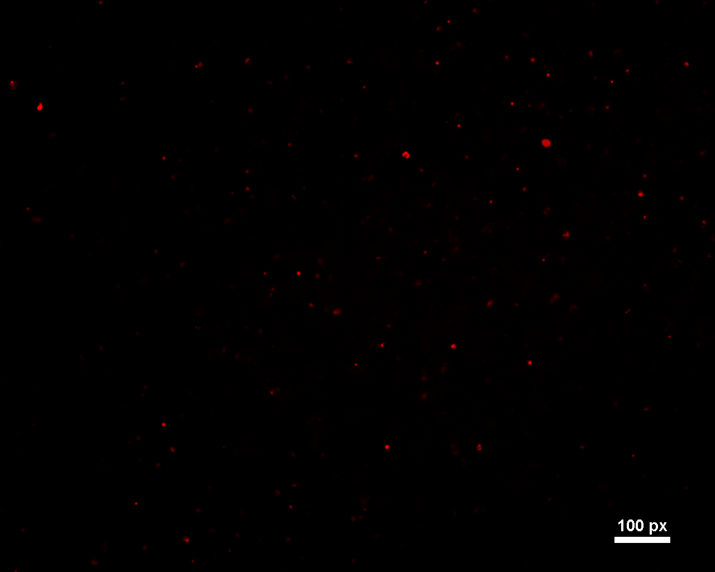
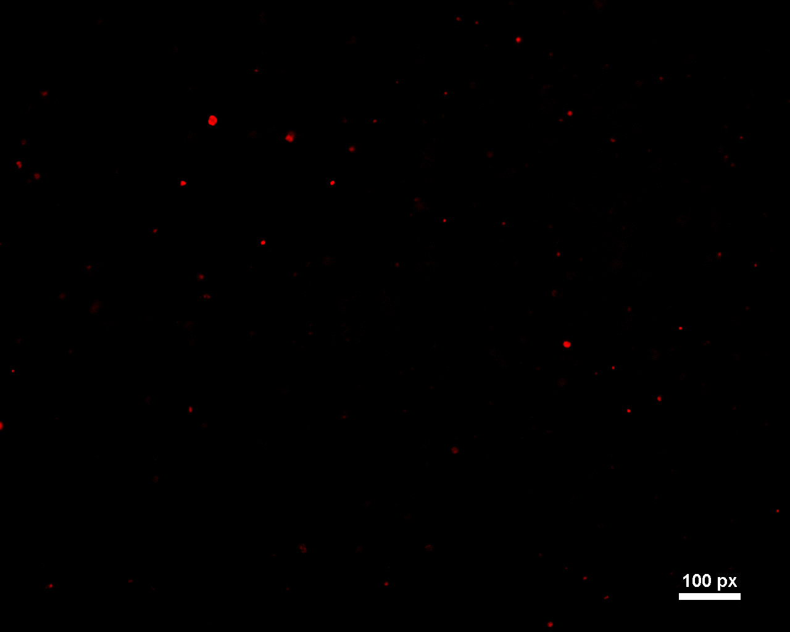
A
1.2mM
0.6 mM
0.1 mM
B
Cell viability (%)
1.2mM
0.6mM
0.1mM
Concentration of H₂O₂(mM)
Figure S2. Viablility test of hPMSC in the hybrid bio-ink with various H2O2 concentration by Live and Dead assay.

