Slide 1
Supplementary Table 2:
Antibodies
Species | Epitope | Clone | Company | Fluorochrome
Human | CD154 | MR1 | Miltenyi | PE
Human | CD3 | UCHT1 | BD | BUV661
Human | CD4 | SK3 | BD | BUV737
Human | CD8 | SK1 | BD | BUV805
Human | CD69 | FN50 | BD | BUV395, BV421
Human | CD103 | Ber-ACT8 | BD | FITC
Human | CD49a | SR84 | BD | PE
Human | TNFα | Mab11 | BD | FITC
Human | CD45RA | HI100 | BD | BUV563
Human | GZMB | GB11 | BD | AF700
Human | CD137 | 4B4-1 | Invitrogen | AF647
Human | CD4 | S3.5 | Invitrogen | QD705
Human | CD3 | UCHT1 | Invitrogen | QD605
Human | CD45RA | MEM-56 | Invitrogen | QD655
Human | CD3 | OKT3 | ThermoFisher | eVolve605
Human | CD103 | B-Ly7 | ThermoFisher | PE, PeCy7, FITC
Human | Eomes | WD1928 | ThermoFisher | eFluor660
Human | 2B4 | eBioDM244 | ThermoFisher | APC
Human | CXCL13 | 53610 | ThermoFisher | APC
Human | CXCR6 | K041E5 | Biolegend | APC
Human | CD27 | O323 | Biolegend | BV510
Human | CD103 | Ber-ACT8 | Biolegend | AF647, BV711
Human | CD69 | FN50 | Biolegend | PeDazzle594
Human | Tbet | 4B10 | Biolegend | BV421
Human | IFNγ | 4S.B3 | Biolegend | eF450
Human | PD-1 | EH12.2H7 | Biolegend | BV421, PeCy7
Human | CTLA4 | L3D10 | Biolegend | PE
Human | CD28 | CD28.2 | CLB | FITC

Slide 2
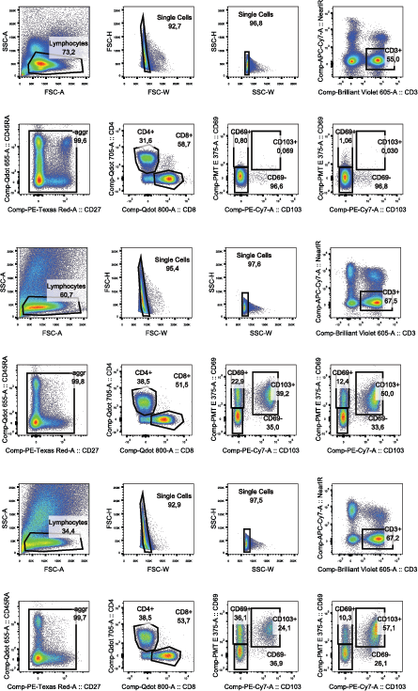
Supplementary Figure 1: General gating strategy used throughout manuscript
PBMC
Lung
Tumor

Slide 3
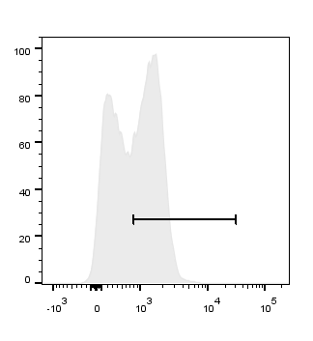
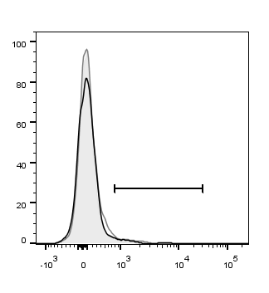
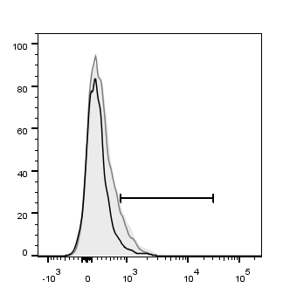
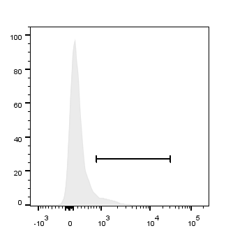

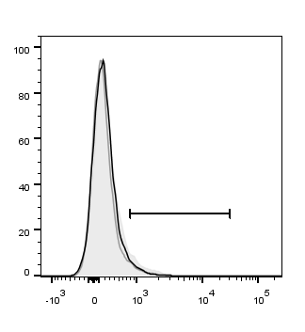
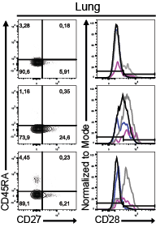
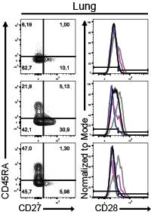
Supplementary Figure 2:
(A) Lung and tumor T cells express low levels of CCR7 shown by representative histogram overlays and quantified with dot plots for the lung and tumor compartments. (B) Representative contour plots and histograms show the gating strategy for determining differentiation status of lung CD103⁺ T_{RM}, CD69⁺ T_{RM} and CD69⁻ T cells. (C) The frequencies of CD27⁺CD45RA⁺CD28⁺ (light purple), CD27⁺CD45RA⁺CD28⁻ (medium purple), CD27⁺CD45RA⁻CD28⁺ (dark purple), CD27⁺CD45RA⁻CD28⁻ (light grey), CD27⁻CD45RA⁻CD28⁺ (medium grey), CD27⁻CD45RA⁻CD28⁻ (black), CD27⁻CD45RA⁺CD28⁺ (light blue), CD27⁻CD45RA⁺CD28⁻ (dark blue) of CD103⁺, CD69⁺ and CD69⁻ lung CD4⁺ (C; top dot plot), tumor CD4⁺ (C; bottom dot plot), lung CD8⁺ (D; top dot plot), and tumor CD8⁺ (D; bottom dot plot). Open circles and solid circles indicate adeno- and squamous carcinoma respectively.
CD4⁺ Lung
CD45RA
CD27
A
C
CD28
Blood
Lung
Tumor
100
56
3 (CD103+)
5 (CD103+)
75
CD4⁺
4 (CD69+)
12 (CD69+
2 (CD69-)
15 (CD69-)
50
% of population
25
8
5 (CD103+)
4 (CD103+)
0
2 (CD69+)
5 (CD69+)
CD45RA
CD27
CD8⁺
2 (CD69-)
8 (CD69-)
100
CD4⁺ Tumor
CD28
75
CCR7
50
% of population
25
0
D
CD45RA
CD27
100
CD8⁺ Lung
CD28
75
50
B
% of population
CD4⁺
CD8⁺
25
CD103⁺
0
CD8⁺ Tumor
CD45RA
CD27
100
CD28
CD69⁺
75
50
% of population
CD69⁻
25
0

Slide 4
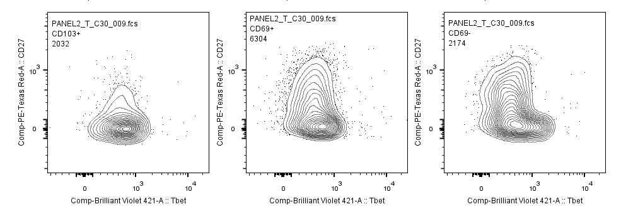
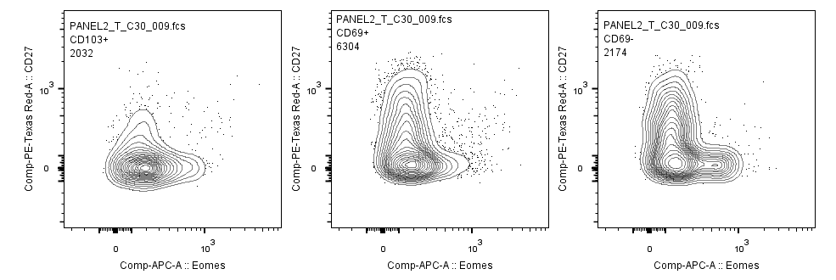
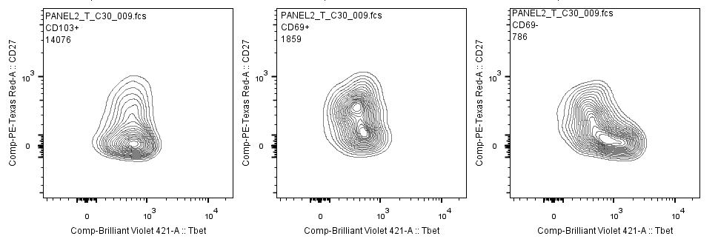
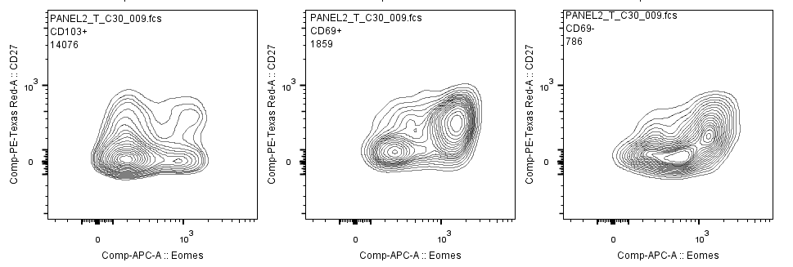
Supplementary Figure 3:
(A) T-bet geometric mean fluorescence intensity (GeoMean) and Eomes expression in naive and effector blood T cells. (B) Co-expression of CD27 and T-bet and CD27 and Eomes on TILs. (C) Frequencies of Tregs in CD4+ tumor and lung compartment
A
B
CD103⁺
CD69⁺
CD69⁻
CD103⁺
CD69⁺
CD69⁻
CD4⁺
CD8⁺
CD27
Tbet
Eomes
C

Slide 5
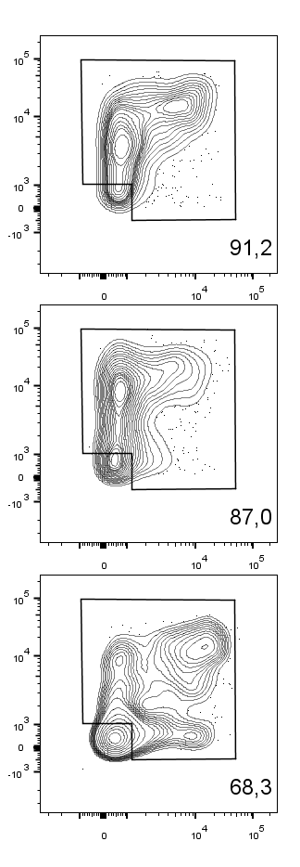
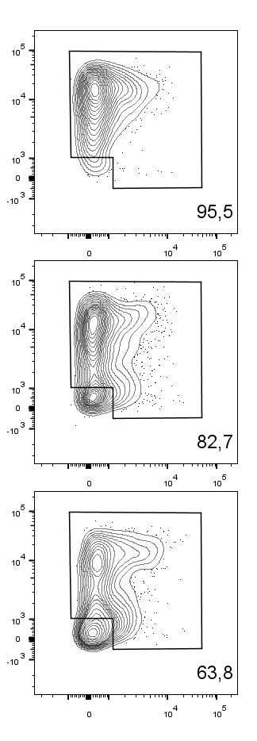
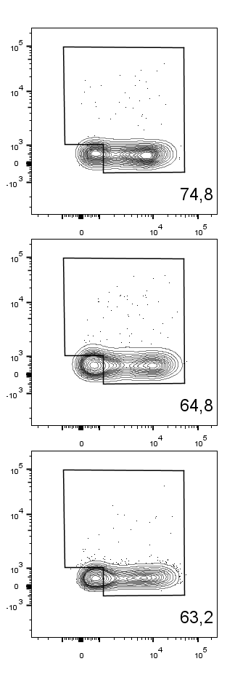
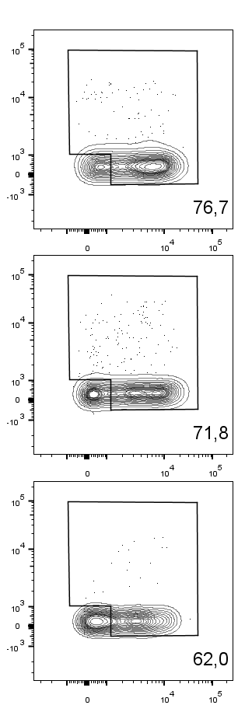
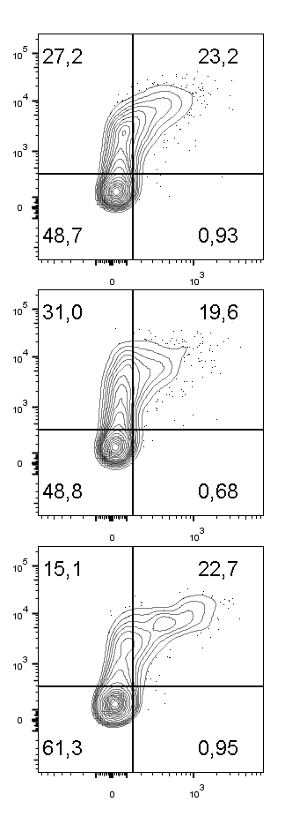
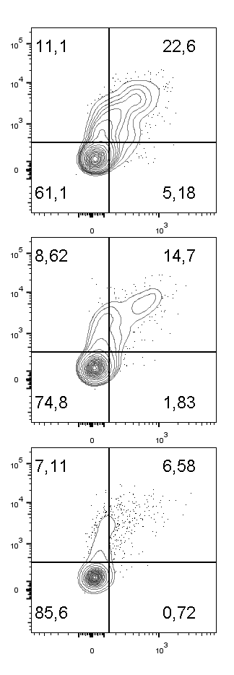
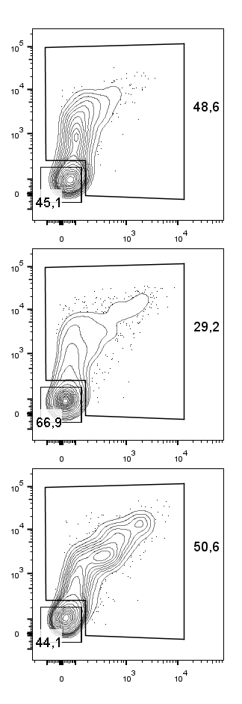
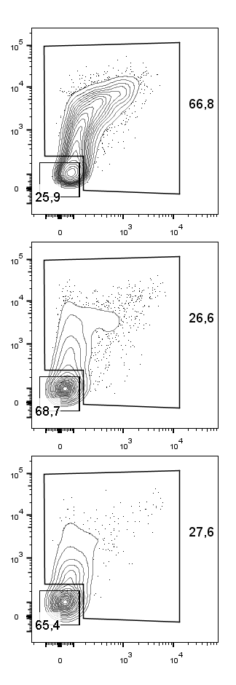
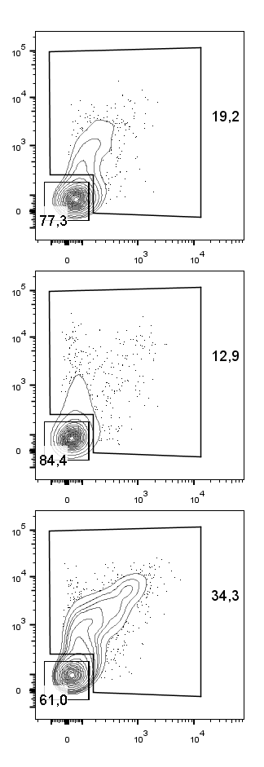

Supplementary Figure 4:
T_{RM} and TILs were stimulated with αCD3 and αCD28 overnight. (A-C) CD40L and CD137 upregulation by CD4⁺ and CD8⁺ T_{RM} and TILs and TNF-α and IFN-γ production by lung T_{RM} and TILs were determined by intracellular cytokine staining. (C) Representative contour plots show the gating strategy for Cytokine⁺ versus Cytokine⁻ cells.
A
CD4⁺
CD8⁺
B
Lung
Lung
Tumor
Lung
Tumor
CD4⁺
CD8⁺
CD103⁺
CD103⁺
CD69⁺
CD69⁺
CD69⁻
CD69⁻
CD40L
TNF-α
CD137
IFN-γ
C
CD4⁺
CD8⁺
D
CD4⁺
CD8⁺
Lung
Tumor
Lung
Tumor
CD103⁺
CD69⁺
CD69⁻
TNF-α
IFN-γ
+
+
-
+
-
-
+
+
-
+
-
-
+
+
-
+
-
-
+
+
-
+
-
-
CD103
CD69
Lung
Tumor
Lung
Tumor

Slide 6
Supplementary Figure 5:
There were no differences samples from adenocarcinoma or squamous carcinoma in TNF-α+IFN-γ+ CD103+, CD69+, and CD69- CD4+ or CD8+ TILs stimulated with αCD3 with control cell line (CL) (black circles), αCD3 and αCD28 with control CL (black squares), or αCD3 and αCD28 with CD70-expressing CL (black triangles).
Adenocarcinoma
CD4⁺
Squamous carcinoma
CD8⁺
CD103
+
+
-
+
-
-
+
+
-
+
-
-
CD69

