Slide 1
pI
Ai
4
18 cm
7
M_{r}
Ac(63527)
G(63529)
G(63530)
Ac(78829)
Ac(63512)
G(63528)
G(63536)
Ac(63624)
Ac(63646)
Actin (Ac) and GAPDH (G)
2D-DIGE-α Gel4-25b-G300
FIGURE S8| Figure legend was inserted in the powerpoint notes section.
Notes:
FIGURE LEGEND S8| Position of the GAPDH (G) and actin (Ac) protein spots, with significant (P ˂0.05) overexpression in fluorescent gel images of the virulent Histomonas meleagridis culture. The four GAPDH (G) and the five actin (Ac) protein spots were marked on the representative fluorescent gel image Gel4-25b-G300 (Ai) obtained by the 2D-DIGE-α experiment. These protein spots were additionally marked on the corresponding silver-stained Gel 4 (Aii). The representative fluorescent gel image Gel3-25a-G300 (Bi) and its corresponding silver-stained Gel 3 (Bii) obtained by the 2D-DIGE-β experiment were used to mark the position of the three GAPDH (G) and the two actin (Ac) protein spots. In the first dimension proteins were separated using 18 cm IPG strips with a pH range 4-7 and in the second dimension by using 10% polyacrylamide gels. The arrows at the x- and y-axis in each gel are indicating the direction of protein mobility according to their pI (x-axis) and M_{r} (y-axis). The parentheses provide the spot IDs which were assigned to each spot by Delta2D software version 4.7 (Decodon GmbH, Greifswald, Germany). Abbreviations: 2D-DIGE, two-dimensional differential gel electrophoresis; 25, virulent H. meleagridis parasites harvested at passage number 25; 25a and 25b, protein samples extracted from virulent H. meleagridis parasites on day 1 and day 2, respectively; G300, protein samples labeled with G-Dye 300; GAPDH, glyceraldehyde-3-phosphate dehydrogenase; IPG, immobilized pH gradient; M_{r}, molecular mass; pI, isoelectric point; Spot IDs, spot identification numbers.

Slide 2
pI
Aii
4
18 cm
7
kDa
260
140
100
70
G(63530)
Ac(63527)
G(63529)
50
Ac(78829)
Ac(63512)
G(63528)
40
G(63536)
35
Ac(63624)
25
Ac(63646)
15
Actin (Ac) and GAPDH (G)
2D-DIGE-α silver-stained Gel 4
FIGURE S8| Figure legend was inserted in the powerpoint notes section.
Notes:
FIGURE LEGEND S8| Position of the GAPDH (G) and actin (Ac) protein spots, with significant (P ˂0.05) overexpression in fluorescent gel images of the virulent Histomonas meleagridis culture. The four GAPDH (G) and the five actin (Ac) protein spots were marked on the representative fluorescent gel image Gel4-25b-G300 (Ai) obtained by the 2D-DIGE-α experiment. These protein spots were additionally marked on the corresponding silver-stained Gel 4 (Aii). The representative fluorescent gel image Gel3-25a-G300 (Bi) and its corresponding silver-stained Gel 3 (Bii) obtained by the 2D-DIGE-β experiment were used to mark the position of the three GAPDH (G) and the two actin (Ac) protein spots. In the first dimension proteins were separated using 18 cm IPG strips with a pH range 4-7 and in the second dimension by using 10% polyacrylamide gels. The arrows at the x- and y-axis in each gel are indicating the direction of protein mobility according to their pI (x-axis) and M_{r} (y-axis). The parentheses provide the spot IDs which were assigned to each spot by Delta2D software version 4.7 (Decodon GmbH, Greifswald, Germany). Abbreviations: 2D-DIGE, two-dimensional differential gel electrophoresis; 25, virulent H. meleagridis parasites harvested at passage number 25; 25a and 25b, protein samples extracted from virulent H. meleagridis parasites on day 1 and day 2, respectively; G300, protein samples labeled with G-Dye 300; GAPDH, glyceraldehyde-3-phosphate dehydrogenase; IPG, immobilized pH gradient; M_{r}, molecular mass; pI, isoelectric point; Spot IDs, spot identification numbers.

Slide 3
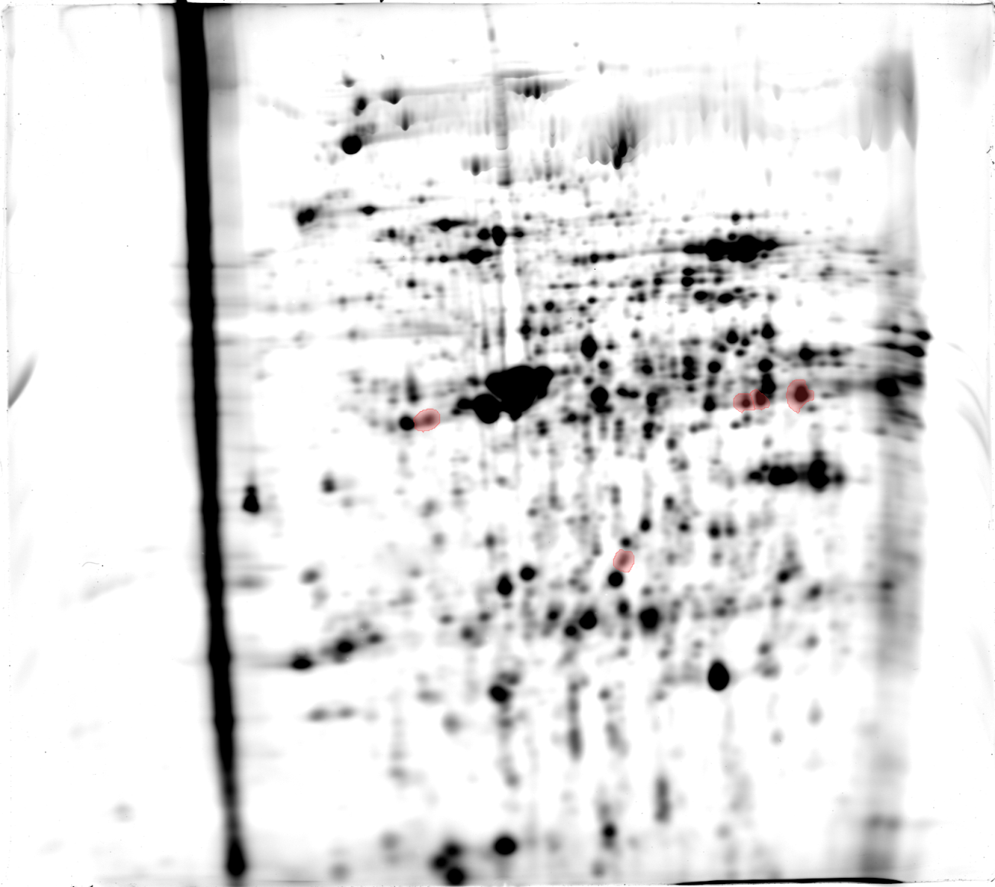
pI
Bi
4
18 cm
7
M_{r}
G(509)
G(524)
G(526)
Ac(535)
Ac(627)
Actin (Ac) and GAPDH (G)
2D-DIGE-β Gel3-25a-G300
FIGURE S8| Figure legend was inserted in the powerpoint notes section.
Notes:
FIGURE LEGEND S8| Position of the GAPDH (G) and actin (Ac) protein spots, with significant (P ˂0.05) overexpression in fluorescent gel images of the virulent Histomonas meleagridis culture. The four GAPDH (G) and the five actin (Ac) protein spots were marked on the representative fluorescent gel image Gel4-25b-G300 (Ai) obtained by the 2D-DIGE-α experiment. These protein spots were additionally marked on the corresponding silver-stained Gel 4 (Aii). The representative fluorescent gel image Gel3-25a-G300 (Bi) and its corresponding silver-stained Gel 3 (Bii) obtained by the 2D-DIGE-β experiment were used to mark the position of the three GAPDH (G) and the two actin (Ac) protein spots. In the first dimension proteins were separated using 18 cm IPG strips with a pH range 4-7 and in the second dimension by using 10% polyacrylamide gels. The arrows at the x- and y-axis in each gel are indicating the direction of protein mobility according to their pI (x-axis) and M_{r} (y-axis). The parentheses provide the spot IDs which were assigned to each spot by Delta2D software version 4.7 (Decodon GmbH, Greifswald, Germany). Abbreviations: 2D-DIGE, two-dimensional differential gel electrophoresis; 25, virulent H. meleagridis parasites harvested at passage number 25; 25a and 25b, protein samples extracted from virulent H. meleagridis parasites on day 1 and day 2, respectively; G300, protein samples labeled with G-Dye 300; GAPDH, glyceraldehyde-3-phosphate dehydrogenase; IPG, immobilized pH gradient; M_{r}, molecular mass; pI, isoelectric point; Spot IDs, spot identification numbers.

Slide 4
pI
Bii
4
18 cm
7
kDa
260
140
100
70
G(509)
50
G(524)
40
G(526)
Ac(535)
35
Ac(627)
25
15
Actin (Ac) and GAPDH (G)
2D-DIGE-β silver-stained Gel 3
FIGURE S8| Figure legend was inserted in the powerpoint notes section.
Notes:
FIGURE LEGEND S8| Position of the GAPDH (G) and actin (Ac) protein spots, with significant (P ˂0.05) overexpression in fluorescent gel images of the virulent Histomonas meleagridis culture. The four GAPDH (G) and the five actin (Ac) protein spots were marked on the representative fluorescent gel image Gel4-25b-G300 (Ai) obtained by the 2D-DIGE-α experiment. These protein spots were additionally marked on the corresponding silver-stained Gel 4 (Aii). The representative fluorescent gel image Gel3-25a-G300 (Bi) and its corresponding silver-stained Gel 3 (Bii) obtained by the 2D-DIGE-β experiment were used to mark the position of the three GAPDH (G) and the two actin (Ac) protein spots. In the first dimension proteins were separated using 18 cm IPG strips with a pH range 4-7 and in the second dimension by using 10% polyacrylamide gels. The arrows at the x- and y-axis in each gel are indicating the direction of protein mobility according to their pI (x-axis) and M_{r} (y-axis). The parentheses provide the spot IDs which were assigned to each spot by Delta2D software version 4.7 (Decodon GmbH, Greifswald, Germany). Abbreviations: 2D-DIGE, two-dimensional differential gel electrophoresis; 25, virulent H. meleagridis parasites harvested at passage number 25; 25a and 25b, protein samples extracted from virulent H. meleagridis parasites on day 1 and day 2, respectively; G300, protein samples labeled with G-Dye 300; GAPDH, glyceraldehyde-3-phosphate dehydrogenase; IPG, immobilized pH gradient; M_{r}, molecular mass; pI, isoelectric point; Spot IDs, spot identification numbers.

