Slide 1
Supplemental 1
Control
REDV-ELP
1
1
2
2
3
3
4
4
5
5
Fig. S1. H&E staining of re-endothelialized liver scaffolds at low magnification. After decellularization, scaffolds were covalently conjugated or not (control) with 10 μM of REDV-ELP. Matrices were re-endothelialized and perfused for 4 days. The left lateral lobe (1), caudate lobe (2), inferior right lateral lobe (3), superior right lateral lobe (4) and median lobe (5) were collected, fixed in 10% formalin, embedded in paraffin for tissue slicing and stained with hematoxylin and eosin. Scale bar = 250 µm.

Slide 2
Supplemental 2
Target | Condition | Average Ct
eNos | REDV-ELP | 21.54
eNos | Control | 22.31
VEGF | REDV-ELP | 23.18
VEGF | Control | 25.08
VE-Cad | REDV-ELP | 21.54
VE-Cad | Control | 23.12
iNos | REDV-ELP | 36.05
iNos | Control | 35.29
GAPDH | REDV-ELP | 17.48
GAPDH | Control | 17.21
Fig. S2. Raw data of the gene expression level by qPCR. Level of expression of eNOS, VEGF , VE-cadherin, iNos and GAPDH of EC grown within control or REDV-ELP scaffolds after 4 days of perfusion determined by RT-qPCR. Average of Ct from three independent experiments.

Slide 3
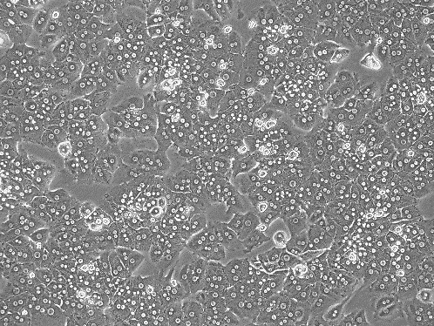
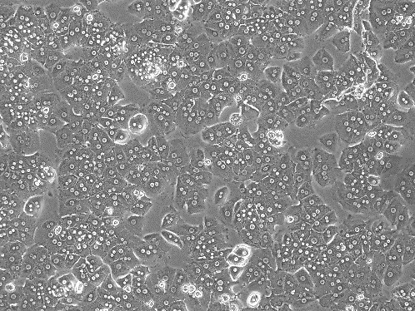
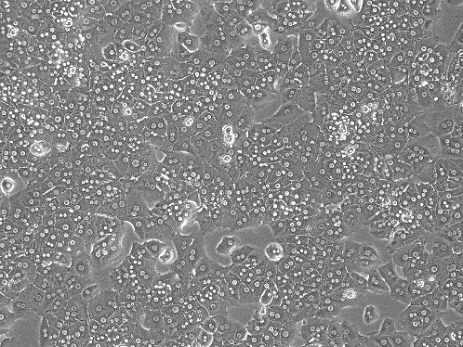
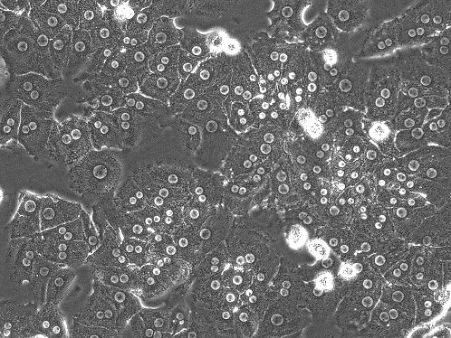
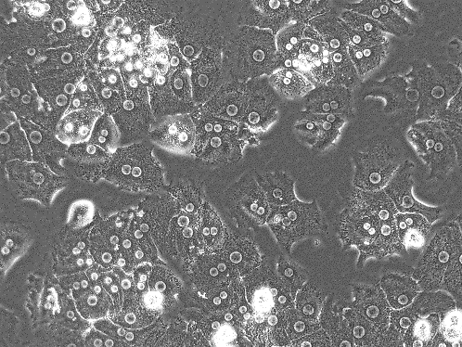
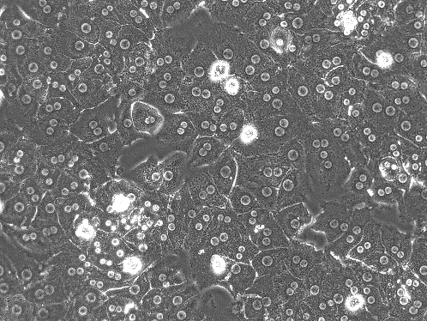
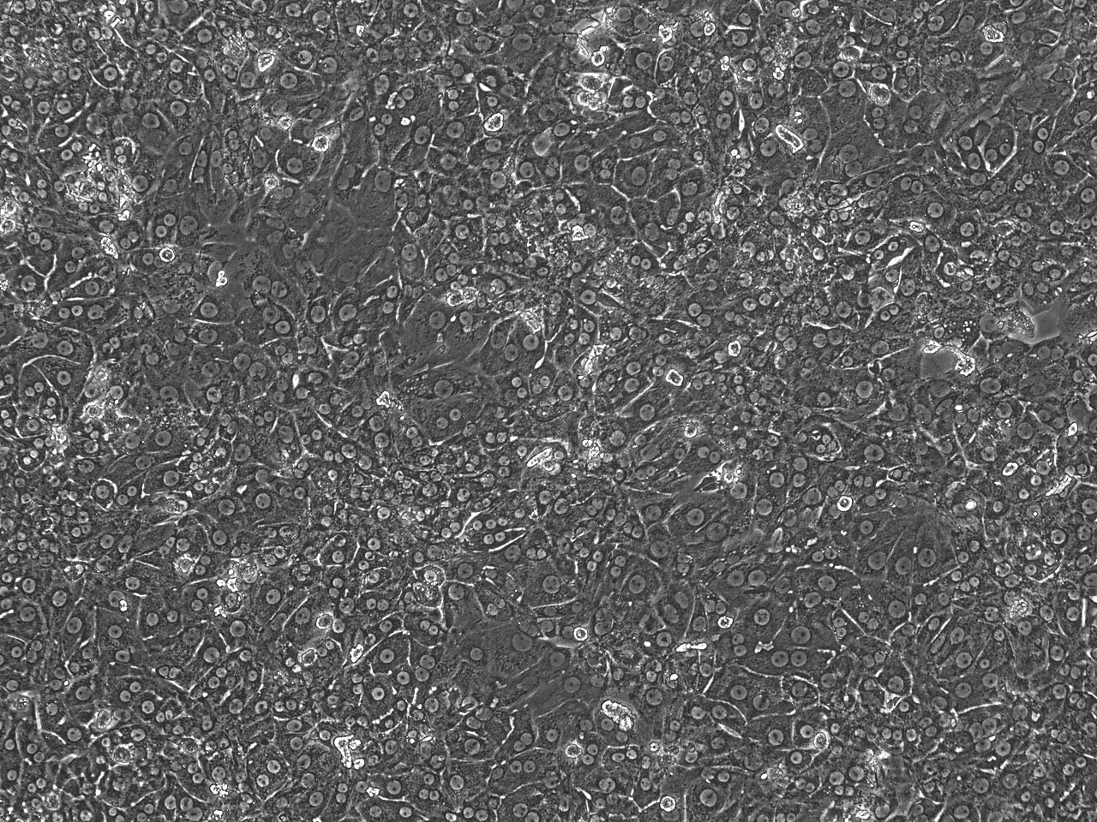
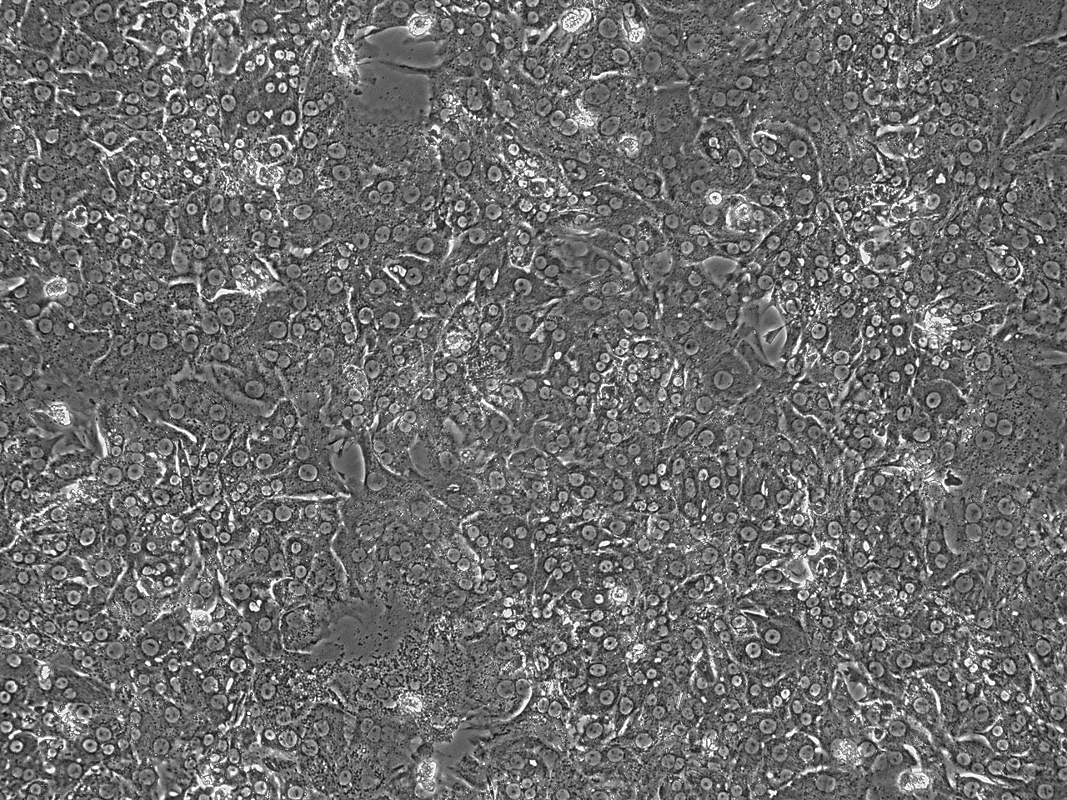
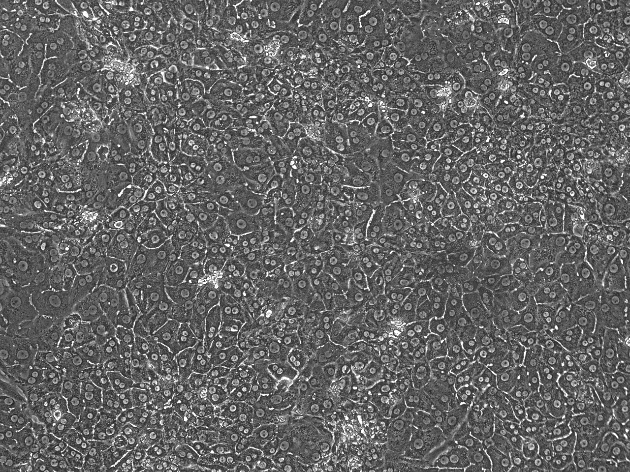
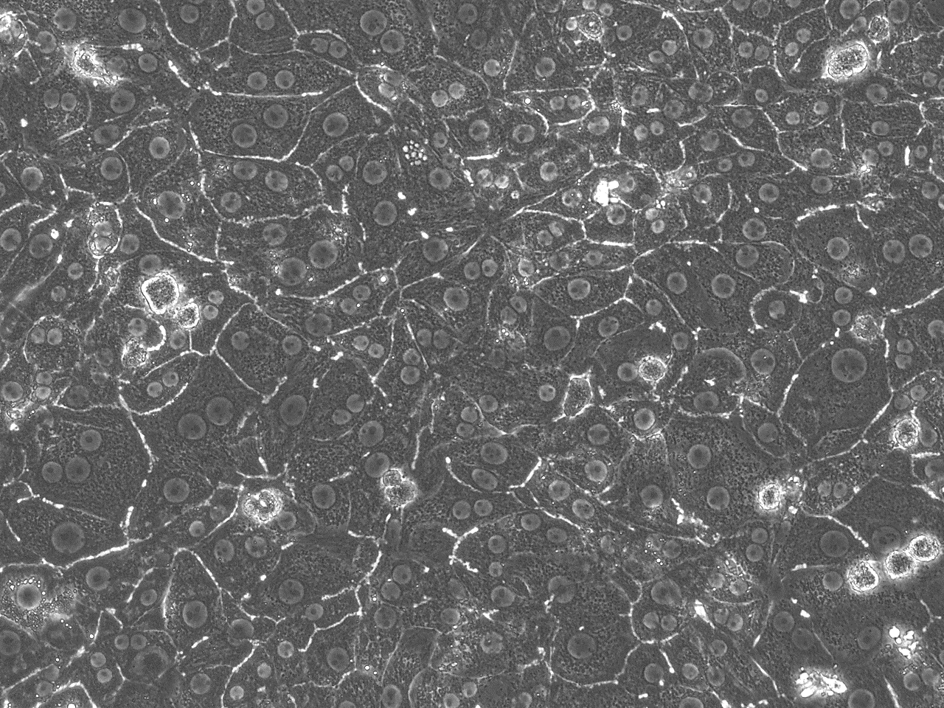
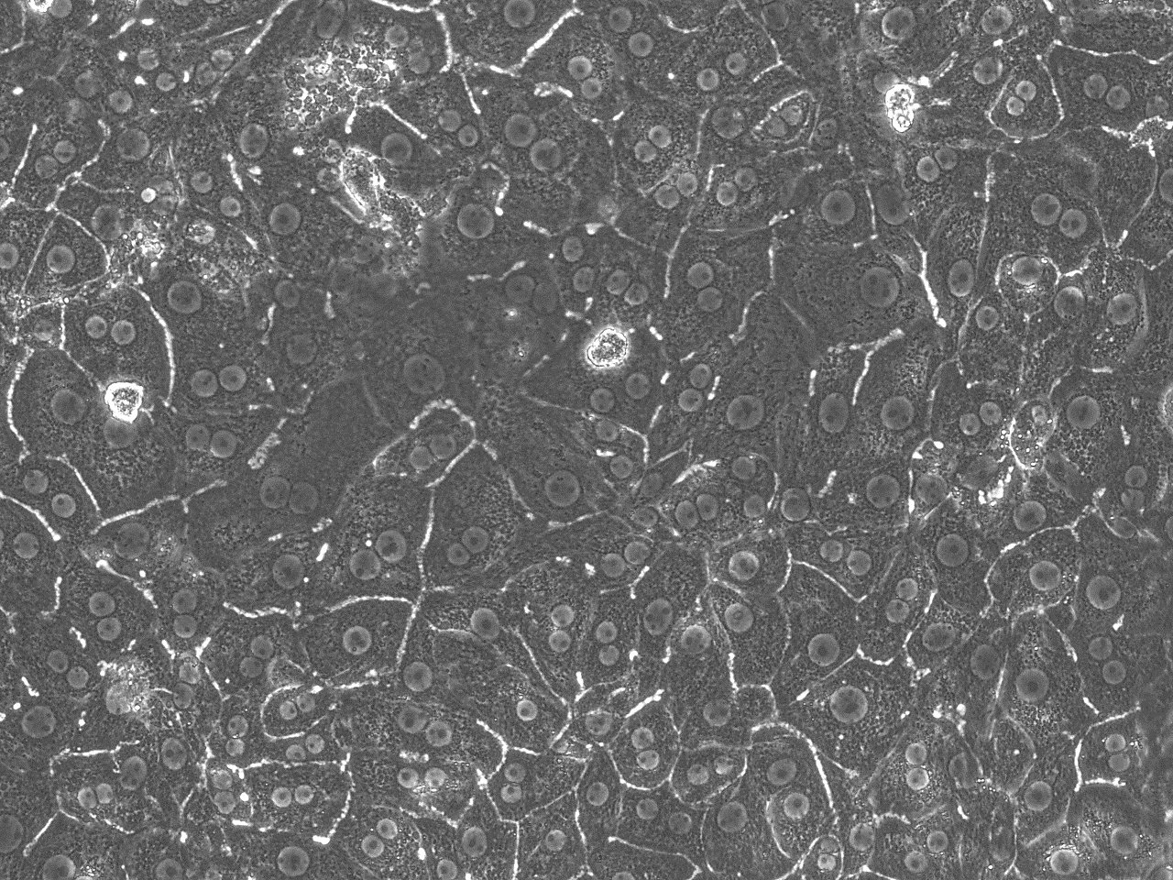
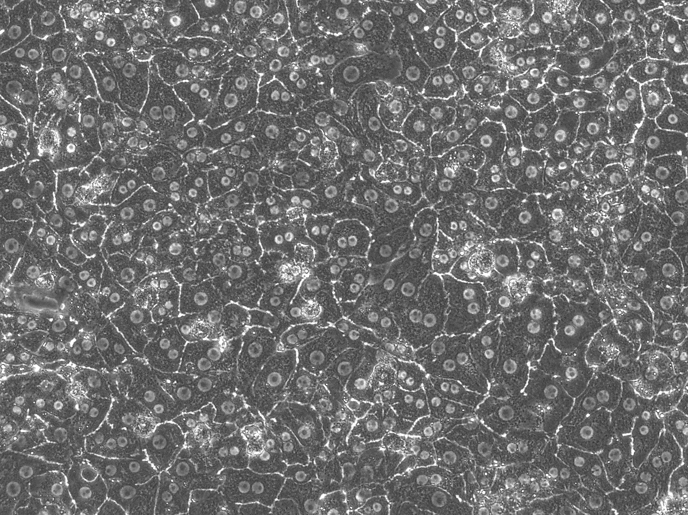
Supplemental 3
A
Day 1
Control
ELP
REDV-ELP
X10
X20
Day 4
Control
ELP
REDV-ELP
X10
X20
B
C
Fig. S3. Function and morphology of hepatocytes cultivated on REDV-ELP collagen. Collagen coated well plate were covalently conjugated or not (control) with 10 μM of ELP or 10 μM of REDV-ELP. Freshly isolated hepatocytes were added on functionalized collagen and cultured for 4 days. (A) Pictures of hepatocytes on day 1 and 4. Scale bars = 200 µm. (B) Albumin synthesis (B) and urea secretion (C) of hepatocytes over 4 days of culture.

