Slide 1
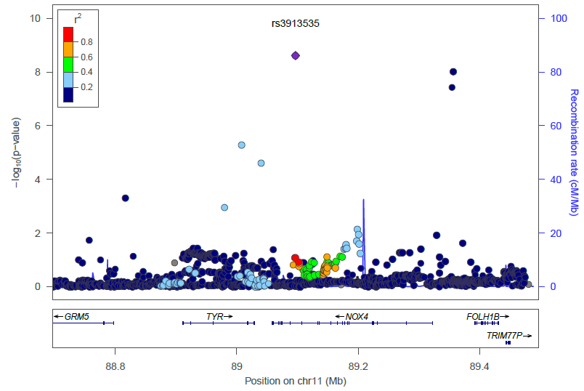
rs10765219 and rs11018670
Fig. S2 Regional plot of NOX4 gene area
r² represents the linkage disequilibrium among SNPs.

