Slide 1
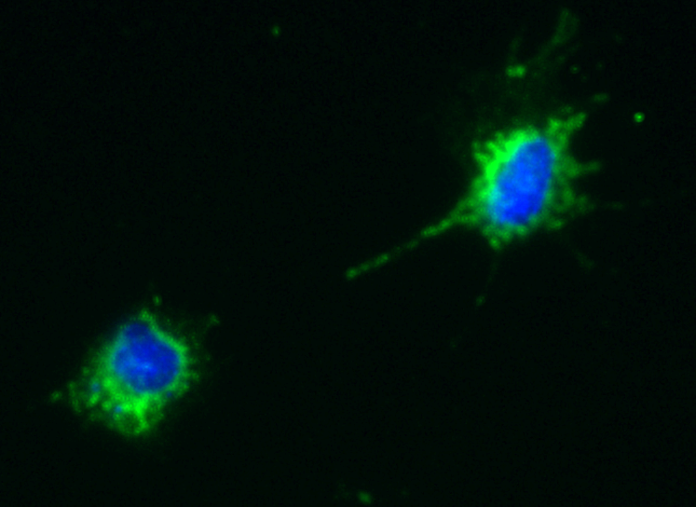
A
B
C
D
E
Supplementary Figure 1. Gene Expression in high and Low-SOST expressing cells
Notes:
(B) There are some significantly regulated combinations (not shown) (38 < Ct values < 44). (C) Not significant (34 < Ct values <41).

Slide 2
A
B
C
D
Supplementary Figure 2. In vivo and in vitro effects of sclerostin

Slide 3
A
B
C
E
F
D
Supplementary Figure 3. Gene expression in shRNA CAIII cells

Slide 4
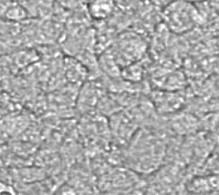
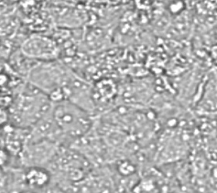
NT
1.0 mM
sh-cont
sh-CAIII
Bar = 50 µm
Supplementary Figure 4. shRNA CAIII are more sensitive to H2O2 (3 days)

