Slide 1
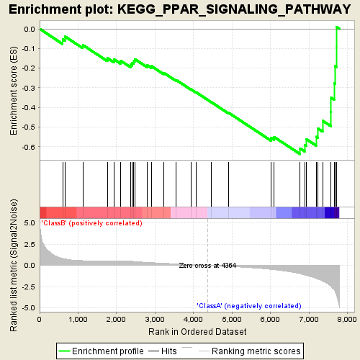

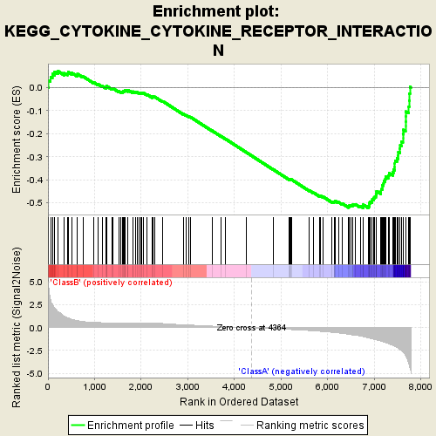

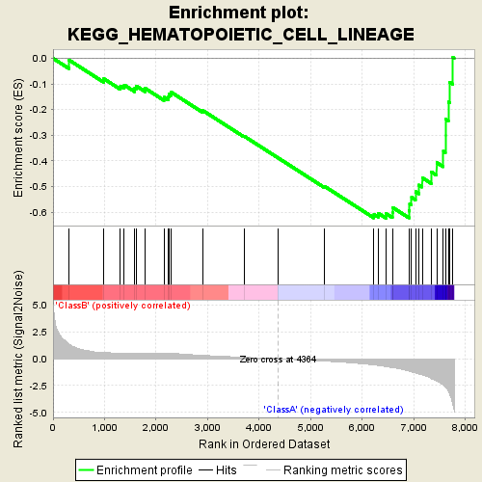

Supplementary Figure S4
MYCsh
GFPsh
MYCsh
GFPsh
FDR = 7.4%
P < 0.005
FDR = 3.7%
P < 0.001
MYCsh
GFPsh
FDR = 3.6%
P < 0.005
Supplementary Figure S4. GSEA analysis with Kyoto Encyclopedia of Genes and Genomes (KEGG) gene sets. GSEA analysis was conducted using GSEA v2.2.4 software and the Molecular Signatures Database (Broad Institute). All of the raw data were formatted and applied to the KEGG gene sets (C2).

