Slide 1
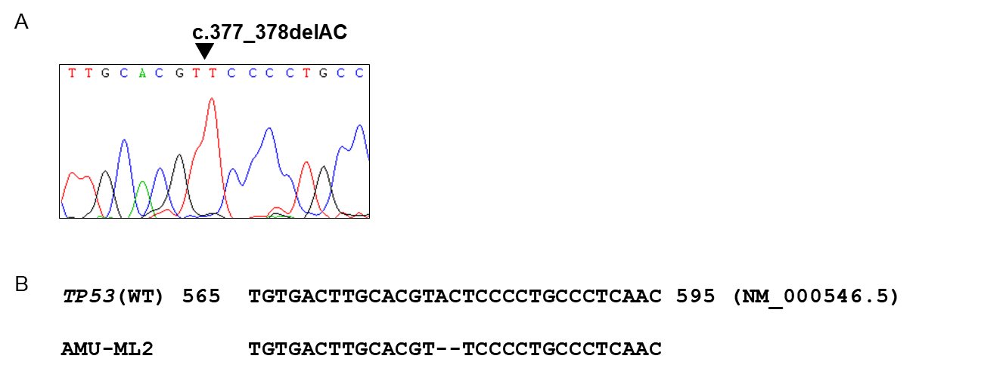
Supplementary Figure S5
Supplementary Figure S5. Sequencing analysis of TP53 gene in AMU-ML2 cells. (A) Total RNA was isolated from AMU-ML2 cells using the Nucleospin RNA kit (TaKaRa Bio, Inc.). After synthesizing complementary DNA, PCR amplification of TP53 gene was performed with a gene specific primer set, as described in Online Supplementary Data. Sequence analysis was performed by using an Applied Biosystems 3130 Genetic Analyzer. The TP53 frameshift mutation c.377_378delAC was detected in AMU-ML2 cells (arrowhead). (B) Sequence alignment of TP53 with wild-type (WT) TP53 gene. Nucleotide number is in reference to GenBank accession NM_000546.5 (TP53 transcript variant 1, mRNA).

