Slide 1
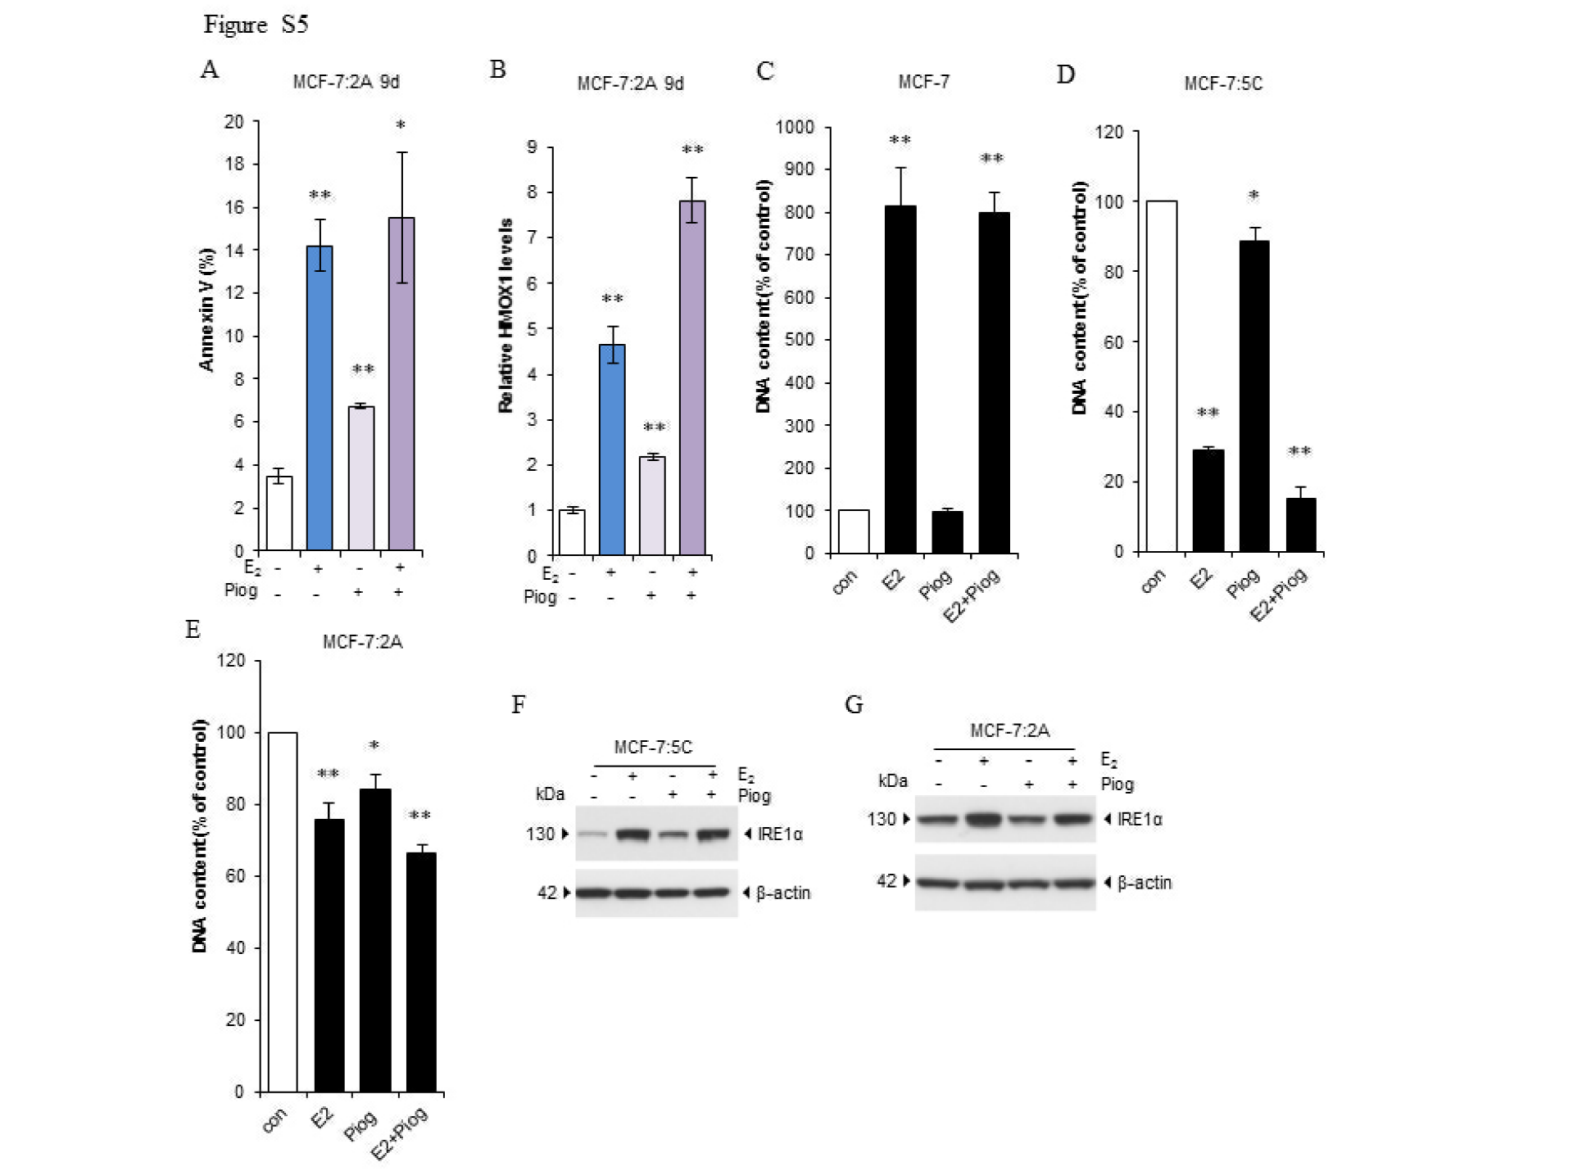

Slide 2
Supplementary Figure S5. Effects of pioglitazone on three breast cancer cell lines. A, MCF-7:2A cells were treated with a vehicle control (0.1% EtOH+0.1% DMSO), E₂ (1 nM), pioglitazone (10 µM), or a combination of them for 9 days. Cells were then harvested for use in an annexin V binding assay. *P<0.05, **P<0.001 compared with control. B, MCF-7:2A cells were treated with a vehicle control (0.1% EtOH+0.1% DMSO), E₂ (1 nM), pioglitazone (10 µM), or a combination of them for 9 days. Cells were then harvested in TRIzol reagent. HMOX1 expression levels were quantitated using RT-PCR. **P<0.001, compared with control. C, MCF-7 cells were transferred from phenol red containing medium to E₂-free medium for 3 days. Cells were then seeded in 24-well plates. After 24 hours, cells were treated with a vehicle control (0.1% EtOH+0.1% DMSO), E₂ (1 nM), pioglitazone (10 µM), or a combination of them for 7 days. Cells were harvested for DNA growth assay. **P<0.001 compared with control. D, MCF-7:5C cells were seeded in 24-well plates. After 24 hours, cells were treated with a vehicle control (0.1% EtOH+0.1% DMSO), E₂ (1 nM), pioglitazone (10 µM), or a combination of them for 7 days. Cells were harvested for DNA growth assay. *P<0.05, **P<0.001 compared with control. E, MCF-7:2A cells were seeded in 24-well plates. After 24 hours, cells were treated with a vehicle control (0.1% EtOH+0.1% DMSO), E₂ (1 nM), pioglitazone (10 µM), or a combination of them for 7 days. Cells were harvested for DNA growth assay. *P<0.05, **P<0.001 compared with control. F, Effects on E₂-induced IRE1α by pioglitazone in MCF-7:5C cells. MCF-7:5C cells were treated with E₂ (1 nM), pioglitazone (10 µM), or a combination of them for 3 days. IRE1α expression was detected using Western blotting. G, Effects on E₂-induced IRE1α by pioglitazone in MCF-7:2A cells. MCF-7:2A cells were treated with E₂ (1 nM), pioglitazone (10 µM), or a combination of them for 9 days. IRE1α expression was detected using Western blotting.

