Slide 1
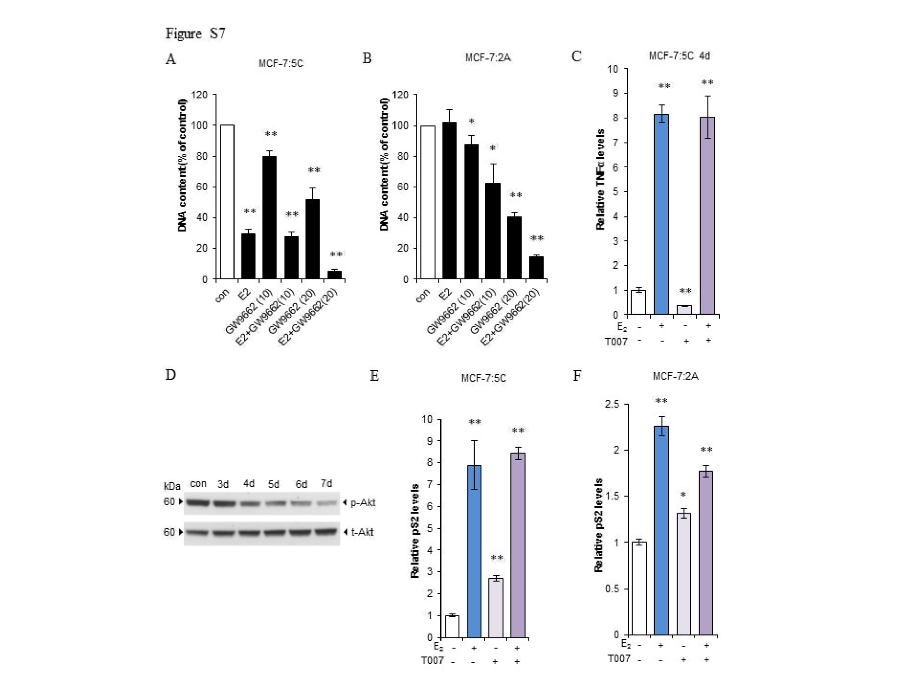

Slide 2
Supplementary Figure S7. Effects of GW9662 and T0070907 on two LTED breast cancer cells. A, DNA Growth assay of GW9662 in MCF-7:5C cells. Cells were treated with E₂ (1 nM), GW9662 (10, 20 µM), or a combination of them for 7 days. Cells were harvested for DNA proliferation assay. **P<0.001. B, DNA Growth assay of GW9662 in MCF-7:2A cells. Cells were treated with E₂ (1 nM), GW9662 (10, 20 µM), or a combination of them for 7 days. Cells were harvested for DNA proliferation assay. *P<0.05, **P<0.001. C, MCF-7:5C cells were treated with E₂ (1 nM), T0070907 (5 µM), or a combination of them for 4 days. Cells were then harvested in TRIzol reagent. TNFα expression was quantitated by RT-PCR. **P<0.001. D, T0070907 inhibited phosphorylation of Akt in MCF-7:5C cells. Cells were treated with T0070907 (5 µM) for indicated times. Phosphor-Akt and total Akt were detected using Western blotting. E, MCF-7:5C cells were treated with E₂ (1 nM), T0070907 (5 µM), or a combination of them for 72 hours. Cells were then harvested in TRIzol reagent. pS2 expression was quantitated by RT-PCR. **P<0.001. F, MCF-7:2A Cells were treated with E₂ (1 nM), T0070907 (2.5 µM), or a combination of them for 72 hours. Cells were then harvested in TRIzol reagent. pS2 expression was quantitated by RT-PCR. *P<0.05, **P<0.001.

