Slide 1
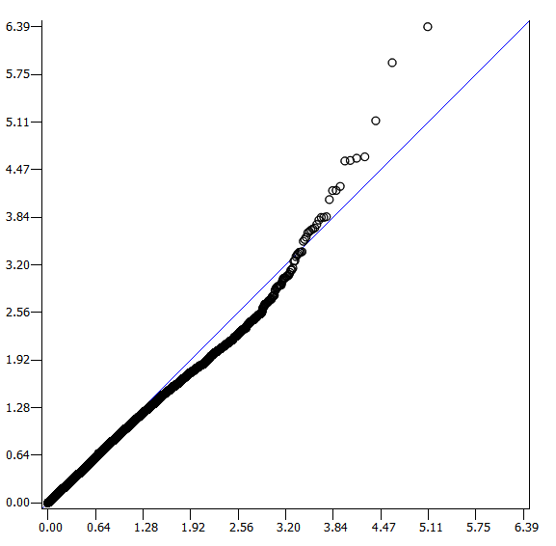
Observed significance log10(1/P)
Expected significance log10(1/P)
Fig. S1 Q-Q plot expected and observed log10(1/P) values
Only SNPs with P values < 0.01 were used and their P values were multiplied 100 before plotting.

