Slide 1
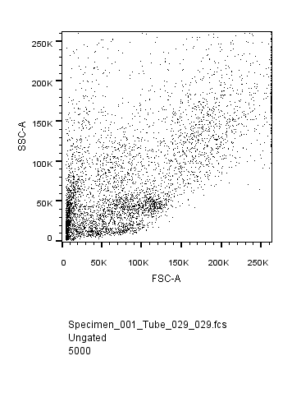
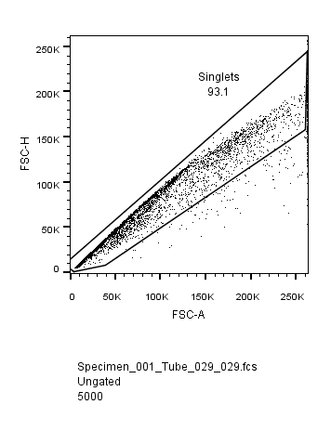
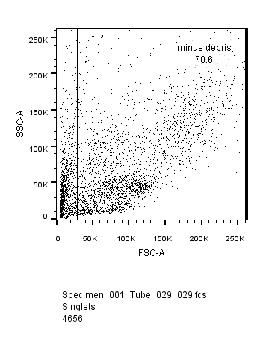
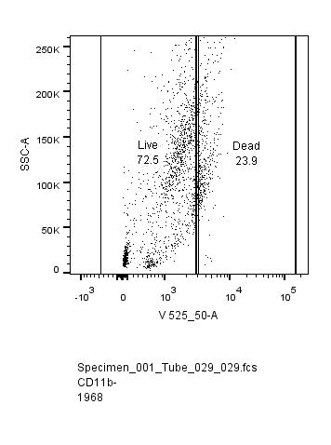
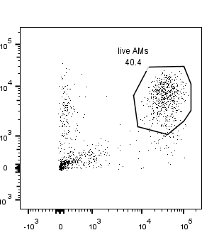
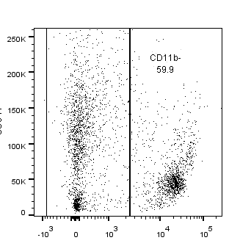
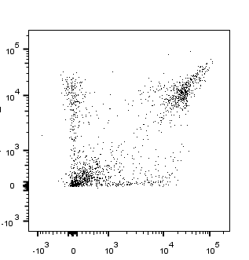
Supplementary Figure S5
Siglec-F
SSC-A
Ly6G
CD11c
CD11b
CD11b
Supplementary Fig S5. Flow cytometry gating strategies. Singlet cells were positively gated, debris removed then cells gated based on live/dead cell Zombie markers. Live AM cells were positively gated on CD11b^{neg} cells, and residential AMs classed as CD11c^{high} Siglec-F^{high} cells. Neutrophils were gated based on CD11b^{pos} cells and Ly6G^{high} staining. No CD11b^{pos} AMΦs, classed as high FSC and autofluorescent, or high CD11c with CD11b were identified in any mice in this study.

