Slide 1
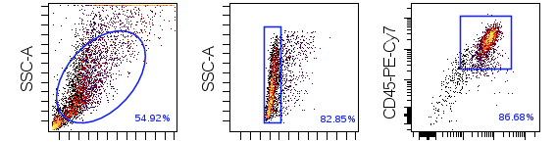
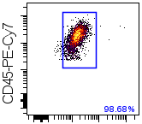
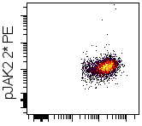
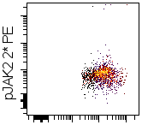
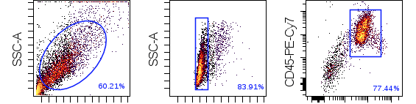
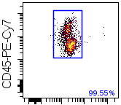
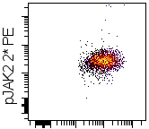
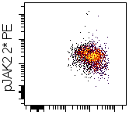
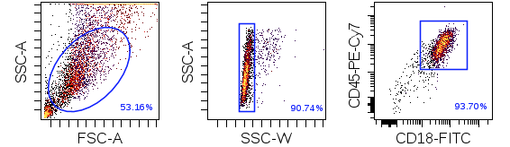
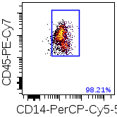
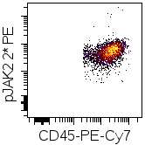
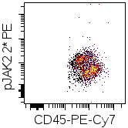
Supplemental Figure 1
CD45+CD18+
cells
CD45+CD18+
CD14+ cells
signaling gate set at 50% of control
live cells
singlets
basal
+JAK inhibitor
control
PTPN11
CBL

Slide 2
Supplemental Figure 2
GM-CSF (ng/mL)

Slide 3
Supplemental Figure 3
control
PTPN11
CBL
dmso control
PD901
trametinib
momelotinib
ruxolitinib
idelalisib
rapamycin
% of dmso control
% of dmso control
% of dmso control
Drug concentration (nM)
Drug concentration (nM)
Drug concentration (nM)

